Slide 1
Remote Observatory Collection Statistics
William Hanna
Columbia Falls, Montana
TTSO18 Parkes, NSW, Australia (via Zoom)
Monday April 1, 2024

Slide 2
Topics
Review of my remote equipment
Collection spreadsheet (first light 4 June 2018)
Selected statistics
Notes:
A brief review of the telescope that I operate remotely at Martin Pugh Astrophotography in Manton, NSW, east and a bit south of Yass, roughly 50 kilometers north of Canberra.
Details of my spreadsheet and its uses.
Some interesting statistics over the nearly six years of operation.

Slide 3
Remote Equipment
508mm PlaneWave CDK 3454mm f/6.8
0.66x Focal Reducer yields 2287mm f/4.5
Hedrick Focuser
Mirror heaters and fans
Paramount ME II w/ absolute on-axis encoders
QHY174M-GPS camera, w/ GPS battery backup
w/ 7-position 1.25” Starlight Xpress Standard Filter Wheel SXUFW-1T
CompuLab IPC2 i7 Win7 w/ 500GB SSD

Slide 4
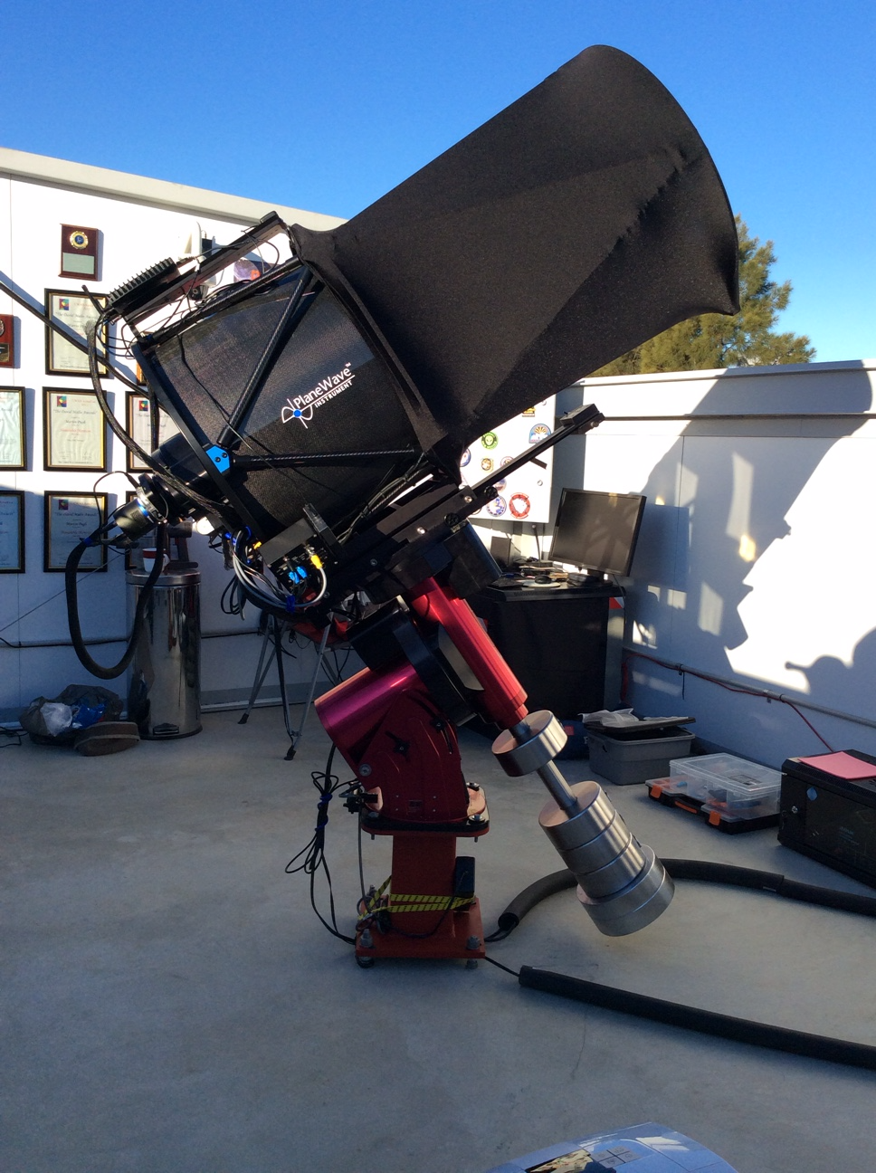
The System
Notes:
The east wall, behind the telescope in this photo, is the tallest obstruction in my overall field-of-view.

Slide 5
Collections Increased with Gaia16_EDR3 Data
Notes:
The ability to use the Gaia16_EDR3 dataset in Occult4 became available on February 9, 2021. As a result, almost all of the “additional” new predictions are for events with a target star magnitude between 14 and 16.

Slide 6
Collection Limit Based on Observed Experience
Notes:
This has been revised downward by a factor of 2 since my initial estimation. A full-frame (1920 x 1200 pixels) collection in SharpCap is only possible up to around 15 frames per second. Any faster and the collection box size must be reduced to minimize the likelihood that there will be no dropped frames. The sensitivity of the QHY camera is not as good as that of some of the analogue cameras used by others, but it is well suited to remote operation.

Slide 7
Statistical Categories
Positive
Miss
Weather-affected
Cloud, rain, wind, humidity, twilight
Technical Issue
Loss of connection, hardware fault, roof closed
mea culpa
Started too late, bad selection, personal issue
Notes:
Positives and misses are self-explanatory.
The automatic roof controller looks at several conditions, some of which are perhaps too strict for my application.
I have used several connection methods over the years, and I have not been particularly happy with the stability of any of them.
The onboard computer, its SSD, and the mount occasionally have faults that a simple power cycle will not clear.
I do not care how cloudy the overall sky is if the particular area where I am looking is clear (based on the observatory’s All Sky Camera). I occasionally must wake up my host and ask him to override the controller and open the roof manually.
Sometimes I just make a mistake, or something comes up at the last minute.

Slide 8
Example of the Spreadsheet
Notes:
This may be hard to read in the Zoom session.
The cyan columns represent the minimum collection interval given the prediction.
The pale green columns represent the prediction interval expanded by a selected number of diameters, typically 10 unless there are special reasons to use more (e.g., looking for a known or suspected moon) or fewer (e.g., when no moon is suspected).
The cyan-accented comments note that the collection occurs when the Sun’s elevation is more positive than -18 degrees (i.e., in twilight).
The pale orange columns, of use to my host, indicate the minimum local time interval that I would prefer to have the observatory roof open.

Slide 9
Overall Success Rate
Notes:
Just over half of my planned events have been affected by weather, a particularly disturbing situation.

Slide 10
Collections that led to a Result
Notes:
One in four events that ultimately led to the production of a collection report was a positive.

Slide 11
Cutoff at the Gaia16_EDR3 Limit
Notes:
Events with a target star magnitude less than 16 were based on Lucky Star and RIO predictions.
Gaia16_EDR3 increased the number of target stars between magnitudes 14 and 16.

Slide 12
Success or Failure at any Probability
Notes:
The (nearly) “sure things” only seem to occur when the Horizons probability is greater than 95%, but there are still a handful of misses in that range. Similarly, there are a handful of positives even with a probability less than 5%.
Note that the overall misses begin to exceed the overall positives when the probability is less than ～65% (because there have been three times as many misses as positives).

Slide 13
Very Few Targets to the South
Notes:
I find this to be somewhat surprising. The ～80-degree wide band centered on due south has very few events, and those few all have elevations greater than 50 degrees.
The lesson here is that, when choosing the location for an observatory performing occultation timing, optimize the view to the north.

Slide 14
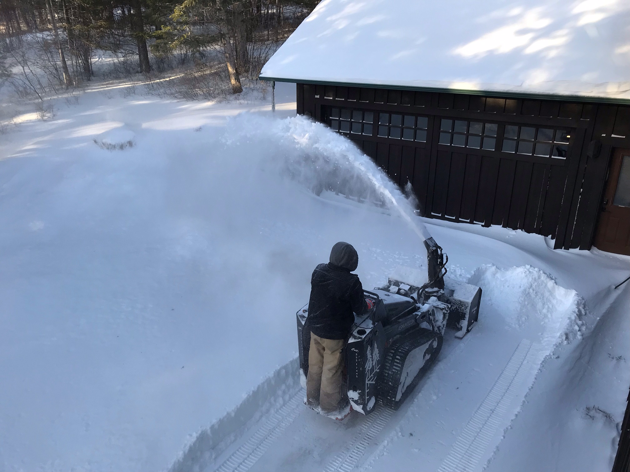
Any Questions?
Notes:
Sometimes you just have to call in the professionals.

