Slide 1
Using a GMN camera for occultations?
TTSO18
Murray Forbes
Notes:
I recently attended the (Sunday 25 Feb, 5am start my time) on-line meeting of the Global Meteor Network (GMN). During one of the talks, observing minor planet occultations was mentioned as a possible future use of this network. I’d been scratching my head trying to think of a talk for TTSO18, and suddenly this fell in to my lap, where I could combine two of my interests.

Slide 2
The Global Meteor Network
Night-time observations of meteors
Global network of cheap video cameras
Raspberry Pi using open-source software;
  For video capture, compression and meteor detection
Triangulation of same meteor by at least two cameras;
  Orbit of meteor
  Location of debris field
Notes:
So what is the Global Meteor Network?
The goal of this project is to observe meteors, with a global network of cameras pointed at the night sky, purchased and installed by citizen scientists. Each camera is connected to a Raspberry Pi running open-source software for video capture, compression and automatic meteor detection.
If the same meteor is seen by at least two cameras then it’s position and trajectory during the visible portion of its flight can be triangulated. This in turn can allow the meteor’s orbit to be back-calculated and, for meteorites, i.e. meteors that survive to reach the ground, the location of debris field can be predicted. A major motivation for the New Zealand regional coordinator is to find New Zealand’s 10th meteorite.
News Flash: Since I prepared this talk, the 10th New Zealand meteorite has been found following a detection by the network, just last week near Lake Tekapo. I guess we’re now looking for the 11th meteorite.

Slide 3
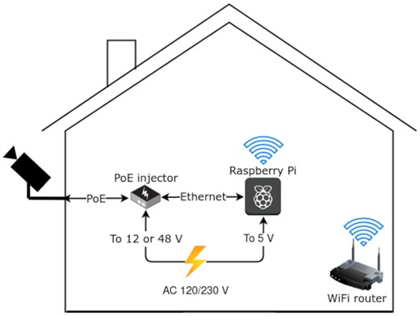
Components Schematic
Notes:
There’s a little more to the system than just a camera in a housing. Both power to the camera and a video stream back to the computer is achieved by a PowerOverEthernet cable. A short network cable then runs between the PoE injector and the computer, which is a Raspberry Pi4 running Linux. The Raspberry Pi runs an open source program, that records the video images onto an SD card through out the night, processes the data in the morning and then sends the analysed data using WiFi via your home network to the GMN web server. The system is very affordable (compared to most astronomy setups), costing me $NZ 550 last year. It’s nearly set-an-forget system, although, like me, you’ll probably become addicted to viewing last nights results every morning on the GMN server.

Slide 4
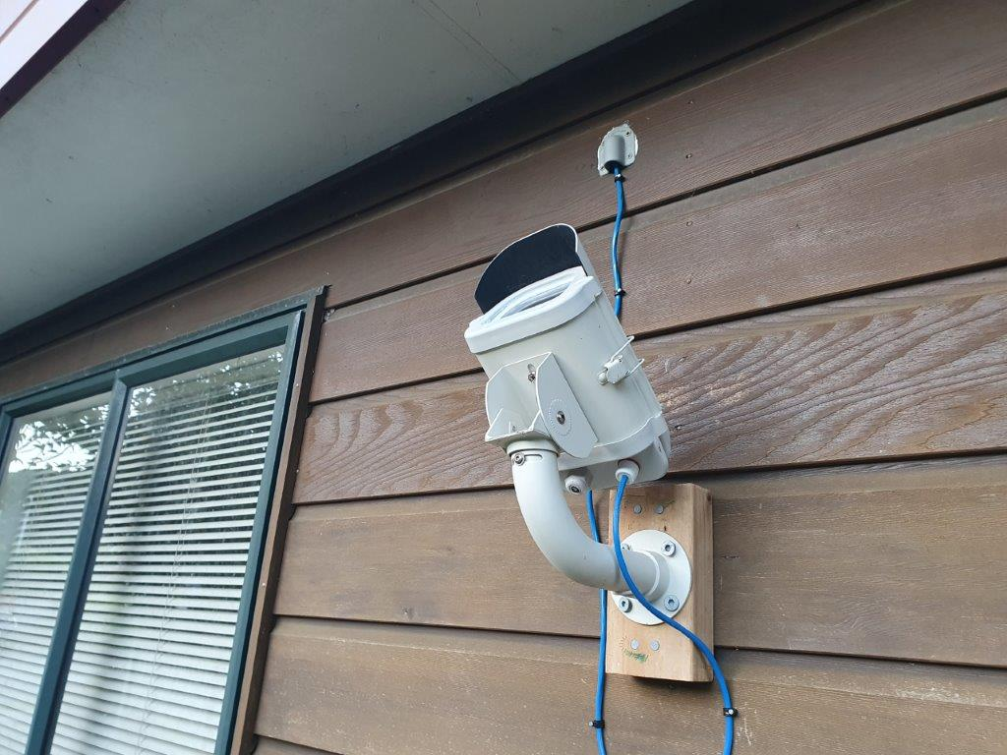
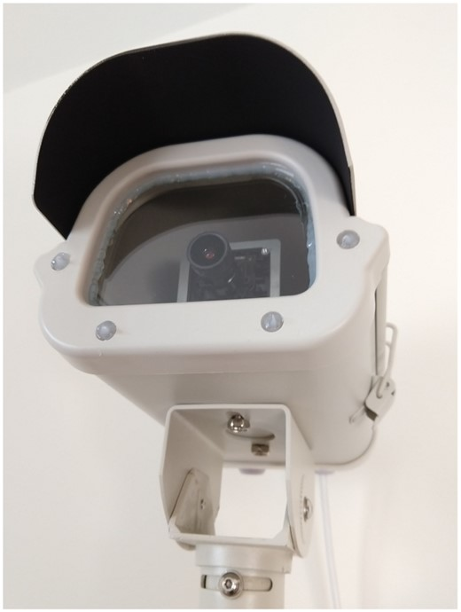
A typical camera
Notes:
The photo on the left shows my camera mounted on the side of the house, a few feet under the eves. The blue Power-over-Ethernet cable runs out the back of the housing and through the house wall, to ultimately connect to a Raspberry Pi.
The photo on the right shows a close up of front of a typical camera. The most commonly used lens is a 4 mm focal length f/0.95 lens, giving an approximately 88 by 45 degrees field of view. The lens, camera and associated electronics are all inside a fixed housing, i.e. it is NOT a tracking camera. Experience has shown the need to apply a silicone sealant around the edge of the glass window and the four holes for weather-proofing.

Slide 5
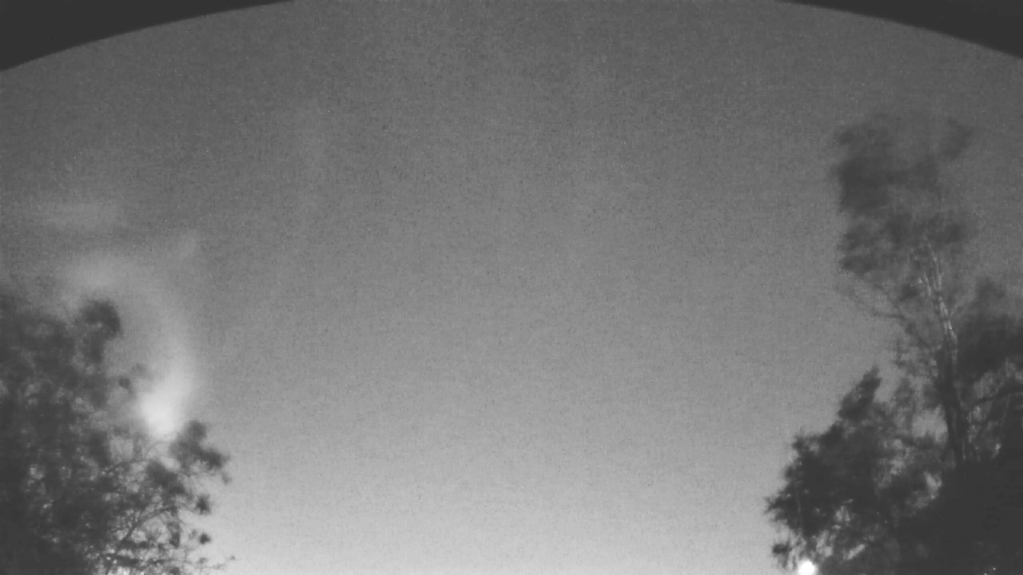
Results from my camera
(NZ0035 on 18/02/2024)
Notes:
The image here has been made by stacking all of the video frames taken over that night by my camera, and taking the median value of each pixel over the entire stack. This has the effect of removing the stars from the image and is the nearest the system can get to producing a flat-field image.
<click>The dark regions at the top-left and top-right of the frame are due to the shield that protrudes out from the top of the camera housing.
<click>Lower down to the left and right are two of my neighbours’ trees. If they were mine, I would have cut them down by now.
<click>Finally, the bright spot along the bottom edge on the right hand side of the image is a street lamp.

Slide 6
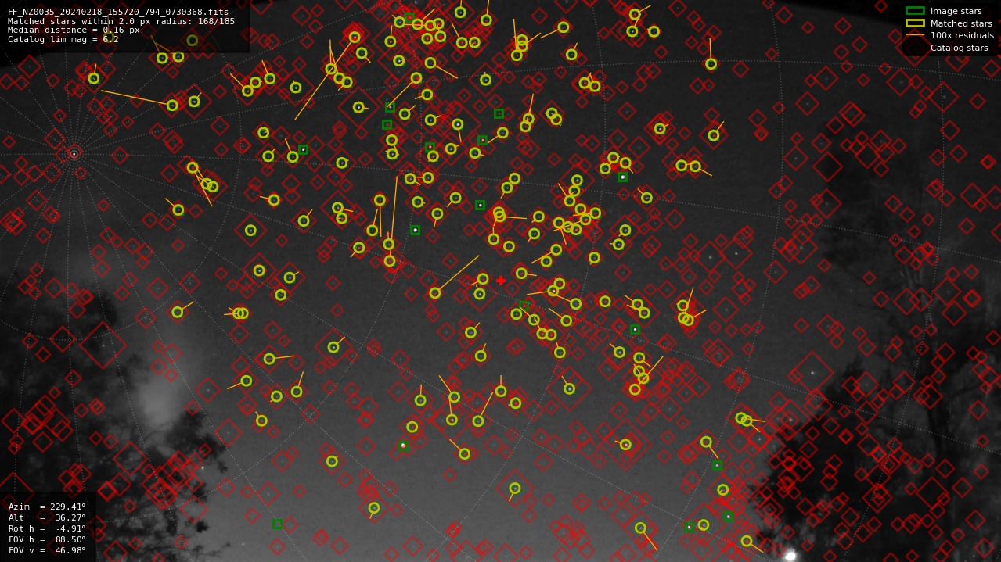
Results from my camera
(NZ0035 on 18/02/2024)
Notes:
This shows the Astrometry report that is prepared on the best frame of the night (as judged by the largest number of stars detected).
The red diamonds show the predicted positions of stars from a catalogue, with the size of the diamond indicating the star’s magnitude.
The yellow circles show the stars detected by the software that could be matched to the position in the star catalogue. The length of the yellow line indicates the size of the difference between the star’s measured and catalogue positions. Note these residuals have been multiplied by a factor of 100, otherwise they wouldn’t be discernible.
The green boxes indicate detected stars that couldn’t be matched with a catalogue location. This is usually because the star is too bright to be included in the catalogue used.
Finally, faint white grid lines of Right Ascension and Declination have overlaid on the image – You should easily deduce my camera is pointing to the South-West, with the South pole (and Sigma Octantus) in the top-left of the image.

Slide 7
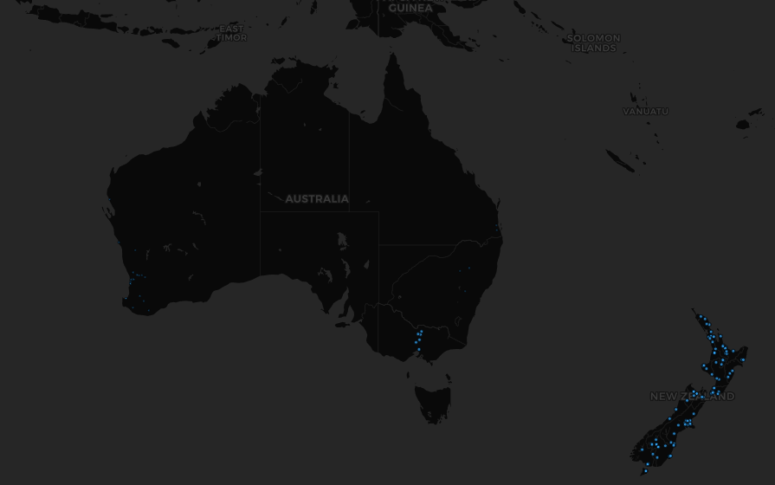
Our GMN cameras
Notes:
Each blue dot represents the location of a camera. NZ has 131 active cameras, as of when I prepared this talk in February, while Australia (only) has 80. I’m not sure why some of the dots are smaller/fainter than others but suspect it means the camera is not fully set up yet. Note: I haven’t shown the Chatham Islands (to the East of NZ), where two cameras were recently installed.

Slide 8
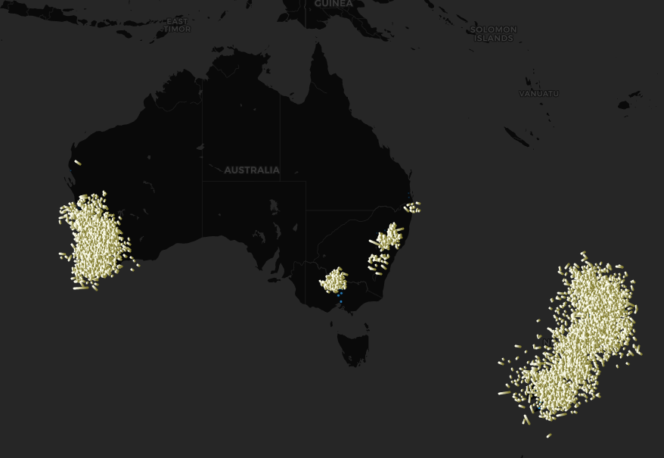
Our GMN cameras
Notes:
Now the map shows all the triangulated meteor tracks (the white lines) over the last month. As a camera’s view can extend about 100 km along its upper line of sight, the tracks don’t show the exact location of a camera. Nevertheless, they can serve as a proxy for the camera’s location and so makes it a bit clearer where the cameras are in Australia (as some of the blue dots in the previous slide were nearly invisible).
As at least two cameras must observe a meteor in order to triangulate the trajectory, a single isolated camera is not much use. This is somewhat similar to our situation in observing occultations, where the real value comes when two or more observers measure the same event.

Slide 9
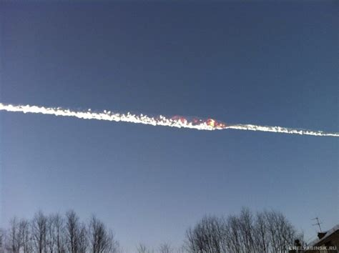
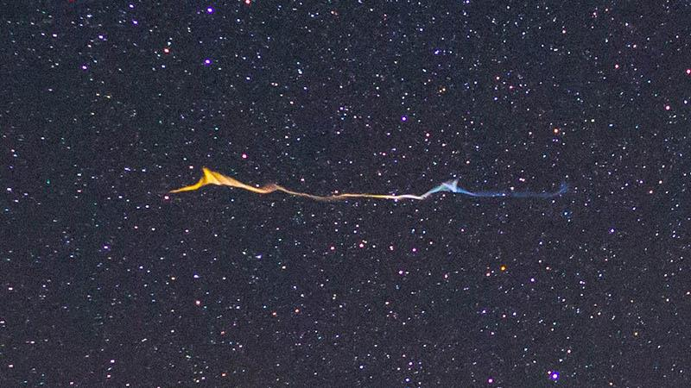
Other Possible Uses
Meteor persistent trains
Notes:
I’ve listed here other possible uses that could be made of the data from the GMN cameras, which may (or may be) be implemented in the future (remember this is an open source system driven by the enthusiasm of volunteers).
Meteor persistent trains (PTs) are long-lasting, luminous phenomena which occasionally linger after the passage of a meteor, with durations of up to an hour. The left hand photo is of a very dramatic trail left by a meteor over Russia during the day. The right hand side photo is more like what we could expect a GMN camera to see at night.

Slide 10
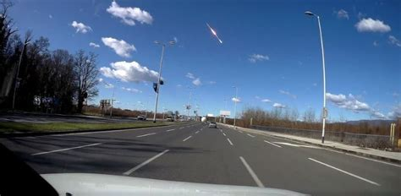
Other Possible Uses
Day time observations of fireballs
Notes:
The photo here shows a fireball over Croatia and Slovenia, recorded by a vehicle’s camera on 28 Feb 2020 at 10:30am local time.
Eye witness accounts of day time fireballs are fairly common, but are of little value in working out a trajectory. Photographs or video recordings do allow the trajectory (and possibly the location of the debris field) to be calculated but are labour intensive. They also depend on the images being available to the researcher.
At the moment, the GMN cameras aren’t run during the day as they have been configured for night-time observations and so are completely saturated if run during the day. There appear to be two approaches that can be taken to allow daytime measurements; the first is to automatically re-configure the camera for day light each morning, restoring it to the night time configuration on sun set. The other is to add a filter slide/wheel to the system with a suitable filter (probably a neutral density filter and/or a filter to block out blue light), again being automatically moved in/out of the field of view. The disadvantage of the re-configuration approach is that it can take a few hours for the camera to stabilise after each configuration change. On the other hand, the filter approach requires a hardware modification to each camera, together with the additional ($5) expense of the filter and filter slide.

Slide 11
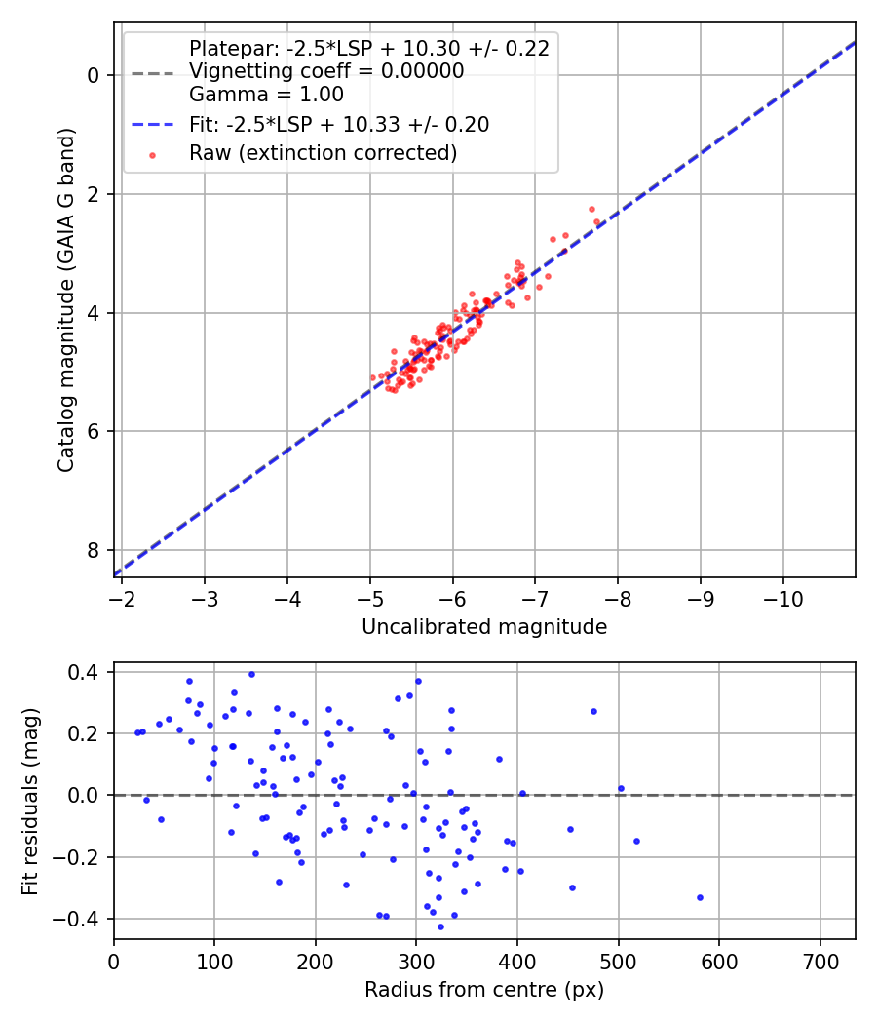
Other Possible Uses
Photometry of bright stars
Notes:
The software already does absolute photometry of the stars visible in the images, albeit is a fairly rough & ready manner. This is because, from a meteor researcher’s point of view, the stars are only there to allow the trajectory of the meteor to be referenced against some coordinate system (in this case, the Right Ascension and Declination equatorial system) and to allow meteor’s brightness to be measured.
I suspect if better photometric reductions procedures were used then the accuracy of the results would be improved, and this is something I’ve been looking into. My gut feeling is that we’d need to get the uncertainties shown in the graph above down to 0.1 mag in order to get useful photometry from these cameras.

Slide 12
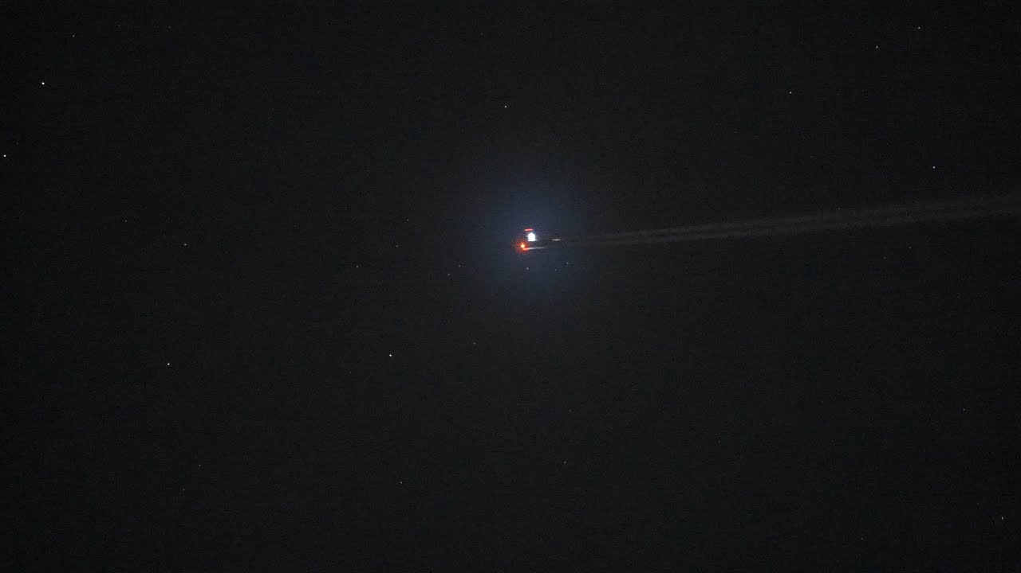
Other Possible Uses
Contrails from aircraft
Notes:
At the moment, aircraft are a nuisance in the images, especially as they resemble meteors and require some sophisticated processing to identify as aircraft. Nevertheless, measuring the presence or absence of a contrail could be used to assist climate researchers in validating their models predicting a contrail. Why? Because approximately 50% of the climate change due to aviation comes from contrails. So a reliable, real time prediction of where a contrail would form would allow aircraft to avoid that region.

Slide 13
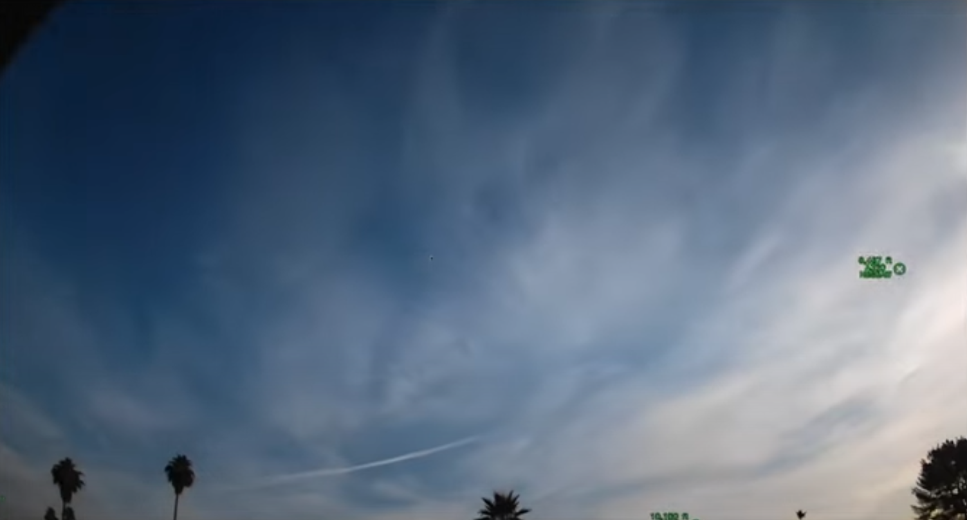
Other Possible Uses
Contrails from aircraft
Notes:
A member of the GMN has already developed his own code to track aircraft and overlay position & flight data, using the addition of a (cheap) radio receiver that picks up the flight data broadcast by all civilian aircraft. This system operates twice a day, for both day and night observations. His code also has contrail recognition and can associate the contrail with a particular flight.

Slide 14
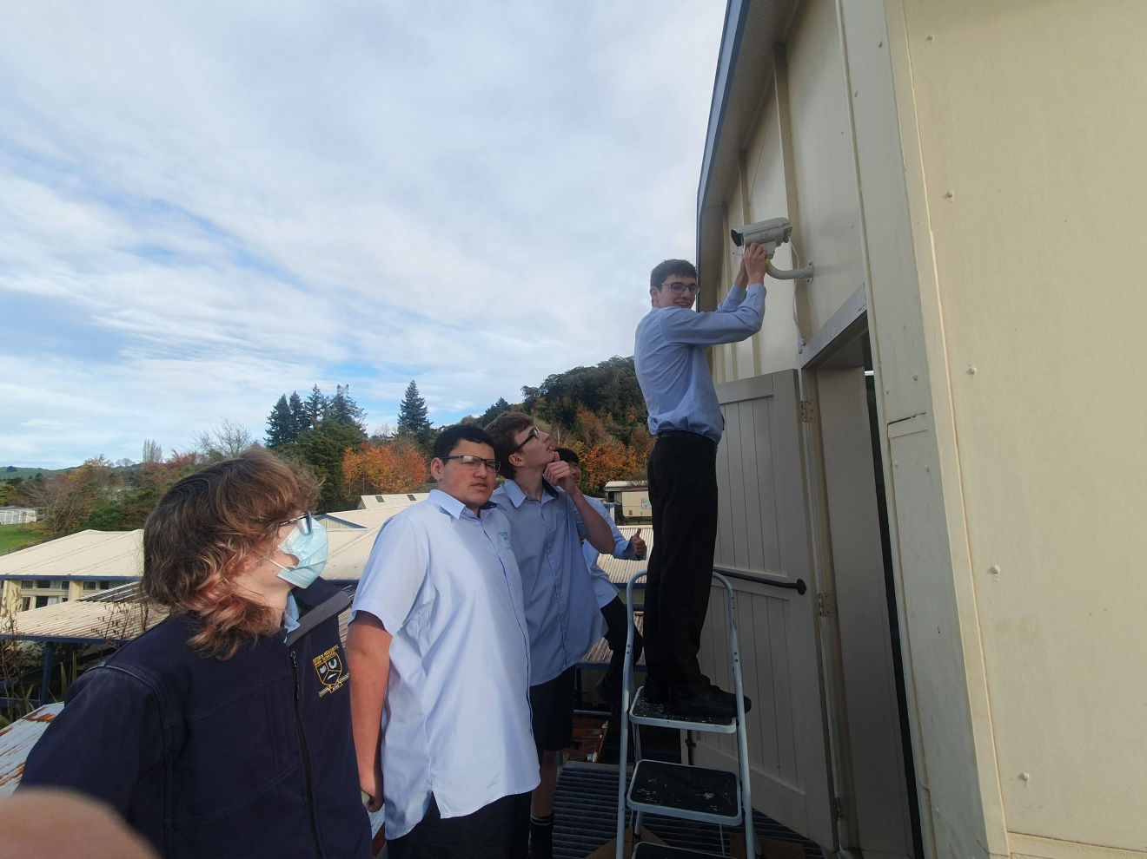
Other Possible Uses
Outreach (e.g. school project/competitions)
Notes:
Thanks to grants from the NZ Ministry of Education, a large number of GMN systems have been installed in New Zealand schools. While NZ hasn’t run a STEM type of school project (yet!) involving the cameras, this has been done in some other countries.

Slide 15
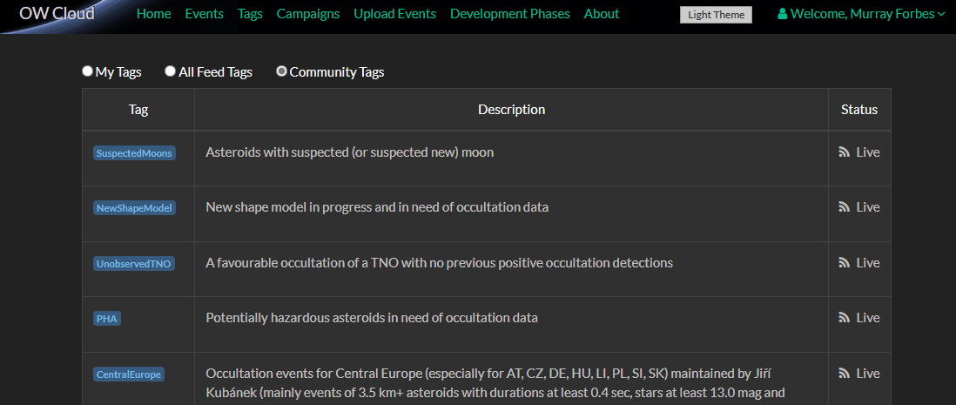
Other Possible Uses
Occultations by minor planets
  Get predictions (from OWC?)
Notes:
The pipeline, at least at a high level, is similar to the one that we’re familiar with. However, as most members of the network are not familiar with occultations, I’ll want to automate as much as I can.
First we need to get predictions of pending occultations. My first thought on this is during the day to scrape the data from OccultWatcherCloud for the coming night, with filters to get only the brighter stars (that are detectable on a GMN camera) and will potentially be visible from that particular camera. The existing software already knows where the camera is pointing (via a previous plate-solve of good image with lots of stars), it’s field-of-view and has a mask image to exclude any obstructions (mainly trees) to your FOV.
I need to look in to this further and will probably have to set up a ‘GMN’ community tag first to do the bright star filter.
In the meantime, I did a global prediction run using Occult over the entire year 2024 for all stars brighter than magnitude 7 and got 244 hits. Considering there are 1226 GMN cameras around the world, I think this number means it’s worthwhile pursuing this idea. P.S. Restricting the search to my camera location gave me 2 hits for the year.

Slide 16
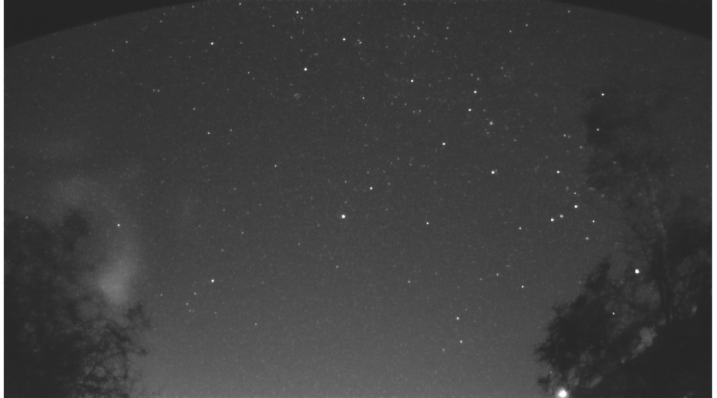
Other Possible Uses
Occultations by minor planets
  Find the star
Notes:
This is one that’s much easier with a GMN camera than it is with our usual telescope/camera setups. I mentioned earlier the GMN software already has plate-solving code, so we can easily find the pixel corresponding to the star. As the camera is not tracking, then the star will slowly move across the camera images. While I will need to double-check this, I suspect over the short period required to observe the event (I typically record for 5 minutes each side of the predicted occultation time) the star won’t move more than a pixel or two so we don’t need to worry about tracking it.

Slide 17
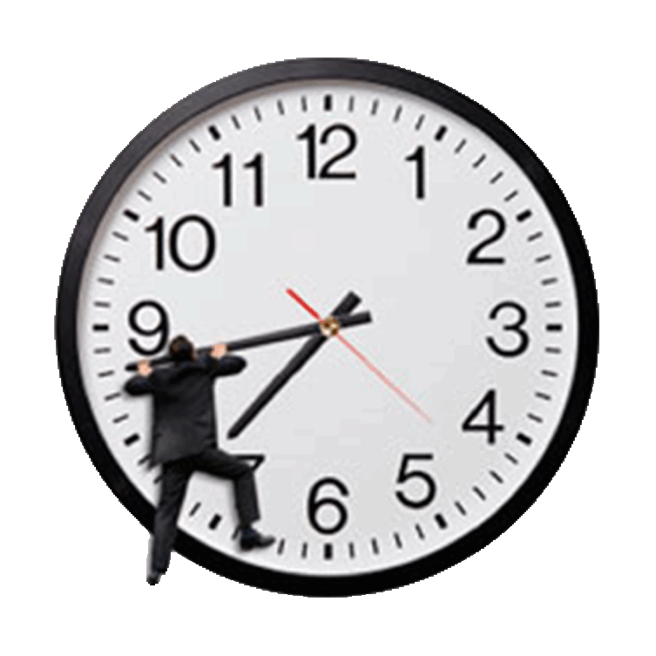
Other Possible Uses
Occultations by minor planets
  Timing
Notes:
This is probably the most important AND most difficult part of an occultation system. The clock needs to be precise, accurate and reliable. Consider the PAL analogue video system that we’re all familiar with. This produces 25 frames per seconds, that is each frame lasts 1/25 = 0.04 seconds = 40 milli-seconds. The rough of thumb is your ‘ruler’ should be at least’ 10 times more precise and accurate than what you trying to measure. So in this case we’re looking for 4 milli-seconds precision & accuracy and should probably aim for 1 milli-second.

Slide 18
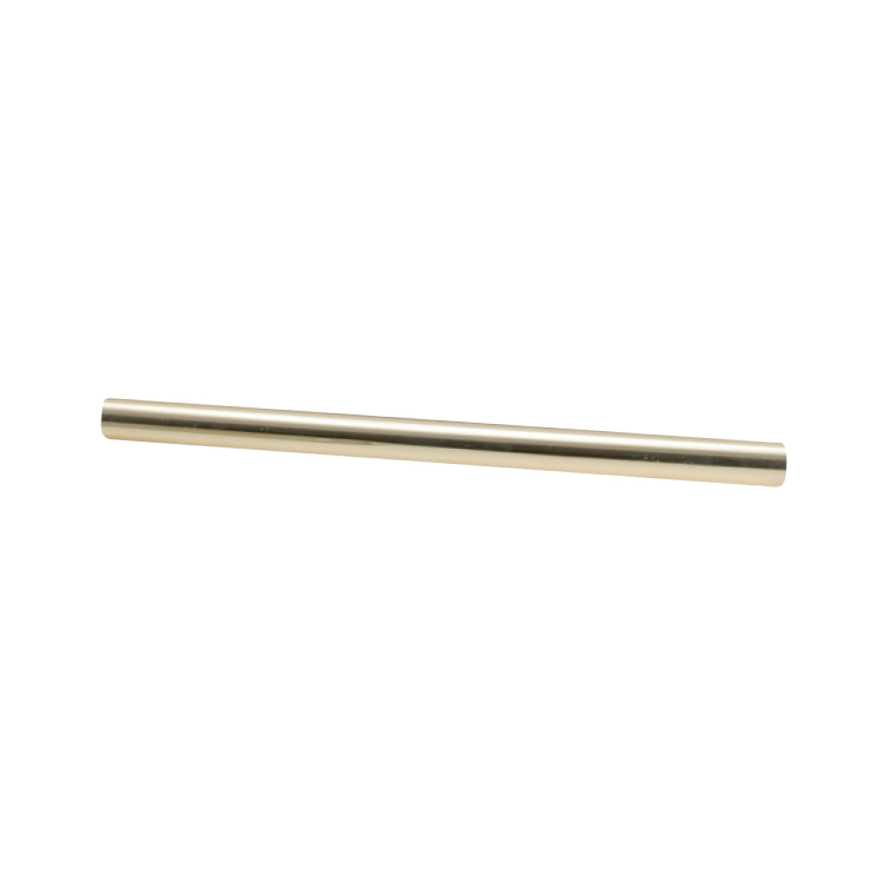
Other Possible Uses
Occultations by minor planets
  Timing
Notes:
So what’s the difference between precision and accuracy? Say you want to measure the length of this steel rod with this ruler. It’s somewhere between 20 and 21 cm long. An analogous situation would be using a clock that only reads to 1 second.

Slide 19
Other Possible Uses
Occultations by minor planets
  Timing
Notes:
However, with a more precise ruler you can measure it as 20.5 cm. Again, this might correspond to a clock that reads to a milli-second.

Slide 20
Other Possible Uses
Occultations by minor planets
  Timing
Notes:
But you could still get an inaccurate reading with the same ruler if it’s not aligned to the beginning of the rod, giving an apparent length of 23.5 cm. This situation could arise in a GPS clock that hasn’t downloaded its Almanac of leap seconds yet.

Slide 21
Other Possible Uses
Occultations by minor planets
  Timing
Notes:
And an example of unreliability could be that the ruler sometimes isn’t even there. This could correspond to a GPS clock that isn't seeing enough satellites.

Slide 22
Other Possible Uses
Occultations by minor planets
  Timing
Notes:
So back to measuring the time. The closer you can insert your clock to the camera the better, as this reduces the (possibly unknown and/or variable) time delay between the image being taken and the time stamp being applied (the latency).
<click> The ideal would be a clock built in to the camera. I’m only aware of one camera with a GPS based clock built-in, being the (rather expensive) QHY174GPS – if you know of any others, please let me know during the Questions & Answers session at the end of this presentation. The camera that’s recommended for the GMN system is a Sony IMX291 Internet Protocol security camera, so this will probably be the commonly used camera in the network. I understand it does have a built-in clock but anecdotally it has been found to drift (at lot). I intend to find the specs for the camera and clock – if the clock is quartz crystal based then it may be possible to possible to improve its stability by keeping the crystal at a constant temperature. Nevertheless, it would still need GPS clock (or possibly using NTP, although the jury’s still out on that) to set the camera’s clock to the correct time.
To test this camera’s clock as it currently is and to see if temperature control improves things, I plan to use a Southern EXposure Time Array (SEXTA ) as described by Barry et al in their paper in the Publications of the Astronomical Society of Australia. Tony or Dave G, if you’re in the audience could you send me a copy of the circuit diagrams, source code etc of the SEXTA as the website referenced in the paper doesn’t exist any more. P.S. I’m still trying to work out how to use SEXTA with IMX291 camera as it uses a rolling shutter, which exposes (and reads out) one row at a time working from the top of the frame downwards – in other words the time each pixel was exposed to light is not the same throughout the frame.

Slide 23
Other Possible Uses
Occultations by minor planets
  Timing
Notes:
The next best location would be between the camera and the computer, in a similar way as done by the IOTA GPS video time stamp insertor. In this case, the clock would probably sit inside the camera housing and be connected between the camera’s Ethernet port and the Power-Over-Ethernet cable. My plan is to first see if such a system is commercially available. My second plan would be to scream loudly for help, as designing such a device is well outside my areas of expertise.

Slide 24
Other Possible Uses
Occultations by minor planets
  Timing
Notes:
And the last location for a clock is on the computer, in this case a Raspberry PI running Linux. The consensus now appears to be that NO operating system has a reliable internal clock. However, a Real Time Clock (mini DS3231 RTC) module is available that runs independently of the Pi. Again, I intend to investigate this possibility using SEXTA. Finally, there is the option of using a GPS module, as a quick internet search on ‘Raspberry Pi GPS module’ found a dozen cheap, commercially available GPS modules that connect to the PI.
To get the maximum number of cameras in the network measuring occultations, the ideal system would not require any hardware additional to the standard setup – which in this case would be the Raspberry Pi’s Real Time Clock. However I suspect the results from my testing will find this is not an acceptable option, and that a GPS module will be needed.

Slide 25
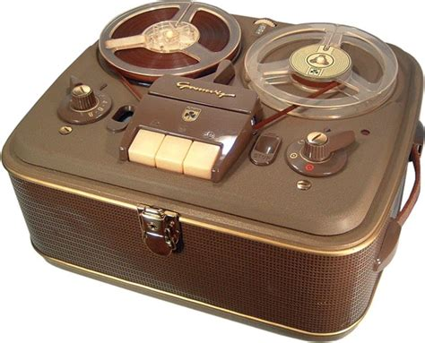
Other Possible Uses
Occultations by minor planets
  Recording
Notes:
While the current GMN software records the frames, it uses a compression algorithm that has been designed by GMN for recording meteors and ends up averaging everything that’s NOT a meteor over 10 seconds to produce one FITS file. In other words, the star images are integrated over 10 seconds.
So we have to come up with our own recording algorithm, which would run for each frame as it arrives from the camera – in parallel to the GMN recording code. Hristo Pavlov has already written a free, open source library to record in the Astro Digital Video (ADV) format. I’m not sure if I should record the entire frame, or a Region-Of-Interest (ROI) centred on the target star – I would need to do some trials with both to compare file sizes.

Slide 26
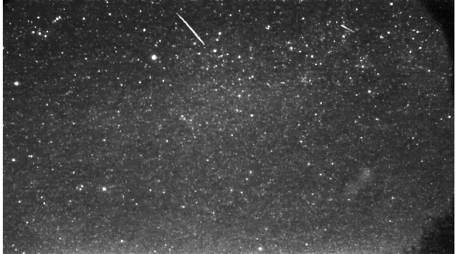

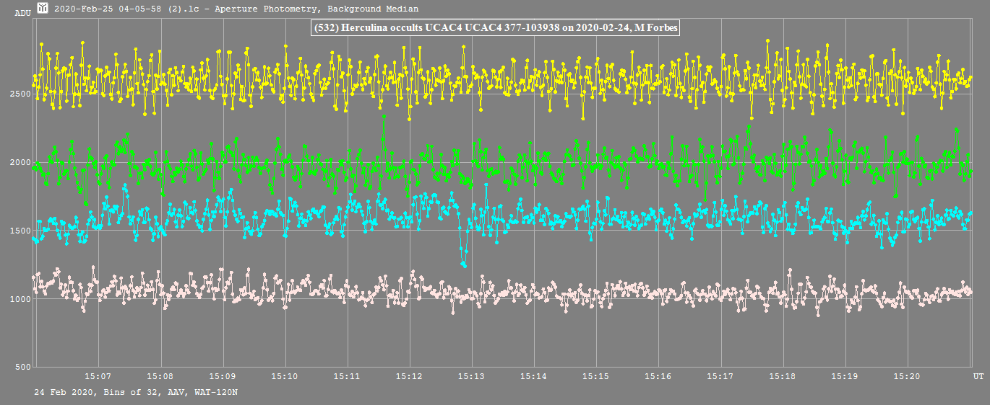
Other Possible Uses
Occultations by minor planets
  Reduction
Notes:
This is the step from video images to a light curve. In the occultation world, this is a fully manual step using a program such as LiMovie, Tangra or PyMovie. As I mentioned before, most owners of GMN cameras probably don’t even know what an occultation is, let alone have these programs installed and know how to use them. So my thought is to add code to the GMN system to produce a light curve graph and pre-populated report spreadsheet and email it to a occultation volunteer (one for each region? Or globally?) for manual follow-up. The volunteer would initially simply view the light curve to see if it is an obvious negative, submitting the report to the regional coordinator if this is the case.

Slide 27
Other Possible Uses
Occultations by minor planets
  Analysis and Reporting
Notes:
In the case of a positive then the volunteer will need to retrieve the video recording. For security reasons I don’t think we should be retrieving the recording directly from the owner’s Raspberry Pi. Instead there will be code on the Pi that automatically sends the recording somewhere else, with the somewhere else still to be decided – perhaps the GMN server, or a GitHub repository? Does the audience have any suggestions.
Anyway, once the volunteer has got the recording they will need to repeat the reduction using their favourite program (as getting the best light curve out of a recording often requires some judgement that I won’t be able to build in to the GMN code that produced the initial light curve). Finally, the volunteer does the analysis using AOTA and sends off the report.
One thing I haven’t mentioned yet is who gets the credit for the event. I expect the owner of the camera can be considered the observer, but there should also be some way to acknowledge the volunteer’s effects – perhaps they could be listed as a second ‘observer’? I would also expect the volunteer to keep the owner informed of what’s happening. Any thoughts on this?

Slide 28
Links / References
What is the GMN? - Global Meteor Network
  https://globalmeteornetwork.org/
    The main page of the network
Global Meteor Network
  https://globalmeteornetwork.org//wiki/index.php?title=Main_Page
    The wiki page on the construction & installation of your own station (if you don’t want to buy a pre-assembled one)

Slide 29
Links / References
GMN camera status page for New Zealand (globalmeteornetwork.org)
  https://tammojan.github.io/meteormap/
    The archive and latest results for cameras in NZ
GMN camera status page for Australia (globalmeteornetwork.org)
  https://globalmeteornetwork.org/weblog/AU/index.html
    The archive and latest results for cameras in Australia

Slide 30
Links / References
Meteor map (tammojan.github.io)
  https://tammojan.github.io/meteormap/
    A global map showing the locations of the cameras and all triangulated meteor tracks
Verifying timestamps of occultation observation systems,
  M. A. (Tony) Barry, Dave Gault et al,
    Publications of the Astronomical Society of Australia (PASP), 2021, 10.1017

Slide 31
Credits
Persistent Train of a Perseid Fireball | Alex Conu - Sky & Telescope
Meteor explodes over central Russia | PBS NewsHour
Fireball over Slovenia | Tomislav Car

Slide 32

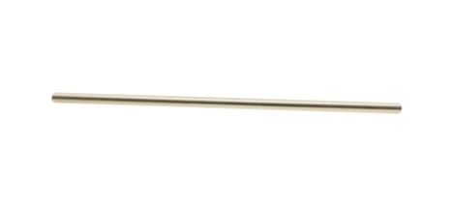
Credits
Aircraft overlay on GMN – Luc Busquin, GMN 2024 meeting
Steel rod, geebridge.com.tv
Vintage recording device, mofoster.com

Slide 33

Credits
Western Heights school, Rotorua

Slide 34

Q & A

