Slide 1
vTTSO14 : Lunar Occultations of Double Stars
Aims of observing Lunar occultations for Double Stars
1. Determine the separation and position angle of a pair of stars.
2. Estimate the magnitude difference of the pair.
3. Detect previously unknown double stars.
4. Confirm or refute possible doubles found visually at occultation.
Contribute light curves to the Kepler2 programme.
Brian Loader 2020

Slide 2
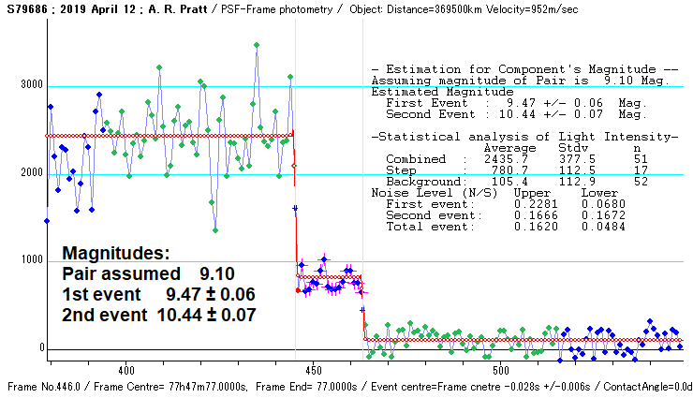
Double Star Occultation light curve with magnitudes

Slide 3
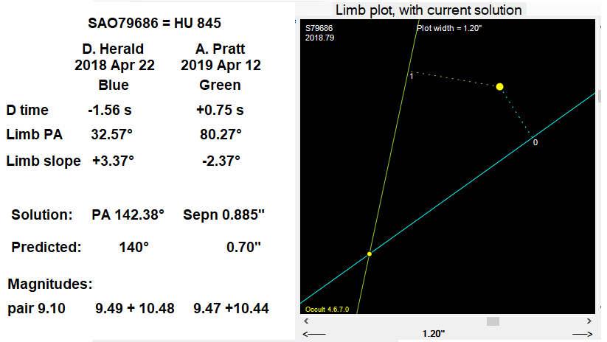
SAO 79686, a solution from 2 observations

Slide 4
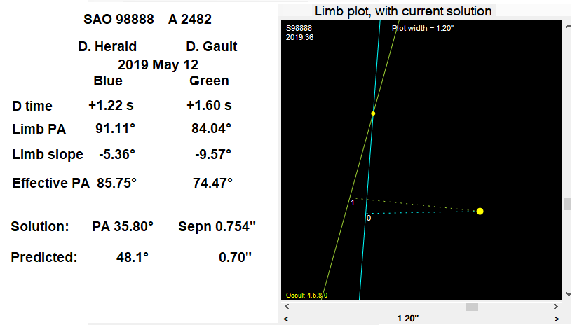
SAO 98888 Observations with same date, close limb PAs

Slide 5
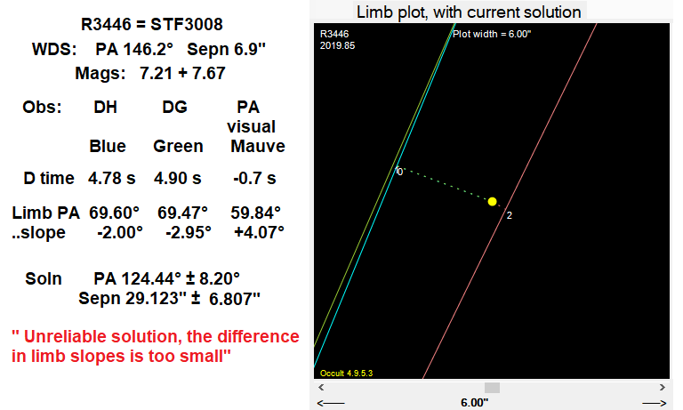
ZC3446, 2019 Nov 7, with very close limb PAs

Slide 6
Numbers of reported observations by year
Year | Observations | Average / Year
1999 to 2008 | 311 | 31.1
2009 to 2015 | 1611 | 230
2016 | 188 | 188
2017 | 132 | 132
2018 | 85 | 85
2019 | 40 | 40
2020 to March 31 | 4
Total 21 yrs | 2371 | 113

Slide 7
Observers for 2019
Observers | Observations
D. Herald | 16
D.Gault | 8
B.Loader | 10
A. Pratt (UK) | 4
M.Forbes | 1
P.Anderson (visual) | 1
Total | 40

Slide 8
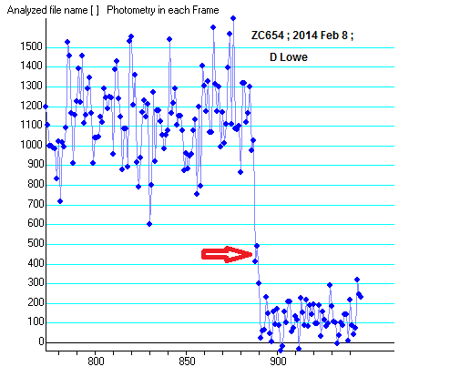
ZC 654 = Occ 921; A possible brief step
ZC 654, D. Lowe
2014 February 8
Disappearance
Duration ca +0.12 sec.
(brighter star first)
Mag. diff. ca 0.75
Rv 0.0598”/sec

Slide 9
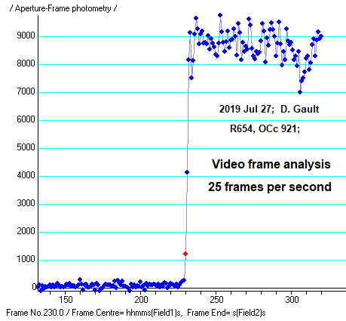
ZC 654 = Occ 921; Occultation reappearance
ZC 654, D. Gault
2019 July 27
Reappearance
No Step?
Rv 0.2406”/sec

Slide 10
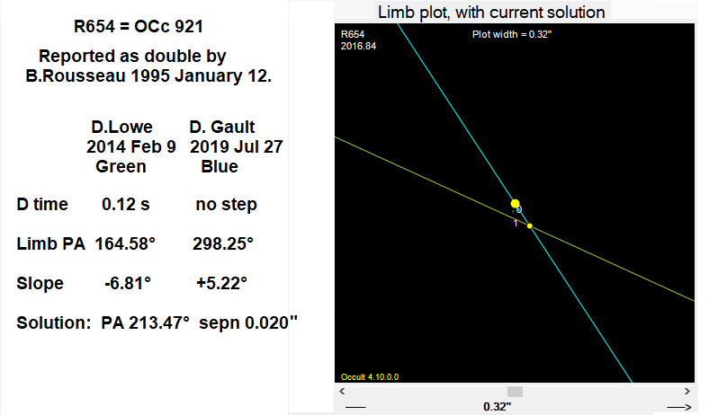
R 654 = Occ 921; Solution

Slide 11
ZC 654; another looks at Dave’s light curve
ZC 654, D. Gault
Reappearance
No Step?
Rv 0.2406”/sec

Slide 12
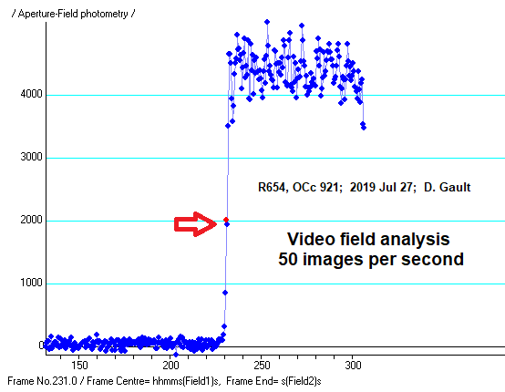
ZC 654 = Occ 921; Field measures, a possible step
ZC 654, D. Gault
Reappearance
Possible 2 field step ca -0.04 sec
Rv 0.2406”/sec

Slide 13
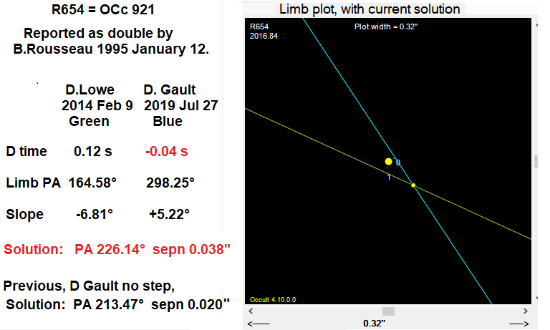
ZC 654; Solution using D Gault’s step

Slide 14
Journal of Double Star Observations, paper number 7
Published 2019 October 1, available on line at www.jdso.org
Covers mainly period 2017 February 13 to 2019 March 31.
Contents
Table 1, 25 observations of WDS doubles with a solution.
Table 2, 42 single observations of WDS, so only a vector solution.
Table 3a, 4 new doubles with solutions.
Table 3b, 23 new doubles with single observations.
Table 4, 15 Occ stars now shown to be single, having a WDS entry.
Table 5, 5 WDS doubles, where no companion observed.

Slide 15
Acknowledgements and Thanks
90+ contributing observers, 23 with observations used in JDSO7
David Herald: OCCULT predictions and solutions of doubles
Kazuhisa Miyashita (Japan): LIMOVIE analysis of videos
Hristo Pavlov: TANGRA analysis of videos

