Slide 1
A First Look at PyMovie
Martin Unwin (RASNZ)
TTSO14, 13 April 2020

Slide 2
Background
Rio satellites event 28 August 2019
  Lysithea (18.9) occults UCAC4 337-085505 (14.0)
  Recorded using Virtual Dub at 16x integration
    80 sec video centred on mid-event, σ_{t} = 9 sec
  Cloud-free but poor seeing, severe wind shake
Tracking disrupted by three strong wind gusts
  One gust ~10 sec before mid-event
  Tangra unable to track or provide photometry
  PyMovie had just been released …

Slide 3
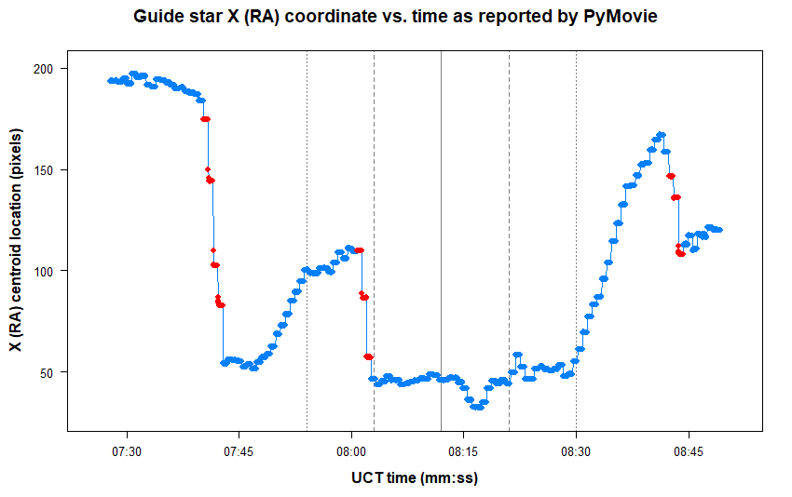

Slide 4
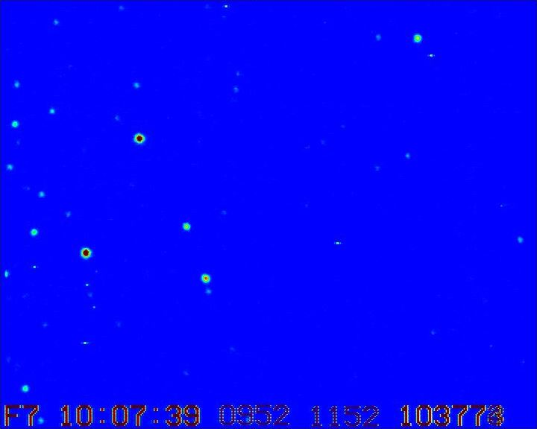
10:07:39.1 – 10:07:42.8

Slide 5
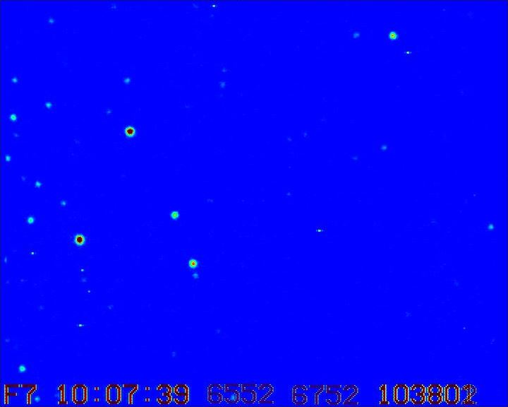
10:07:39.1 – 10:07:42.8

Slide 6
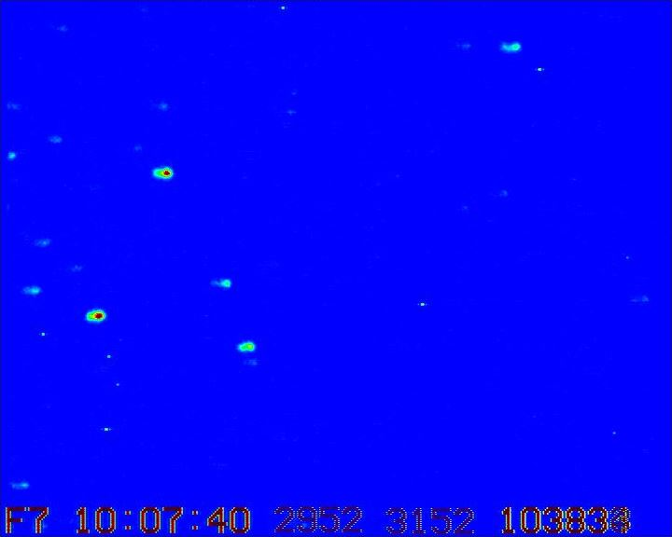
10:07:39.1 – 10:07:42.8

Slide 7
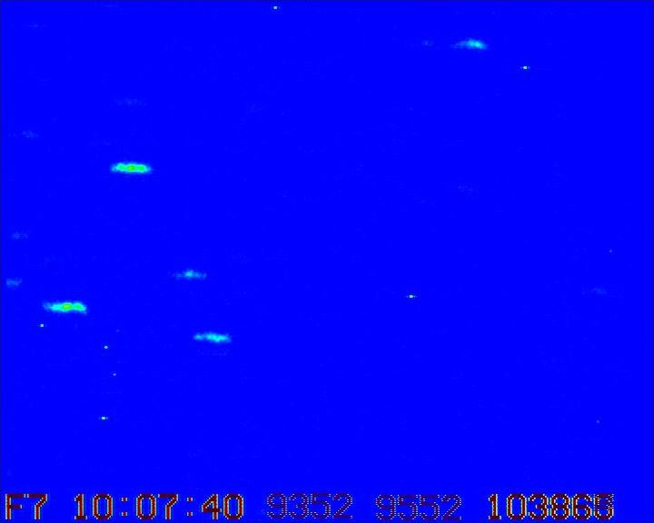
10:07:39.1 – 10:07:42.8

Slide 8
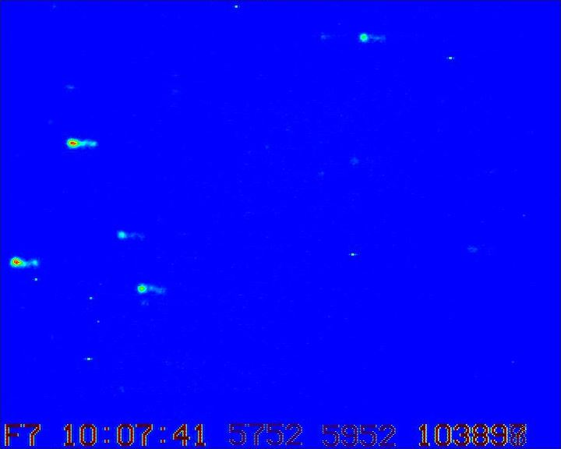
10:07:39.1 – 10:07:42.8

Slide 9
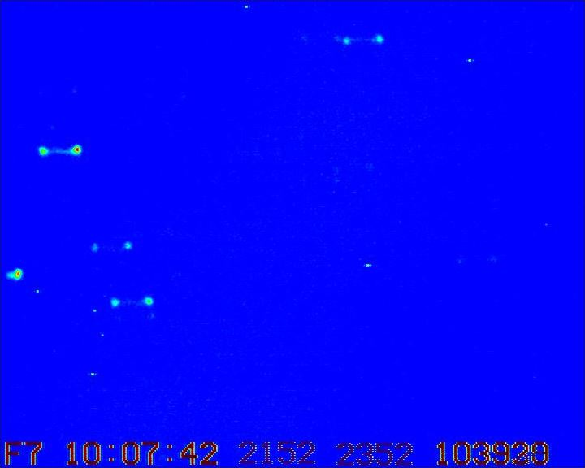
10:07:39.1 – 10:07:42.8

Slide 10
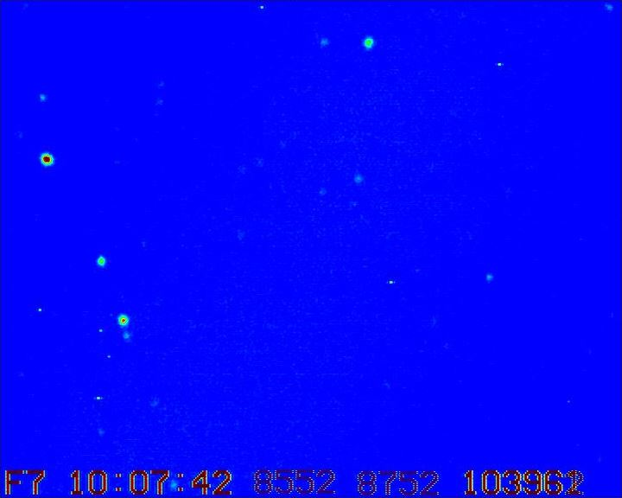
10:07:39.1 – 10:07:42.8

Slide 11
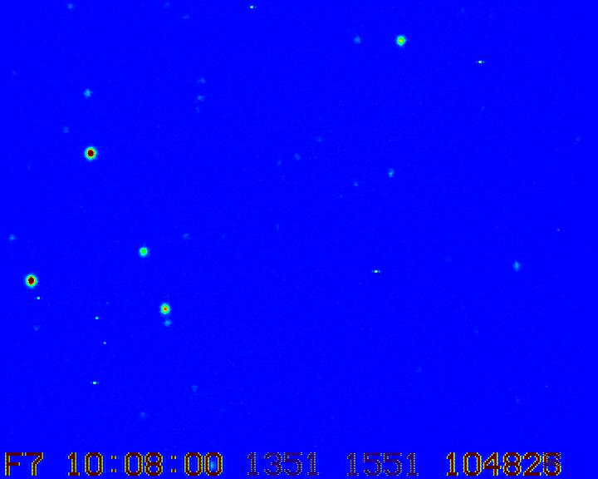
10:08:00.1 – 10:08:02.7

Slide 12
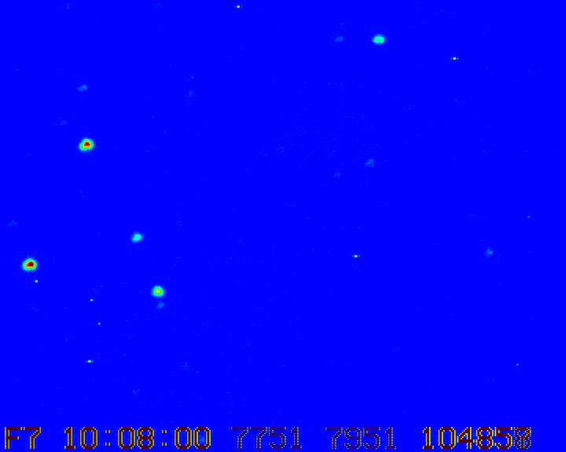
10:08:00.1 – 10:08:02.7

Slide 13
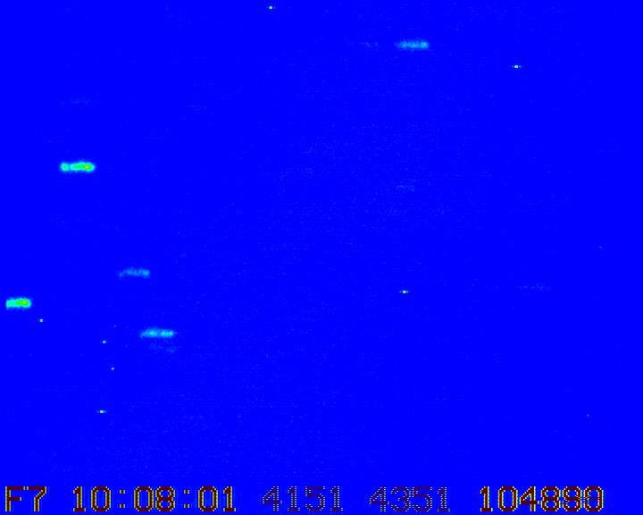
10:08:00.1 – 10:08:02.7

Slide 14
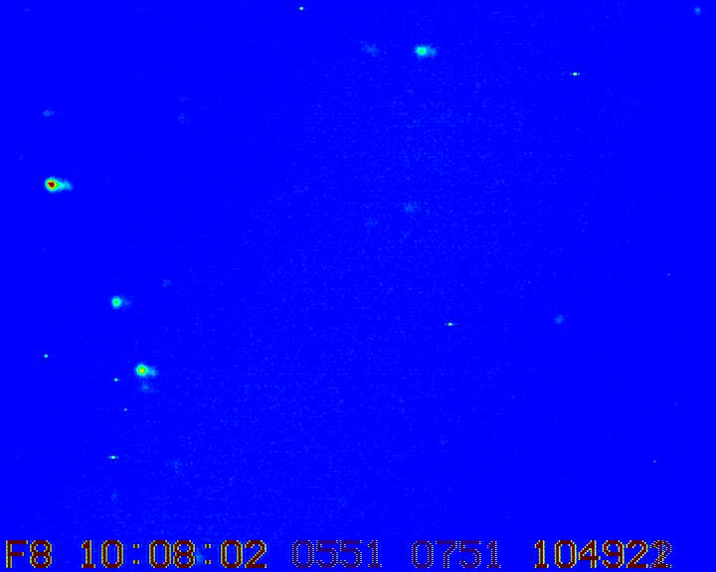
10:08:00.1 – 10:08:02.7

Slide 15
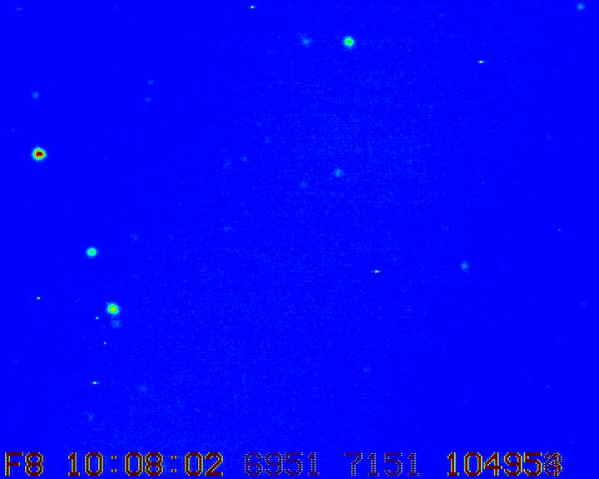
10:08:00.1 – 10:08:02.7

Slide 16
PyMovie
Available via IOTA web site
  Observing / Software / PyMovie
  Install instructions for Windows / Mac
    Requires Anaconda / Python
  PyMovie manual (27 p)
  11 video tutorials
    All by Bob Anderson (PyMovie author)
    Essential viewing!

Slide 17
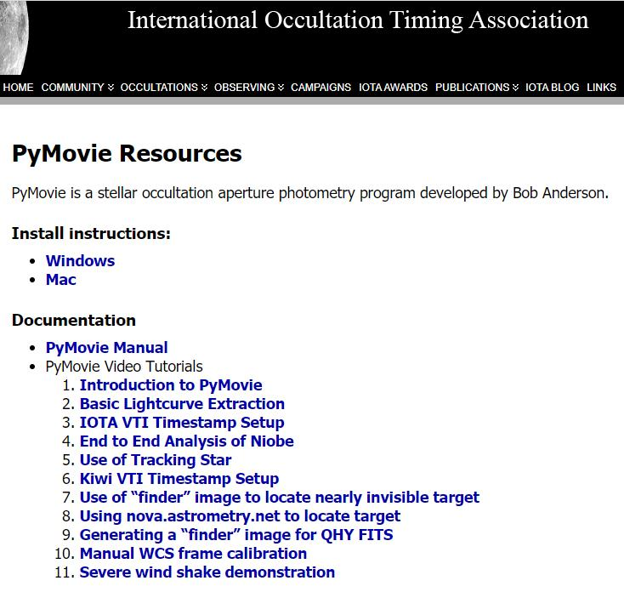

Slide 18
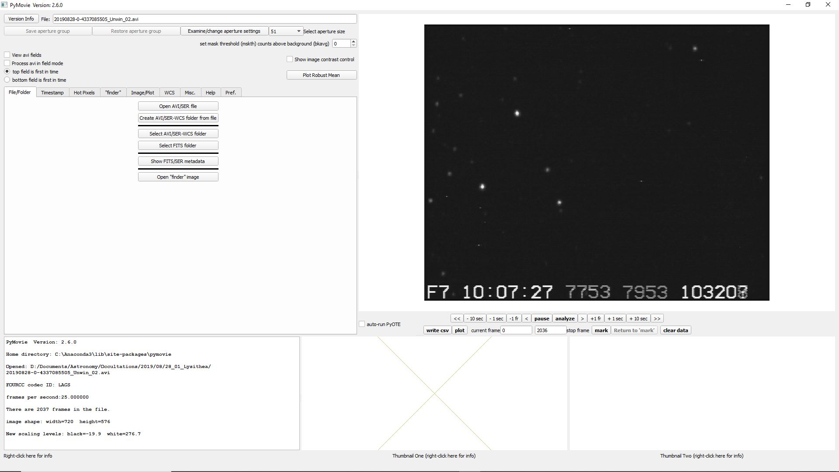
PyMovie Main Screen

Slide 19
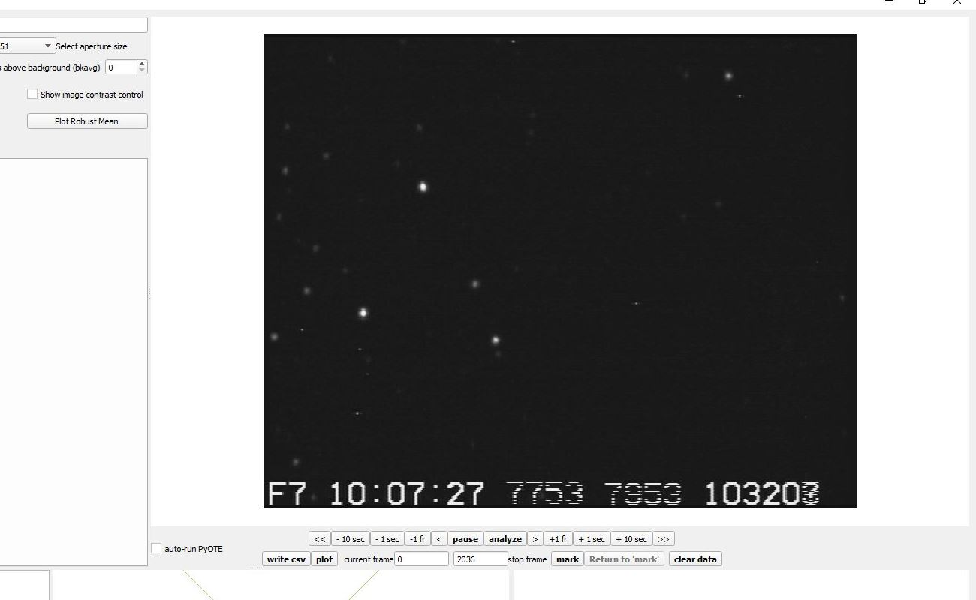
PyMovie Main Screen (cropped)

Slide 20
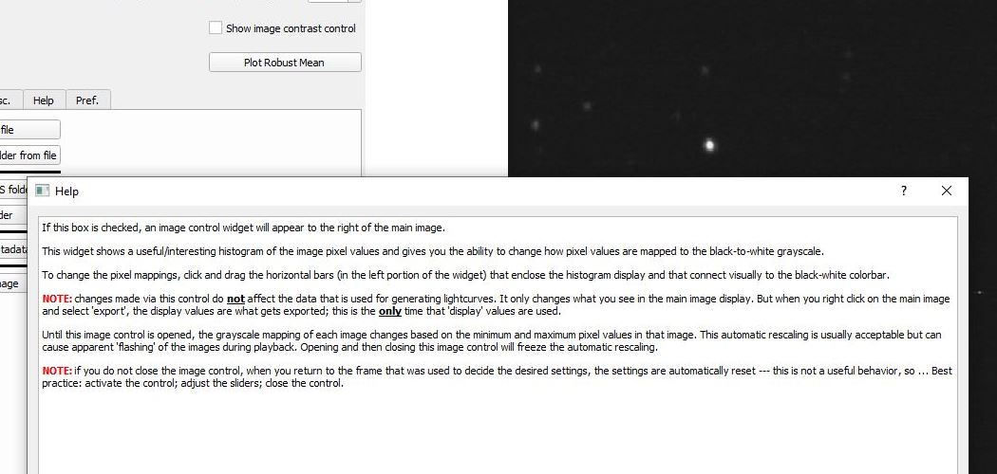
PyMovie Help

Slide 21
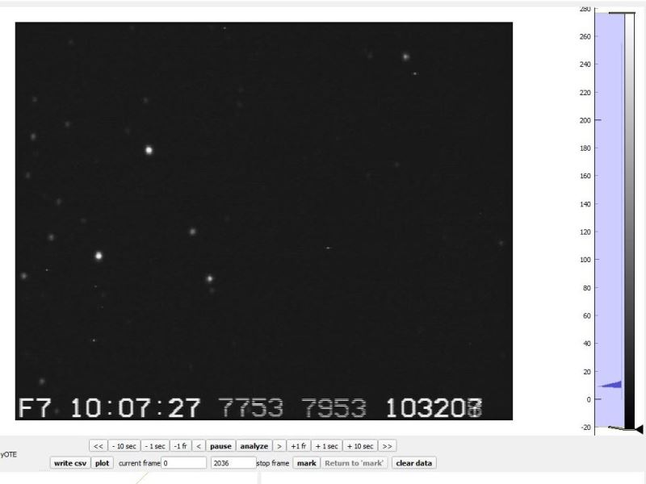
Image Contrast Control

Slide 22
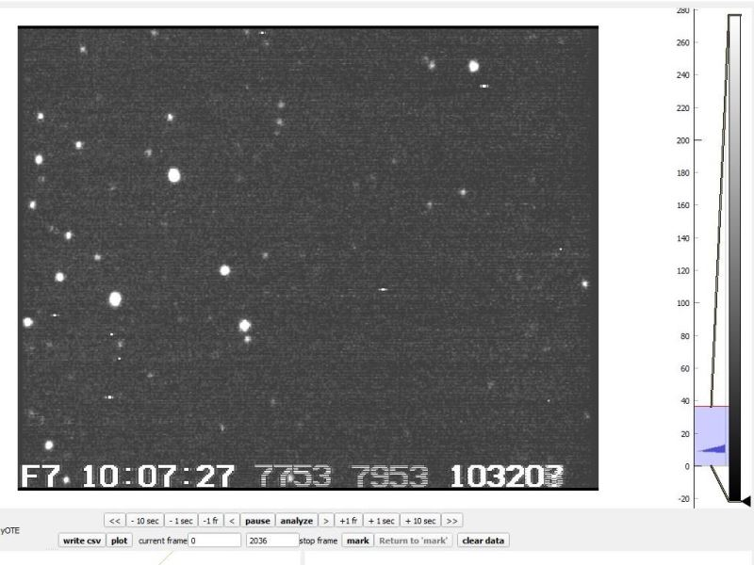
Image Contrast Control

Slide 23
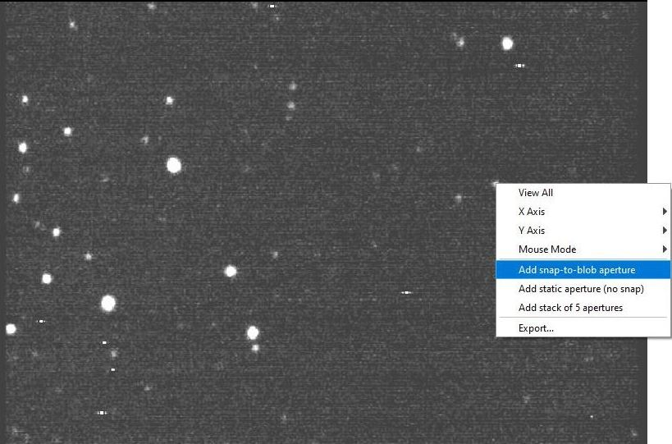
Add an Aperture …

Slide 24
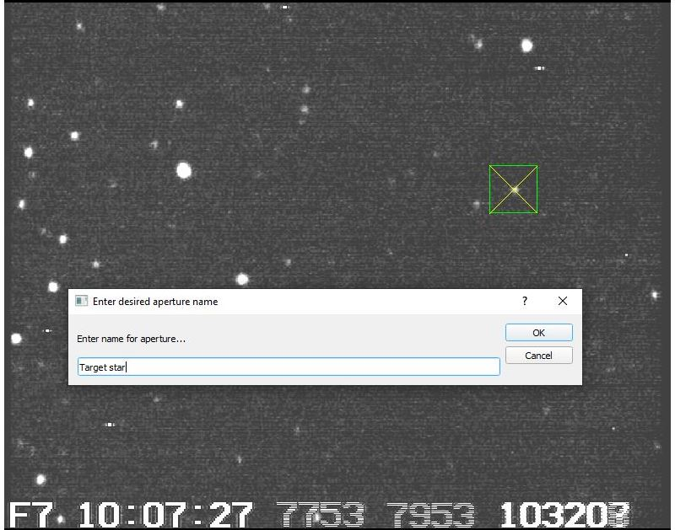
Add an Aperture …

Slide 25
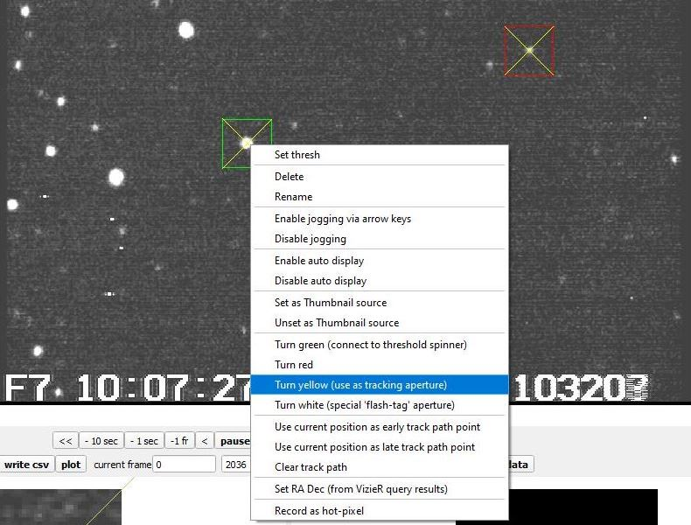
Aperture Options

Slide 26
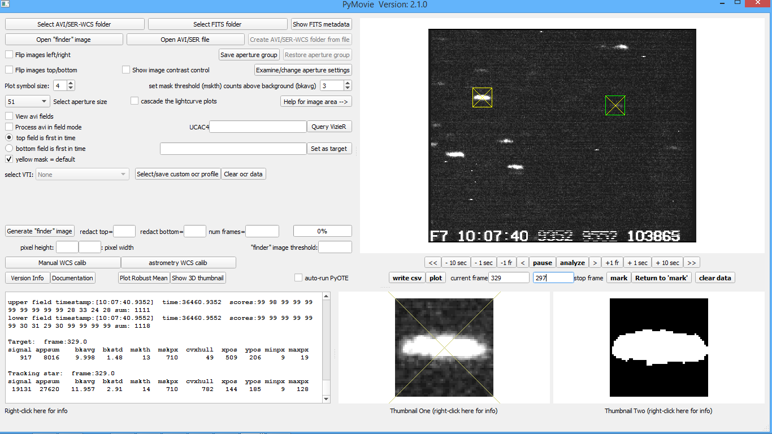
Setting Tracking Mask as Default

Slide 27
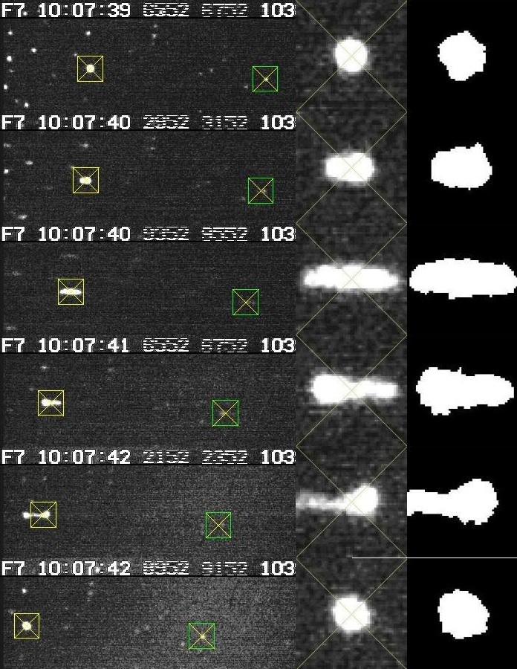

Slide 29
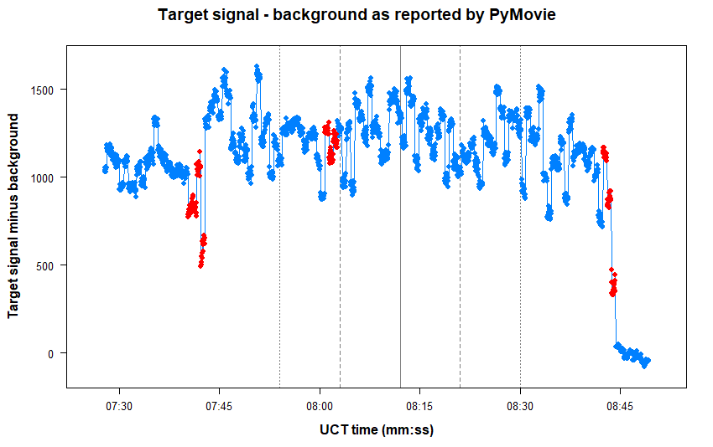

Slide 30
Summary
PyMovie looks useful for handling wind shake
  but still limits to what it can handle
  alternative to Tangra but not a substitute
Pros
  good onscreen help and documentation
  image contrast control
    also allows zoom
    run video forwards or backwards
  dynamic tracking mask
    copes with moderate wind shake
  (can map hot pixels)
Cons
  still evolving
    latest updates not always documented
  no support for .aav video
  another new piece of software to learn …
PyMovie / PYOTE workshop for TTSO15?

Slide 31
Thanks to:
Tony George

