Slide 1
An Empirical Analysis of OW Event Probabilities What are the odds?
Martin Unwin (RASNZ)
TTSO14, 13 April 2020

Slide 2
Motivation
OW event probabilities
Main factor deciding which events we attempt to observe
Derived from uncertainties in orbital parameters
How accurate are they?
Compare observed positive rates with predictions
e.g., for events with prior probability of 50% half of all observations should be positive

Slide 3
OW Event Database
18,592 records
February 2009 – August 2019
3,268 positive (17.6%), 15,324 negative
Data fields of interest
OW event ID
asteroid number & name, target star, date
feed, OW probability, event rank, result (+ve/-ve)
Merged with JPL small-body database
gives class (main belt, Trojan, TNO etc.)

Slide 4
Events by Year
Year | N_{total} | N_{positive} | % positive
2009 | 670 | 97 | 14.5%
2010 | 908 | 173 | 19.1%
2011 | 1,133 | 203 | 17.9%
2012 | 1,124 | 201 | 17.9%
2013 | 1,451 | 203 | 14.0%
2014 | 1,763 | 256 | 14.5%
2015 | 1,782 | 280 | 15.7%
2016 | 2,262 | 352 | 15.6%
2017 | 2,179 | 399 | 18.3%
2018 | 3,235 | 702 | 21.7%
2019 | 2,085 | 402 | 19.3%
All years | 18,592 | 3,268 | 17.6%

Slide 5
Events by Feed
Feed group | N_{total} | N_{positive} | % positive
IOTA¹ | 7,093 | 2,381 | 33.6%
Occult² | 10,781 | 784 | 7.3%
Professional³ | 549 | 93 | 16.9%
Other⁴ | 169 | 10 | 5.9%
All feeds | 18,592 | 3,268 | 17.6%
¹ High probability events from Steve Preston’s website
² E.g., TT14, North America, IBEROC, UKOCL, Personal
³ E.g., RIO TNO, Rio Satellites, Lucky Star
⁴ E.g., comets

Slide 6
Events by Small Body Type
Body type | N_{total} | N_{positive} | % positive
Main belt | 17,240 | 3,168 | 18.4%
Trojan/Centaur | 866 | 54 | 6.2%
TNO | 340 | 32 | 9.4%
All body types | 18,592§ | 3,268 | 17.6%
§Includes 146 unmatched records

Slide 7
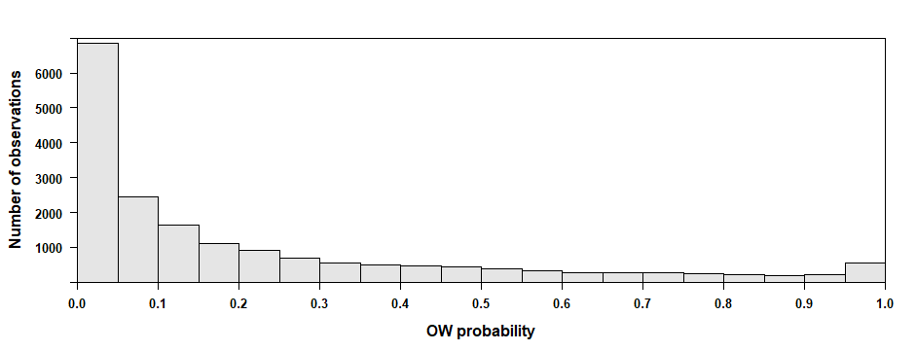
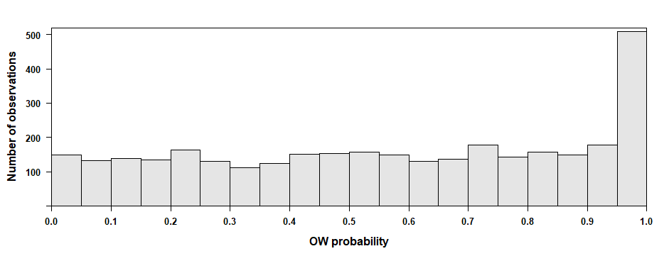
All Observations (N = 18,592)
(median OW probability 0.0999)
Positive Observations (N = 3,268)
(median OW probability 0.582)

Slide 8
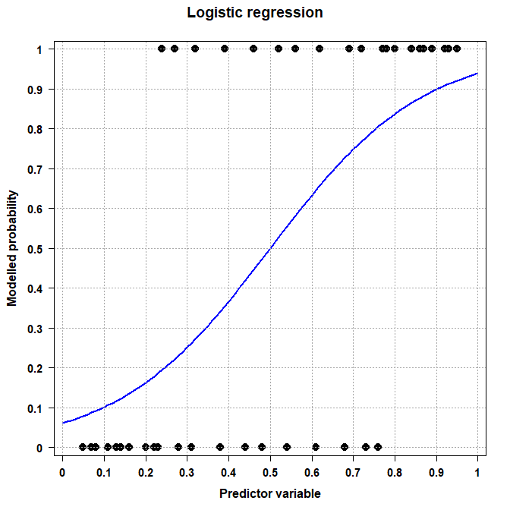

Slide 9
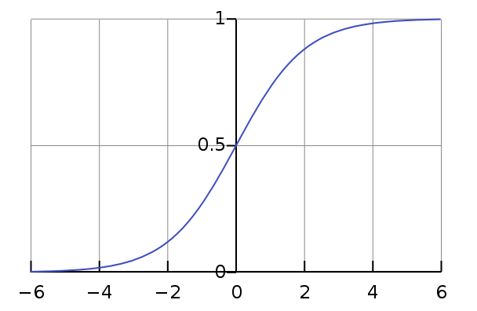
Standard Logistic Function

Slide 10
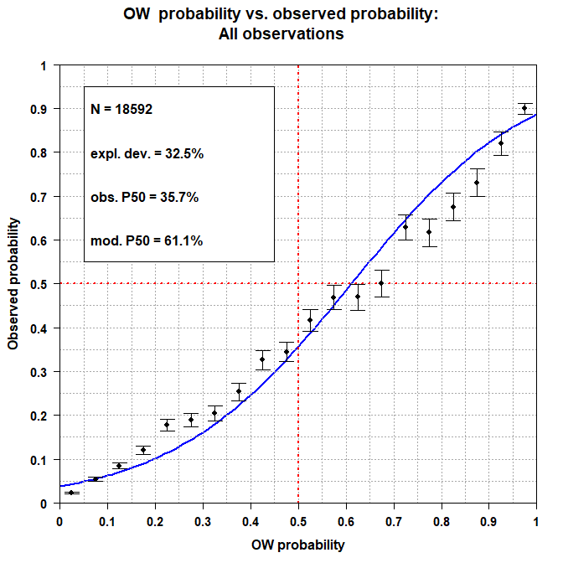
Hardware

Slide 11
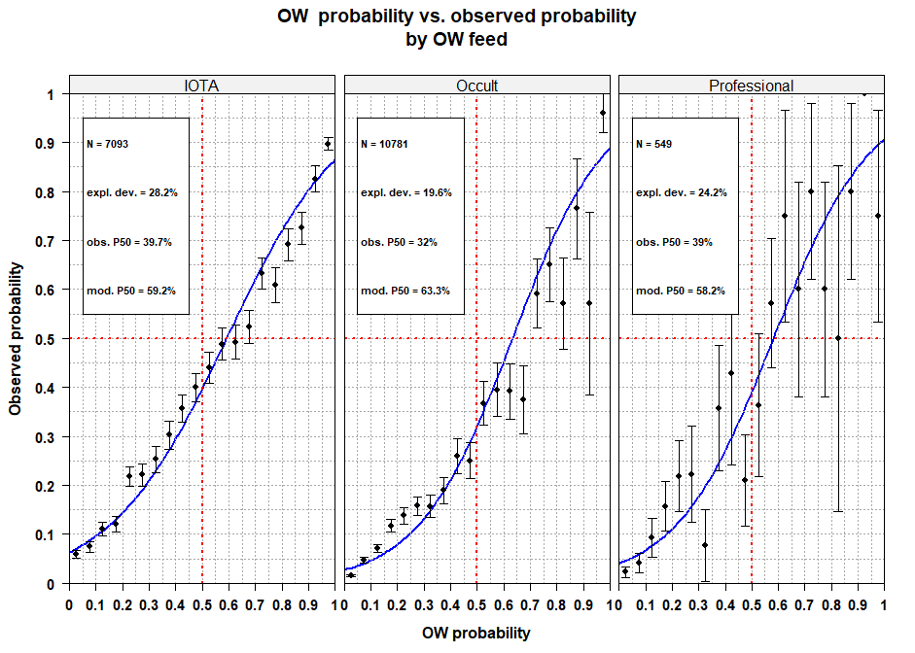

Slide 12
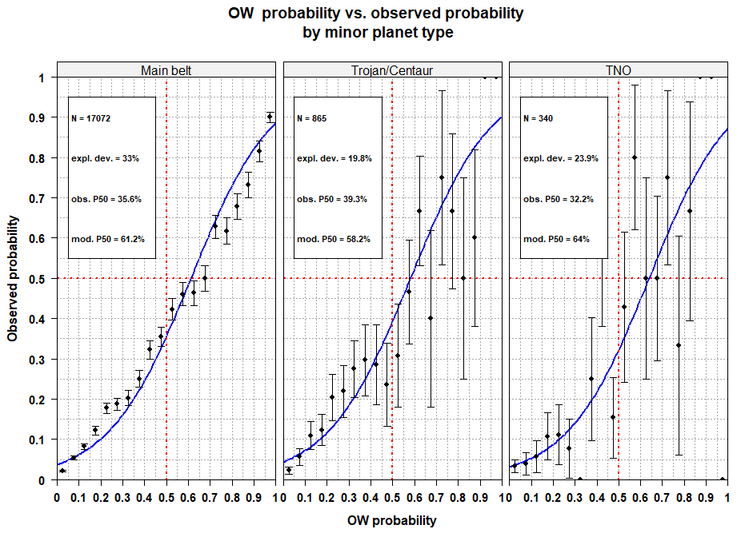

Slide 13
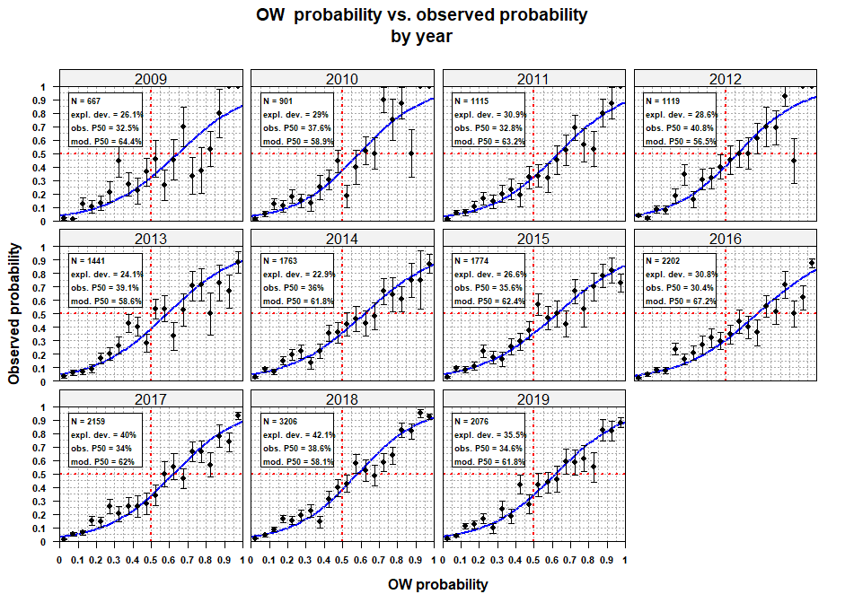

Slide 14
Summary
OW event probabilities tend to be optimistic
50% OW probability ≈ 35% observed probability
50% observed probability ≈ 61% OW probability
Consistent across:
OW feed (IOTA, Occult, Professional)
MP type (main belt, Trojan/Centaur, TNO)
Year (2009 – 2019)
OW probabilities derived from JPL database
Are JPL error estimates conservative?

Slide 15
Thanks to:
Hristo Pavlov
Dave Gault
Dave Herald

