Slide 1
QHY174M-GPS Issues
Bill Hanna
Columbia Falls, Montana
TTSO14 Online
Monday 13 April 2020
Notes:
The QHY174M-GPS is the digital camera chosen by the Southwest Research Institute (SwRI) for their remotely-deployed occultation programs in support of the New Horizons and Lucy spacecraft missions, among others.

Slide 2
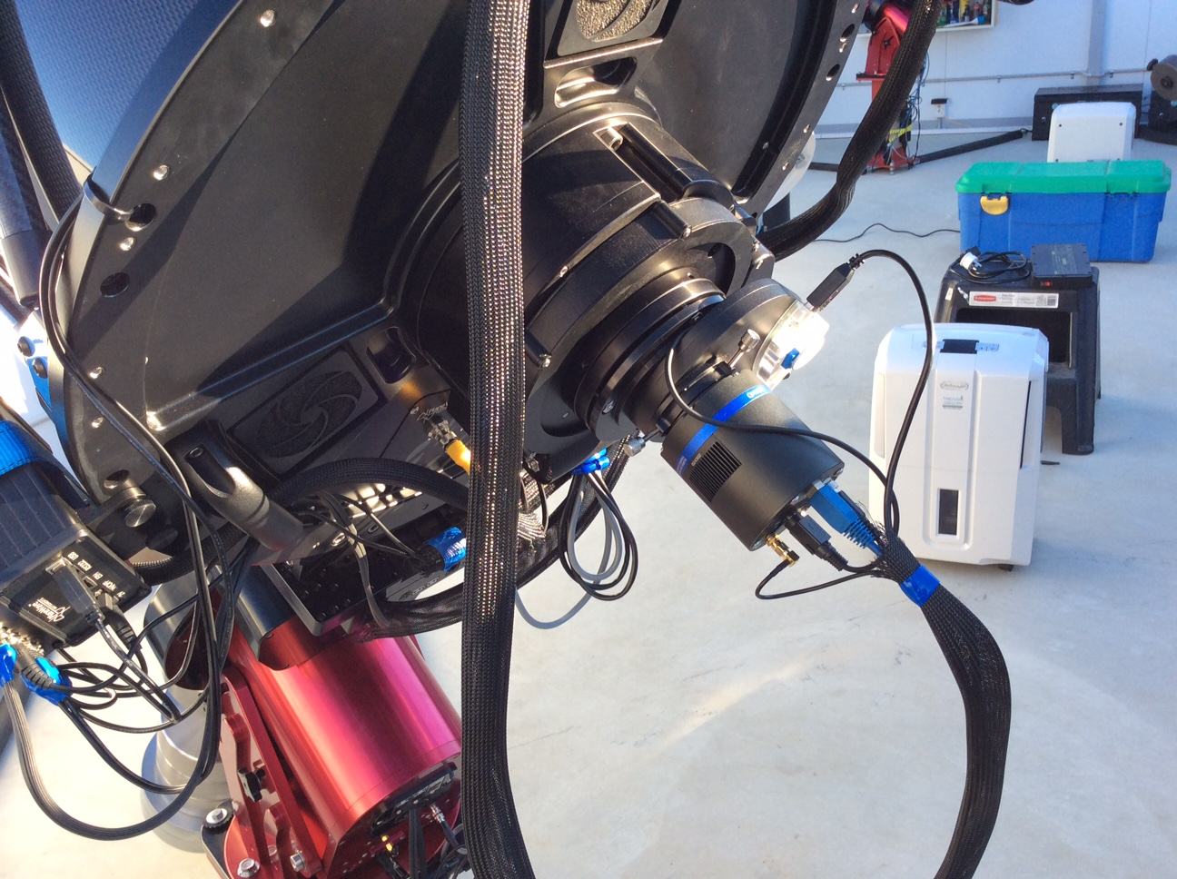
The Camera in situ
Notes:
Here is the camera at the focus of my remote telescope. Note the associated filter wheel which can be controlled via a USB 2.0 port or (much preferred) via a port on the camera.
The camera has connectors for USB 3.0, 12V power (for the TE cooler; the camera itself is powered from the USB 3.0 port), GPS antenna, and QHY filter wheel.

Slide 3
Topics
Associated Web Sites For More Information
SharpCap
Dropped Frames
New Hardware
Notes:
I will not go into great detail about how the camera is set up and used. The web sites from IOTA-ES workshop and QHY have lots of specific information.
SharpCap is the preferred software for driving the camera. I have done some tests of OccuRec with Hristo Pavlov as well.
The biggest issue by far is with dropped frames. This has yet to be resolved to my satisfaction.
A very brief discussion of the Shelyak TimeBox.

Slide 4
Associated Web Sites
http://www.iota-es.de/qhy174gps_workshop.html
https://www.qhyccd.com/index.php?m=content&c=index&a=show&catid=94&id=46&cut=1
https://www.sharpcap.co.uk/
Notes:
Much more detail is available at these web sites:
Workshop from the IOTA European Section.
The camera manufacturer’s web site.
The software developer’s web site.

Slide 5
QHY174M-GPS Specs
Max 138 fps full frame (1920 x 1200 pixels)
  But — I can barely achieve 15 fps full frame without SharpCap reporting dropped frames
Max 490 fps with a 480 x 300 pixel sub-frame
Zero inter-frame gap
A “customised higher frame rate version” is said to be available
Not as sensitive as some analogue cameras still in use
Notes:
Impressive specs but I (and other owners) cannot even approach them reliably. This is really only a problem if collecting at >15 fps.
The QHY documentation mentions a “high rate” version but no one seems to carry it.
The camera has a lot of versatility but at the expense of being less sensitive than, say, the RunCam.

Slide 6
SharpCap Software
Free Version (latest is 3.2.6281.0)
  All of the camera controls
  Many capture formats
  Named capture profiles
“Pro” Version
  One-year licence is ￡10 (highly recommended)
  Enables the most desirable features
    Auto Stretch (I find this essential for occultations)
    Optimised memory usage to minimise dropped frames
  Python-like scripting language
Notes:
If you are willing to spend over $1000 for the camera the annual licence is very good value to achieve full functionality.

Slide 7
What Does It Mean For a Frame to be Reported as “Dropped”?
“Missing Frame” is probably a much better description
  Never even generated within the camera?
  Generated within but not transmitted?
  Transmitted but not acknowledged by the OS?
  Received by the OS but not stored?
  Some (dynamic?) combination of the above?
  Something else?
Actually dropped but not reported as such?
Notes:
“Dropped Frames” are by far the greatest outstanding issue with the camera/software combination.
If SharpCap reports dropped frames then frames have definitely been dropped. If SharpCap reports “0 dropped frames” then be very wary, especially if you used a “high” frame rate.
Check the Tangra .csv file for unequal delta times, or analyse with pymovie or AOTA to identify time inconsistencies.

Slide 8
Why Are Frames Dropped?
Sensitive to several parameters
  MONO8 (8 msb of 10-bits) vs MONO16 (12-bits left-shifted into 16 bits) modes
  Frame Size (full frame is 1920 x 1200 pixels)
  “USB Speed” parameter
  Position of any sub-frame selection
    The camera always transmits the full 1920-pixel width, starting from the top, regardless of sub-frame width
    For high frame rates put the target star at the top left of the full frame then choose the sub-frame dimensions
Notes:
There are many factors that can contribute to the phenomenon:
8-bit vs 16-bit data transmission. Note that in 16-bit mode only 75% of the USB 3.0 data stream bandwidth is valid information.
The frame size really only needs to be big enough to collect the target star and at least one good guiding/comparison star. It may be necessary to rotate the camera to put both near the top of the frame.
It would seem that a lower “USB Speed” selection should reduce the rate of dropped frames but that does not seem to be the case.
Choose the smallest sub-frame possible and put it at the top of the image.
I am investigating whether writing to pre-created files on the SSD will speed up the OS opening/closing the files, but as yet without success.

Slide 9
Shelyak TimeBox
Notes:
Off topic, but I recently received this and I am developing a test plan to evaluate it against an IOTA VTI, QHY174M-GPS, and will use it with a true digital camera (e.g., from The Imaging Source or an Orion StarShoot).
I am writing some Python code to compare QHY174M-GPS-generated FITS header times with PC file time stamps.

Slide 10
Shelyak TimeBox
Designed for use with digital cameras
Uses GPS to update the computer time
  Keeps PC clock within ±2 msec of UTC
  LED firing within 10 µsec of UTC
  Trigger pulse via BNC within 1 msec of UTC
Supplied with a GPS antenna
Requires a USB 2.0 port
Keeps a log of its actions

Slide 11
Questions?
Notes:
Questions?
(The high-altitude clouds in the Pacific Northwest often mean that I can clearly see mountains nearly 60 kilometers away but cannot see anything overhead.)

