Slide 1
Asteroidal Occultations
and Shape Models
Dave Herald

Slide 2
The problem
An occultation gives an accurate profile of an asteroid for its orientation at the time of an event
Asteroids are irregular to greater or lesser extents
=> an accurate asteroid diameter can’t be determined from one or two occultations – only an approximate diameter

Slide 3
Asteroid Shape Models
A group of astronomers (largely ‘unpaid’ astronomers) measure the light curves of asteroids in different parts of their orbit
These light curves can be ‘inverted’ to derive the shape of the asteroid

Slide 4
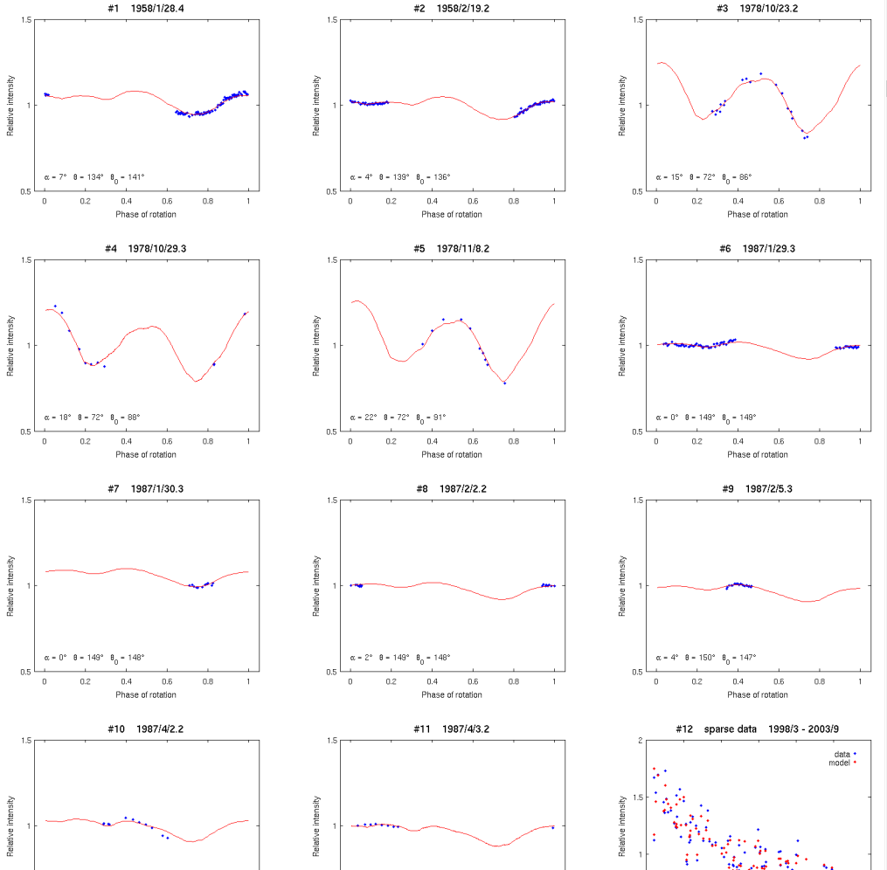
(30) Urania Light curve measurements
(Blue dots) and light curve from a model (Red line)

Slide 5
Shape model ‘issues’
A shape model has no size – just shape
The inversion process usually results in two different orientations of the axis of rotation – with differing shapes. Inversion process cannot determine which one is correct
The inversion process is complex. Early models were limited to convex surfaces. Over the last few years models with concave surfaces have been developed
Inversion assumes uniform surface reflectivity

Slide 6
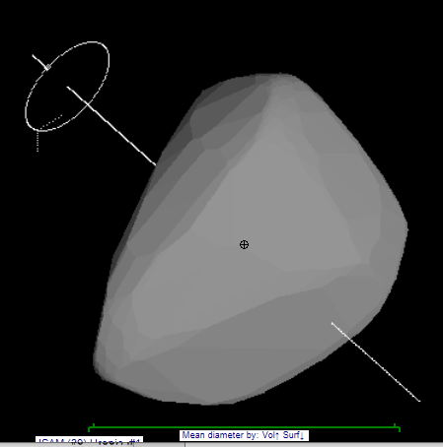
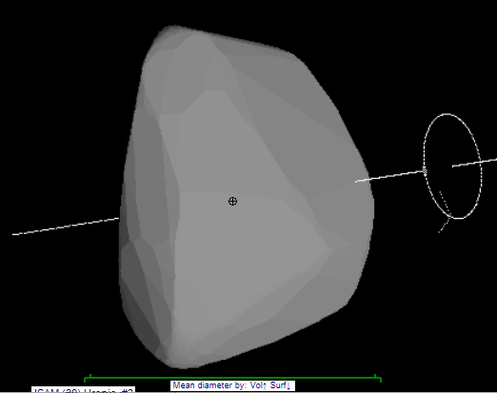
The two shape models for (30) Urania, with different rotational axes

Slide 7
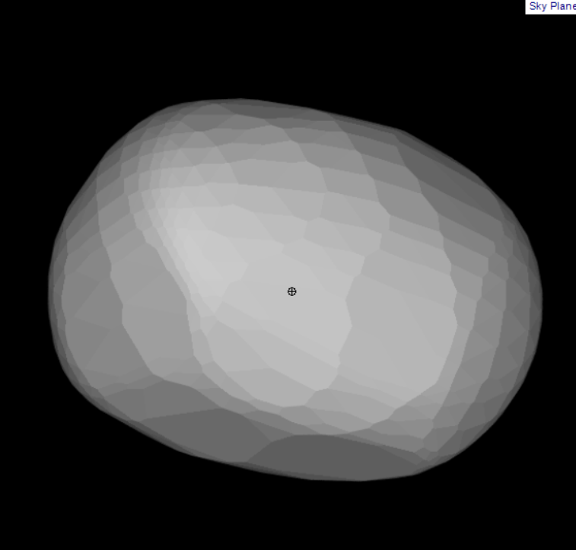
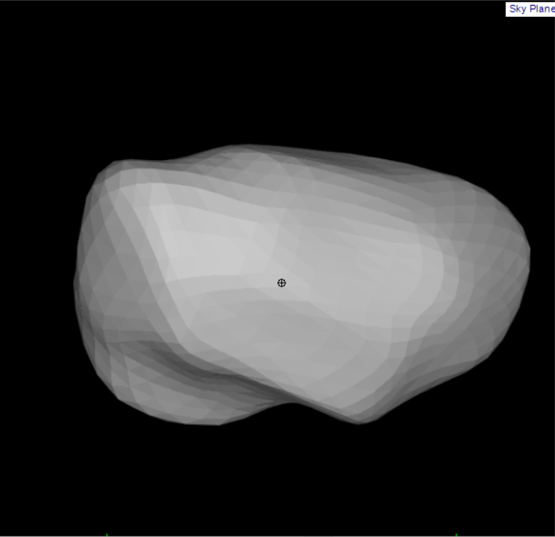
Two shape models for (130) Electra one convex, and one concave, model

Slide 8
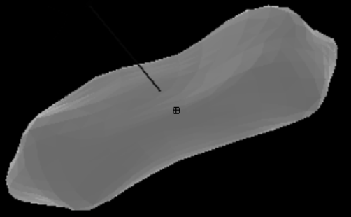
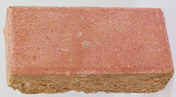
Determining asteroid diameters
Question: what is the ‘diameter’ of an
irregular object like (216) Kleopatra,
or a household brick?
For major planets, the ‘diameter’ (unqualified) is usually interpreted as the equatorial diameter
Asteroid diameters measured by IR satellites depend on reflection – which depends on surface area

Slide 9
Two important diameters
Volume-equivalent diameter – diameter of a sphere having the same volume. Associate this with the asteroid’s mass, and you get the asteroid’s density
Surface-equivalent diameter – diameter of a sphere having the same surface area. This relates to IR satellite measurements of diameter
[a tri-axial ellipsoid gives 3 dimensions, from which an approximate ‘diameter’ or volume can be derived]

Slide 10
Process to derive a diameter
Shape models fully account for the irregular shape of an asteroid (unlike triaxial ellipsoids)
The model includes data that gives the dimension of both the Volume-equivalent and Surface-equivalent diameters, on the scale of the projected image
Net result – when you match the occultation chords to the projected shape model image, you get a direct measurement of the diameters.

Slide 11
Fitting occultations to shape models
The next three slides show fits of the occultation of (90) Metis on 2008 Sept 12 to three shape models available for Metis, and the conclusions to be drawn.
The derived diameter is a ‘volume-equivalent’ diameter.
A ‘surface-equivalent’ diameter can also be derived.

Slide 12
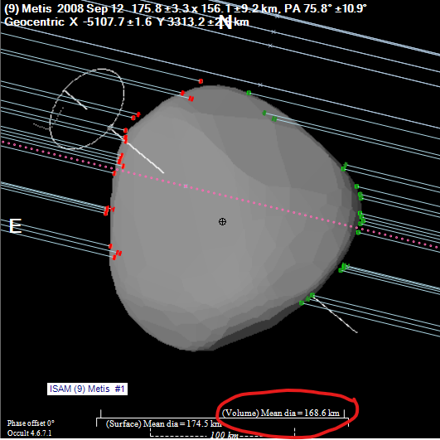
A fairly good fit to convex shape model derived in 2011
Measured ‘volume-equivalent’ diameter 169km

Slide 13
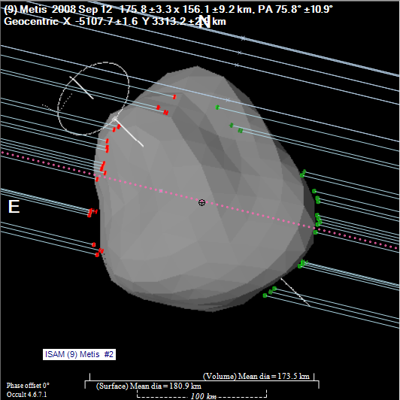
A fit to a concave shape model derived in 2013
The fit is clearly poor. Even so, the diameter can be assessed as being about 170km

Slide 14
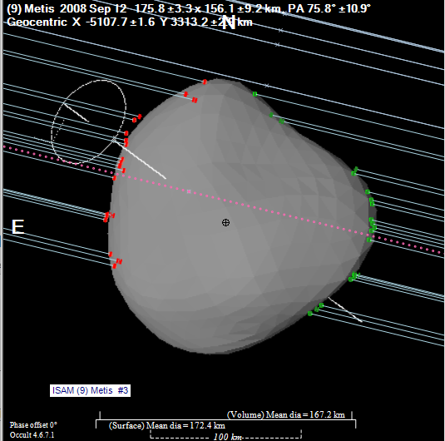
Fit to a 2017 convex shape model
(note the smoother surface cf. 2013)
Derived diameter 167 km

Slide 15
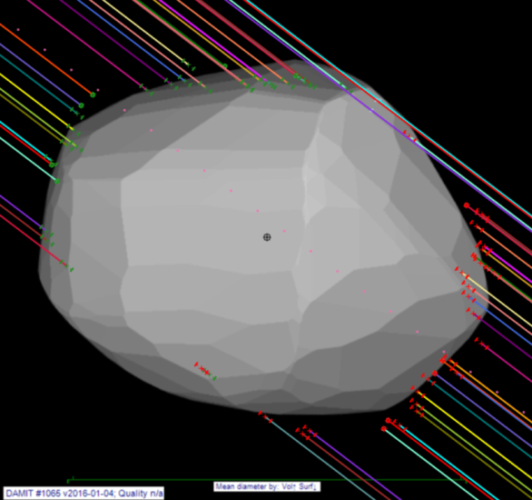
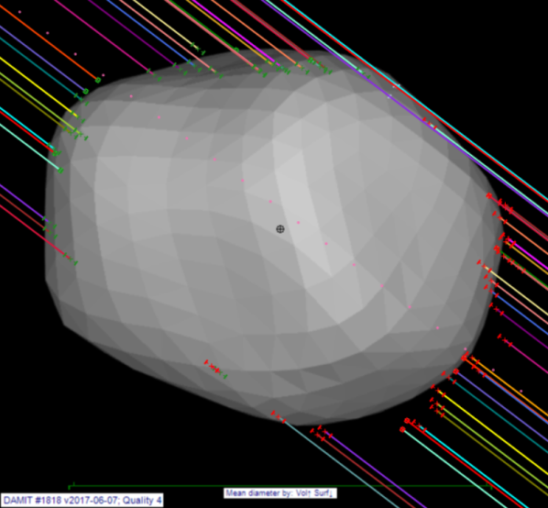
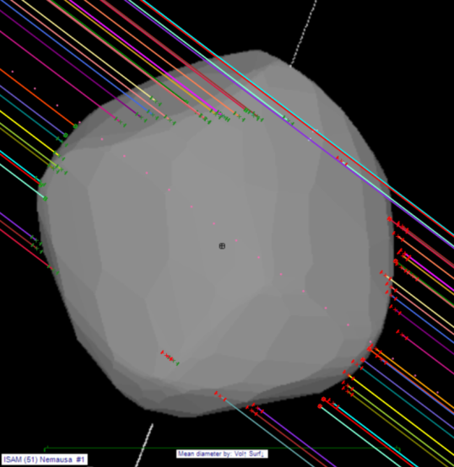
Need to identify the correct model
& deal with ‘odd’ observations
[this example is (51) Nemausa]
Bottom chord looks to have ‘problems’
1st model reasonable. Dia = 144km
2nd model better. Dia = 146km
3rd model – clearly wrong
No model is close to a perfect fit.

Slide 16
Diameter of (51) Nemausa using all events
From these results
Diameters from all events of Nemausa
min max
2007 Feb 28, 140, 141, 0°, Diameter but no fit
1979 Aug 17, 151, 153, 0°, Diameter but no fit
2004 Feb 21, 0.0, 0.0, 0°, 1 chords, Not fitted
2016 Aug 1, 0.0, 0.0, 0°, 1 chords, Not fitted
2015 Mar 9, 0.0, 0.0, 0°, 3 chords, Not fitted
2018 Mar 14, 0.0, 0.0, 0°, 1 chords, Not fitted
2014 Jan 14, >128, 0, 0°, Minimum diameter
2005 Aug 21, >116, 0, 0°, Minimum diameter
2016 Sep 3, 144, 152, 0°, Diameter but no fit
2017 Jan 29, >120, 0, 0°, Minimum diameter
2011 Feb 4, 148, 0, 0°, Model wrong
2015 Jul 22, 0.0, 0.0, 0°, 2 chords, Not fitted
2014 Jan 12, >152, 0, 0°, Minimum diameter
2017 Oct 22, >131, 0, 0°, Minimum diameter
2018 Mar 31, 147, 147, 0°, Good fit
2002 Oct 21, 147, 147, 0°, Good fit
1983 Sep 11, 145, 146, 0°, Good fit
2006 Oct 31, 151, 154, 0°, Poor fit
2013 Sep 30, 138, 138, 0°, Poor fit
2014 Mar 8, 140, 144, 0°, Poor fit
2003 Jan 6, 149, 149, 0°, Good fit
2007 Jan 3, 143, 145, 16°, Good fit
Occultation diameter
Using only ‘good fit’ results
146.5 ± 1.4km
Using all measures
146.0 ± 3.8km
Compare with the satellite results
IR satellite diameters
NEOWISE 146.1 ± 81.0km
NEOWISE 138.1 km
AcuA 158.5 ± 15.0km
AcuA 145.4 ± 14.0km
IRAS 147.8 ± 4.0km

Slide 17
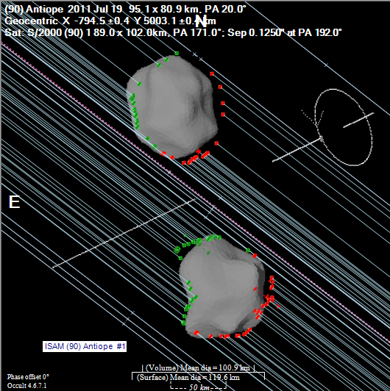
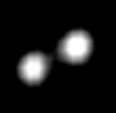
Rotation periods
In addition to diameters, occultations can be used to improve rotation periods
A particular example is the binary asteroid (90) Antiope
Small-aperture occultation resolution is HUGELY better than the largest optical telescopes
Adaptive optics image from the
10-m Keck telescope

Slide 18
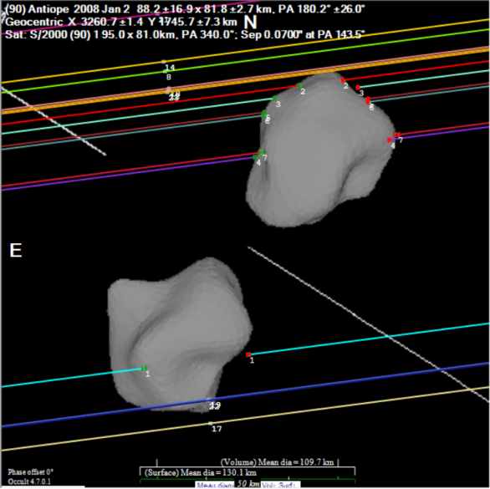
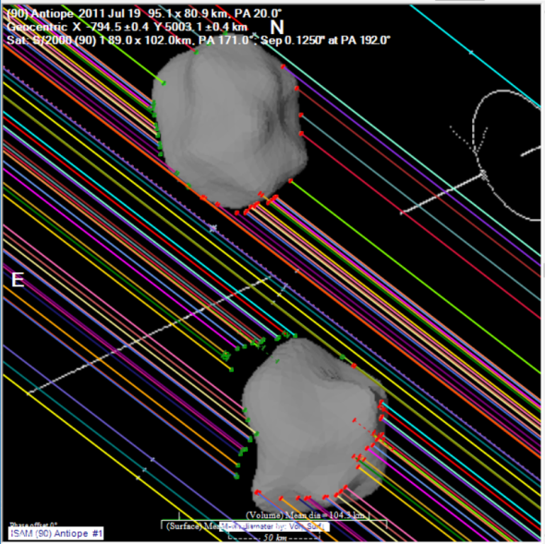
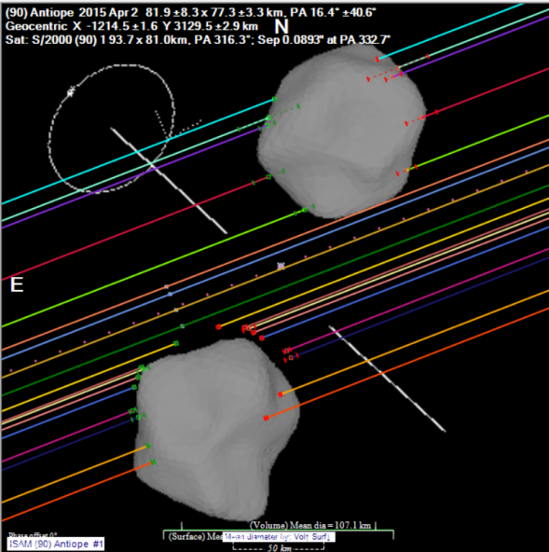
3 Good Antiope events
2008 Jan 2 2011 Jul 19 2015 Apr 2
All models centered on the same component (happens to be the upper one). The plots show that the other component is not aligned – and by varying amounts.
Implies a change in the phase angle at the zero reference time, or possible change in period
By varying the shape-model phase for each event, we can determine a correction to the rotation period

Slide 19
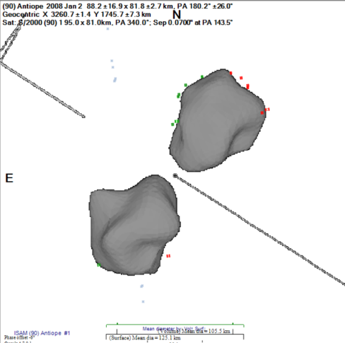
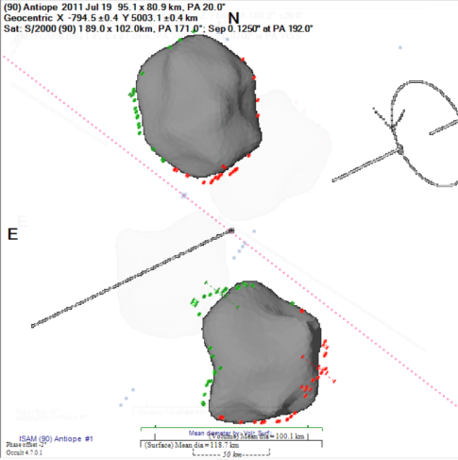
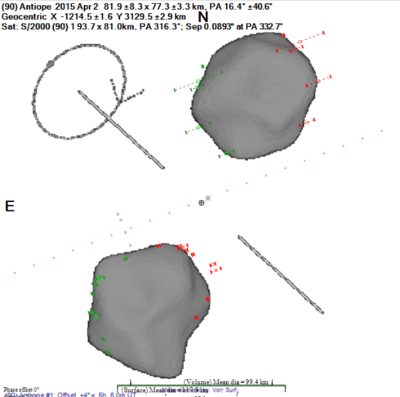
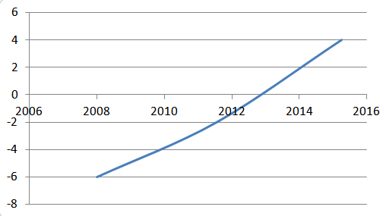
Analysis of Antiope rotation period
2008 Jan 2
-6°, 105km
Poor chord distribution on 2nd component
2011 Jul 19
-2°, 100km
2015 Apr 2
+4°, 99.6km
Measured phase change ≈ 10° over 7.25 yrs
⇒derived rotation correction = +0.00378°/day
Orbital period 16.505046 hrs = 523.47627°/day
New rotation per day = 523.4805 °/day
New rotation period = 16.504913 hrs.
Phase change (deg) by year

Slide 20
High precision astrometry
Occultation astrometry is reported as an offset from the occulted star.
99.7% of occulted stars have Gaia DR2 positions
For a well-observed occultation, the astrometric uncertainty can be as low as 0.0001” – that is, 100 µ-arcsec [typical CCD astrometry using modest ‘scopes has an uncertainty of around 200 mas.]

Slide 21
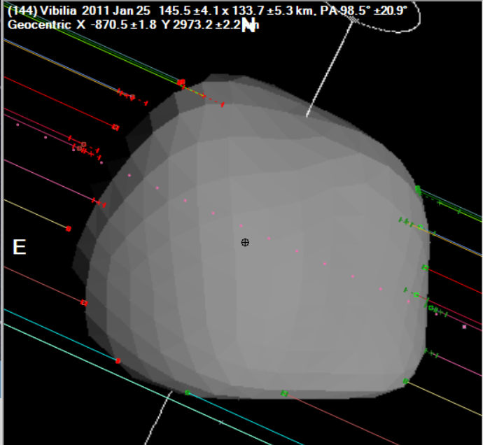
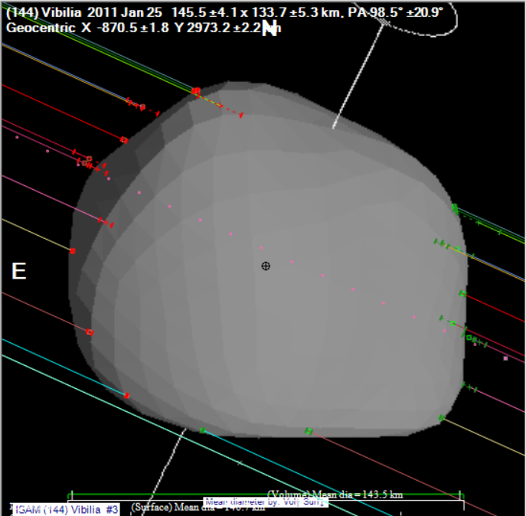
Limitations on CCD Astrometry
Traditional CCD astrometry measures the centre of light of an asteroid
Orbital motion is dictated by the location of the centre of mass, not the centre of light.
The center of light will differ from the center of mass because of:
  Solar illumination phase
  Differences between the location of centre of mass and the centre of figure
Solar illuminated,
phase affected
Black marker is centre of mass (assuming uniform density). The centre of figure is clearly located to the right of the marker.
⇔
True profile

Slide 22
Reporting astrometry from occultations
When a shape model is available, differences between the centre of figure and centre of mass become apparent
Whenever possible, we will be reporting astrometry derived from Occultations to the Minor Planet Center based on Center of Mass. However the IAU standard ADES needs to be updated to allow this to happen.
Extract of an astrometric report in ADES format….
permID |provID |mode|stn|obsTime |raStar |decStar |deltaRA |deltaDec|rmsRA |rmsDec|astCat |com|
6| |OCC |244|2019-01-01T15:23:23.85Z| 94.57830780| 5.98653780| 3.7771| -5.0411|0.0084|0.0158| GDR2|0 |
6| |OCC |244|2019-01-14T03:50:36.88Z| 91.68994530| 7.90771260| 0.4213| 3.8808|0.0003|0.0003| GDR2|0 |
6| |OCC |244|2019-02-04T11:59:15.35Z| 89.13044205| 11.53498680| -0.0918| 2.2475|0.0907|0.0907| GDR2|0 |
12| |OCC |244|2019-01-17T22:00:52.75Z| 51.00970935| 15.25879300| 2.1970| 2.3123|0.0426|0.0426| GDR2|0 |
15| |OCC |244|2019-04-27T17:18:33.15Z|318.28846875|-15.95389700| -1.9653| -1.2354|0.0018|0.0025| GDR2|0 |
16| |OCC |244|2019-02-08T13:12:17.29Z|288.16164090|-20.41309960| -1.7603| 1.5196|0.0035|0.0285| GDR2|0 |
18| |OCC |244|2019-06-26T06:13:20.06Z|280.95155790| -8.63512850| -2.0251| 4.6716|0.0102|0.0413| GDR2|0 |
23| |OCC |244|2019-01-11T22:53:27.29Z| 28.93467885| 9.17252450| 3.1163| 2.6017|0.0369|0.0369| GDR2|0 |
25| |OCC |244|2019-01-17T18:17:19.50Z| 93.66505440| -5.60617100| 3.3456| 2.4467|0.0190|0.0722| GDR2|0 |
39| |OCC |244|2019-03-07T17:40:55.49Z|301.17339015|-13.46387930| -2.1839| -1.4195|0.0033|0.0153| GDR2|0 |
50| |OCC |244|2019-04-01T22:36:33.20Z|172.62366960| 3.49482950| 0.4524| 2.6472|0.0010|0.0008| GDR2|0 |
50| |OCC |244|2019-06-25T12:47:19.38Z|172.91053110| 3.87288430| 1.9023| 1.4413|0.0000|0.0000| GDR2|0 |

Slide 23
Occultations to support space missions
We all know about Ultima Thule & New Horizons….
Japan will be launching DESTINY+ in 2022 to explore (3200) Phaethon – the Apollo asteroid responsible for the Geminid meteor stream
JAXA keen to get precise position of the asteroid, and measure of its size
IR satellite measures:
AcuA 4.8 km IRAS 5.1 km

Slide 24
(3200) Phaethon outcomes
Successfully observed in the US on 29 July
Event tested the accuracy of prediction software of all
Gravitational deflection of the light by the Sun was similar to the width of the occultation path
Event provided a unique opportunity to compare and improve prediction software
Unfortunately a subsequent event on Aug 21 in Japan was clouded out.

Slide 25
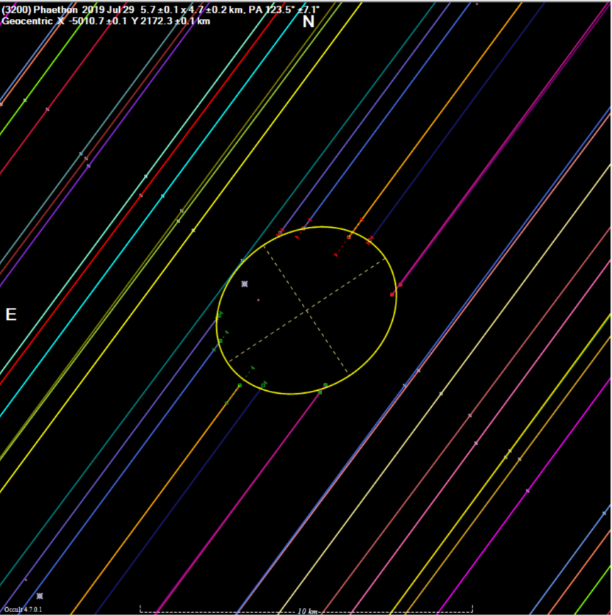
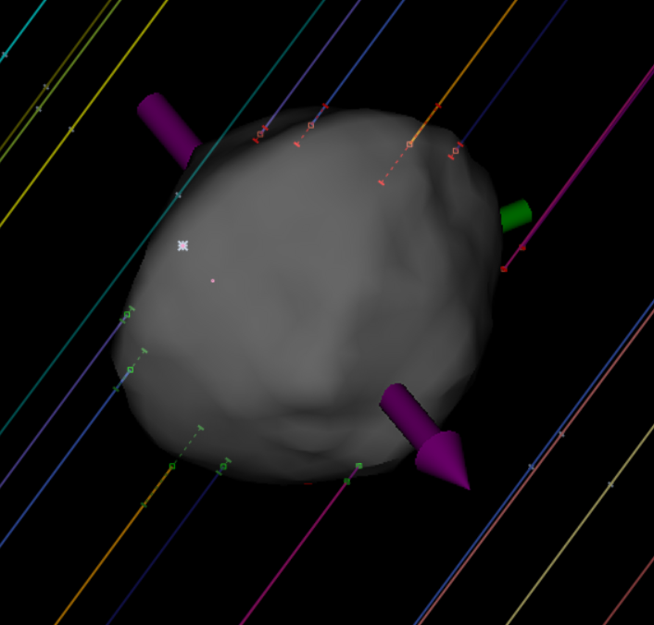
Phaethon - preliminary results
Fit to an unpublished shape model
Ellipse 5.7 x 4.7 km
⇒ Diamater is larger than AcuA and IRAS by ~ 5%

Slide 26

Questions?

