Slide 1
Adventures with Focal Reducers
They are not always a plug and play proposition
Steve Kerr

Slide 2
Why did I want to give this talk?
In March 2017, I did some tests on comparative sensitivity of a Watec 910BD and a Mallincam Recon 828 camera for David Dunham on a star (magnitude 15.9) for the upcoming occultation by 2014 MU69.
The Mallincam came with a 0.5X focal reducer.
I did some tests with my Meade 0.33X and the Mallincam 0.5X and found that I could see fainter with the 0.5X.
Always wanted to go back to try to understand what was happening here or if it was something to do with that morning – setting moon and coming twilight …
The Dunham’s sent me an Knight Owl 0.5X Focal Reducer.
Committed to give a talk before I had done anymore testing …

Slide 3
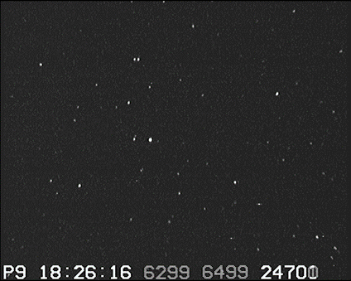
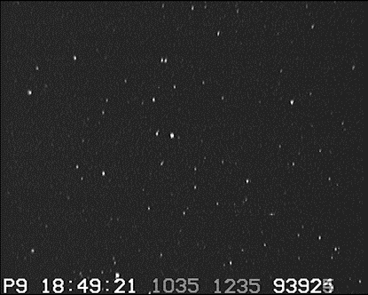
Both images are Watec 910BD at 8x Integration
Meade f/3.3 Focal Reducer
Mallincam 0.5X Focal Reducer

Slide 4
What is a Focal Reducer
An optical element inserted in the light path to reduce the apparent focal length at the imaging plane.
Usually consist of a number of lenses in close proximity to the camera
Should be described as having a given (fractional) multiplier of the focal length but can be labelled as producing a certain focal ration (e.g. Focal Reducers labelled as f/6.3 when used as designed on intended scopes – usually f/10 SCT’s)
Result in a given camera chip covering a larger part of the sky
Will be designed for use in a given optical spacing … and moving away from that spacing can have consequences.
‘Field Flatteners’ are also focal reducers … although not usually strong ones.
When used with camera lenses, focal reducers are called ‘Telecompressors’.

Slide 5
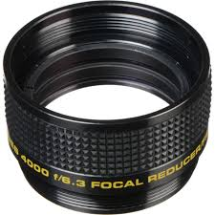
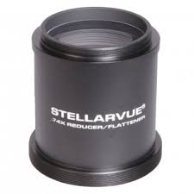
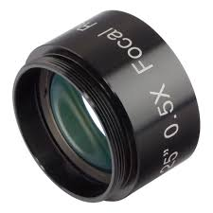
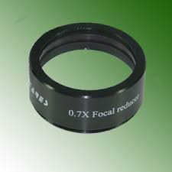
Some pictures stolen from the Internet

Slide 6
Why do I use them? (OK, not always)
Pros
  Dominant reason is to make aiming the telescope easier.
  Gets more comparison stars in the field that helps Tangra.
  Can improve signal to noise by deliberately undersampling (not a strong argument in my opinion)
Cons
  May reduce star visibility when background is bright.
  Unhelpful in crowded fields.
  Increased light losses from more glass.

Slide 7
How do I use them?
My initial motivation for the setup was about getting secure attachment of the camera to the telescope – all threaded fittings or quality compression collars.
Focal Reducer to camera spacing is a critical parameter – this is my ‘standard’ spacer arrangement.

Slide 8
Other options
Meade focal reducer with shorter spacer
Knight Owl with different spacer options

Slide 9
http://www.wilmslowastro.com/software/formulae.htm#FR_b
Website by Mark Crossley from Wilmslow, UK.

Slide 10
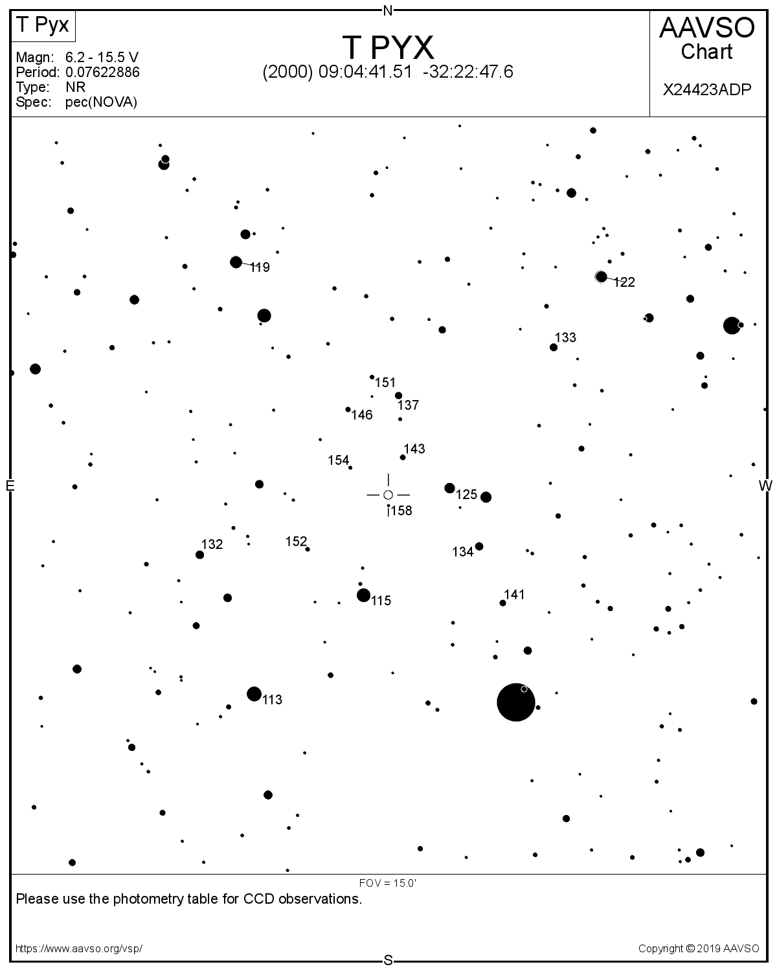
What to test?
Performance of different focal reducers with different focal reducer to camera spacing
Standardised camera settings on a known variable star field.

Slide 11
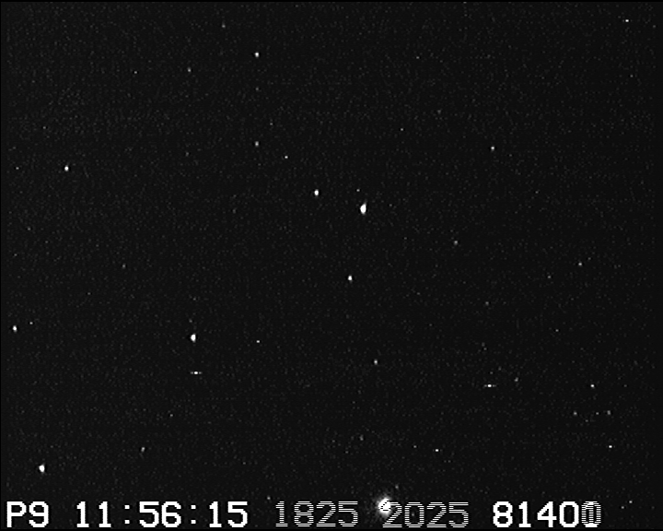
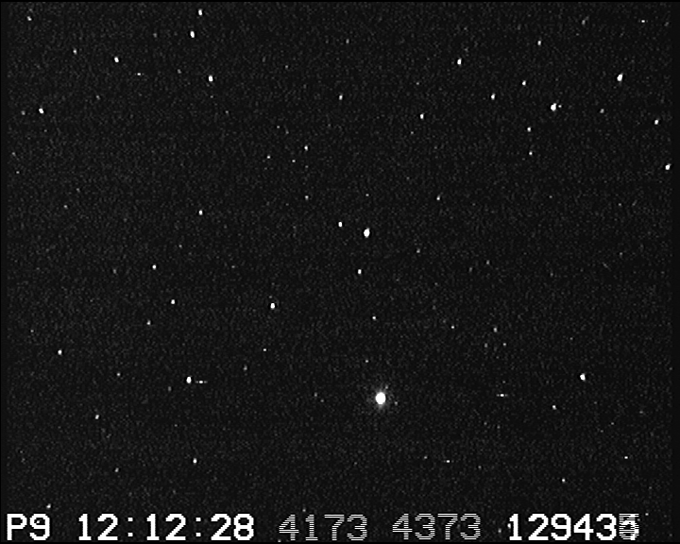
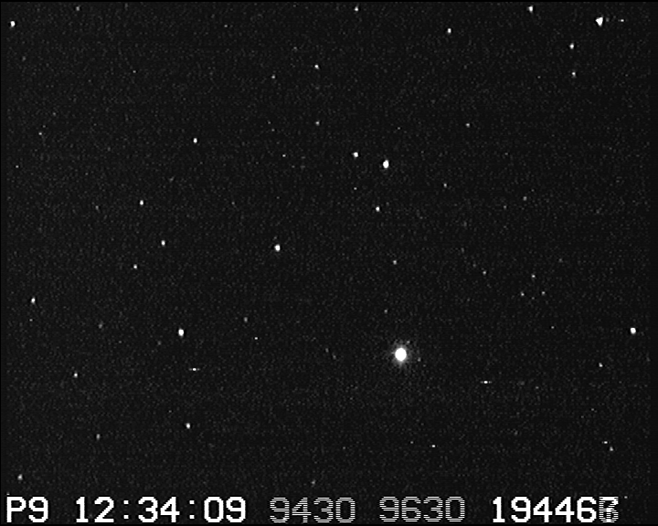
T Pyx – 30cm Meade LX200 ACF OTA – Watec 910BD
16x (8 Frame) Integration - Gain = 32 dB – Gamma = 0.45
Meade f/6.3 with spacer
Meade f/3.3 with spacer
Knight Owl with short spacer

Slide 12
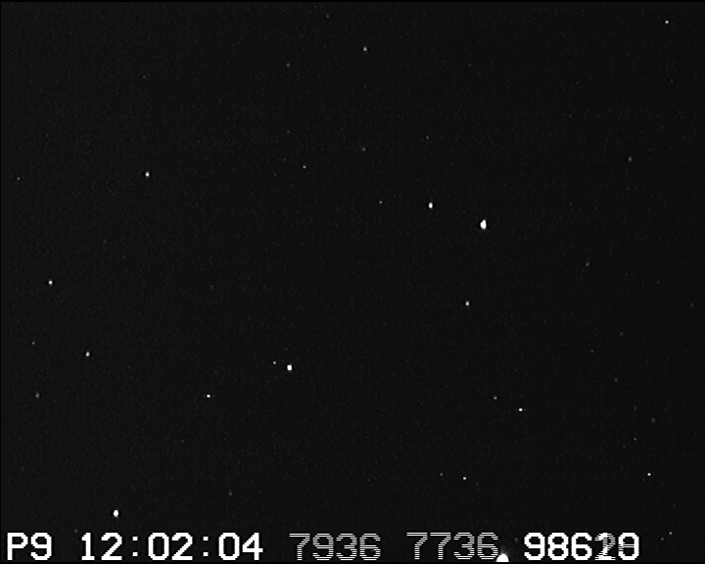
T Pyx – 30cm Meade LX200 ACF OTA – Watec 910BD
16x (8 Frame) Integration - Gain = 32 dB – Gamma = 0.45
Meade f/6.3 with spacer
Meade f/6.3 with smaller spacer

Slide 13
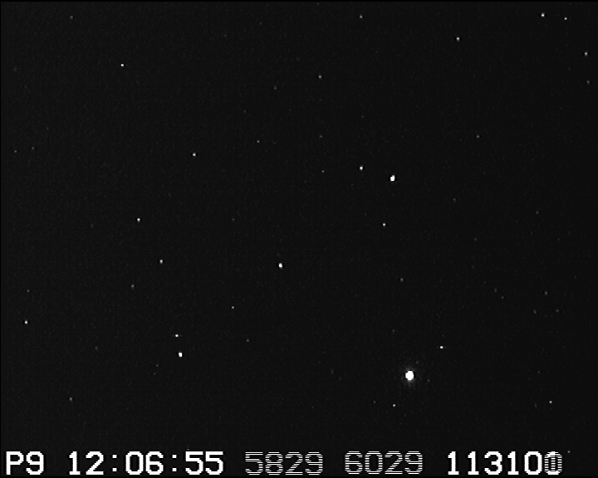
T Pyx – 30cm Meade LX200 ACF OTA – Watec 910BD
16x (8 Frame) Integration - Gain = 32 dB – Gamma = 0.45
Meade f/3.3 with spacer
Meade f/3.3 with smaller spacer

Slide 14
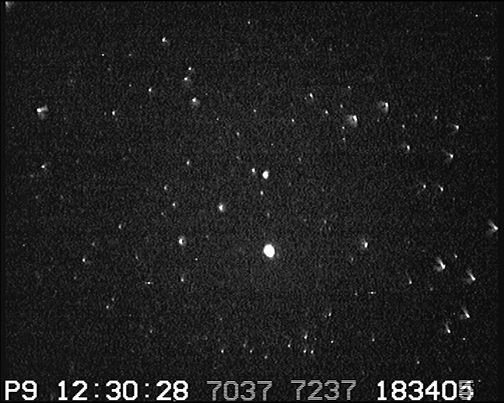
T Pyx – 30cm Meade LX200 ACF OTA – Watec 910BD
16x (8 Frame) Integration - Gain = 32 dB – Gamma = 0.45
Knight Owl with short spacer
Knight Owl with longer spacer

Slide 15
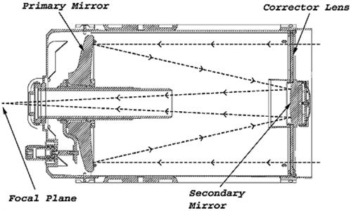
Conclusions?
Optical spacing of camera from focal reducer may be more important than which focal reducer you use.
Using extreme values of focal reducer to camera spacing is forcing the focus (primary mirror location) of the SCT into extreme positions to reach a focus.
Is this resulting in shadowing by the light baffle?
Image from Celestron.com

Slide 16
Things I should have checked
How does this compare to f/10 … i.e. no focal reducer?
Can extreme primary mirror locations be compensated by changing the mounting position of the focal reducer/camera combination? (might resolve if extreme primary mirror locations is really an issue or not)
Does different optical settings lead to different ideal camera settings …so comparing images with the same camera settings is not reflecting the actual observing potential.

Slide 17
Questions?
I may not have any answers …

