Slide 1
Using JPL-Horizons for:
Last-minute updates and
General predictions
Dave Herald

Slide 2
1. Last-minute updates
It can be useful to generate a ‘last-minute’ update using JPL-Horizons
Advantages
  uses latest available astrometry
  Horizons is slowly incorporating Gaia observations
Biggest advantage – comparing with MPC and Astorb path predictions, you might get a sense of expected path movement.

Slide 3
Presentation
The following slides show the simple steps to follow in Occult
Will use an occultation by (664) Judith on 2020 Mar 29 as the example
I will conduct the search against the Occult Gaia catalogue (which is download #40 or #41 in Occult)

Slide 4
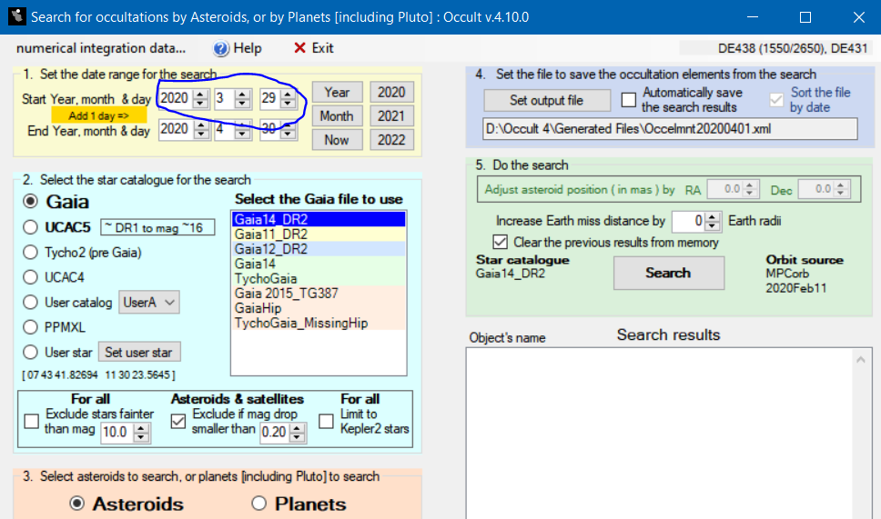
Step 1
Open the Occult Search form, and specify the date of the event

Slide 5
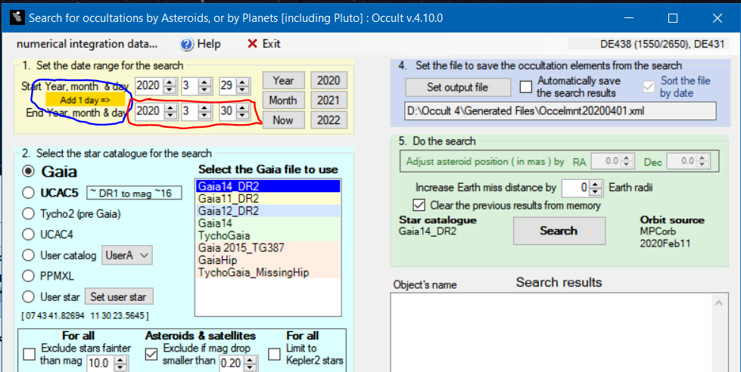
Step 2
Click the ‘Add 1 day’ button, to set the search range one day later

Slide 6
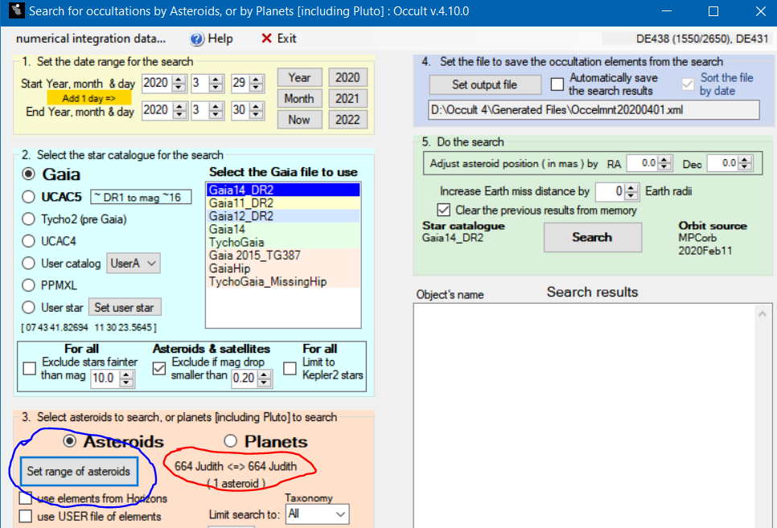
Step 3
Select the asteroid (it must be one only)

Slide 7
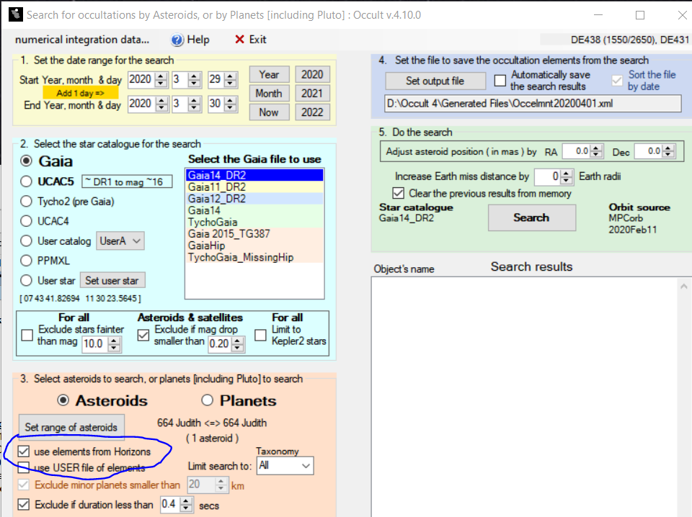

Step 4
Get the orbital elements from Horizons by clicking the check box. A downloading message will appear while the elements are being retrieved [You must be connected to the internet….]

Slide 8
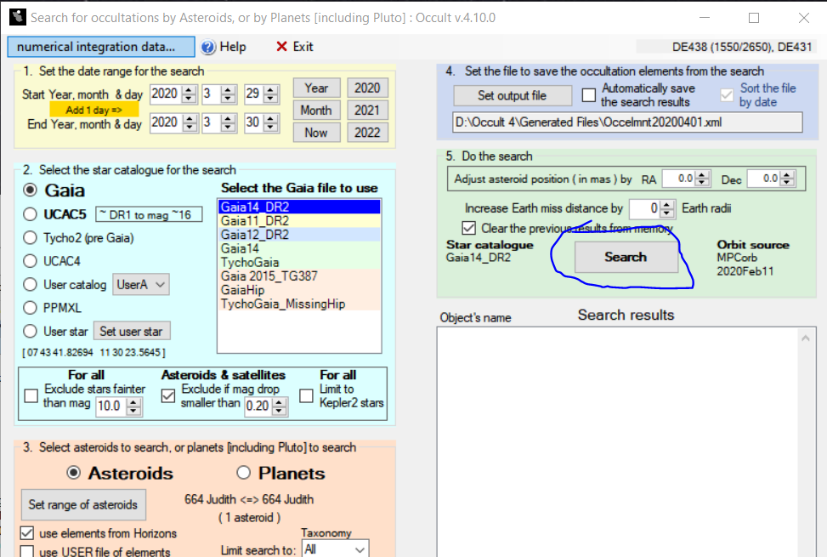
Step 5
Now conduct the search in the usual way – by clicking Search button

Slide 9
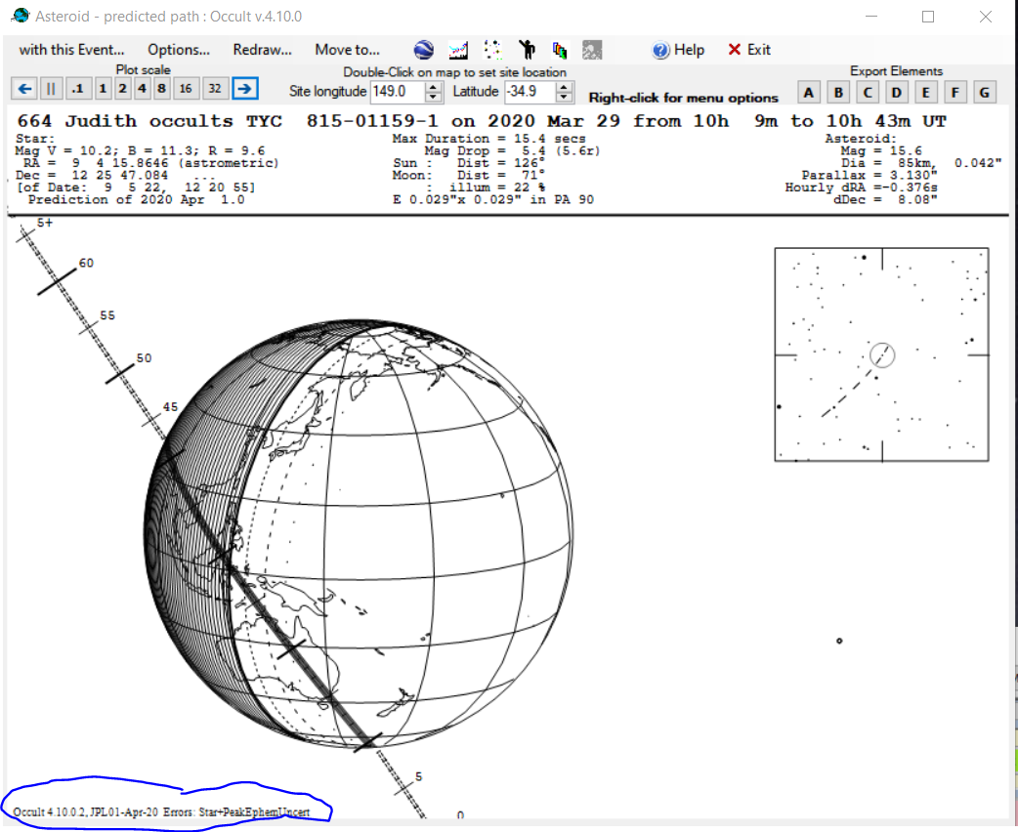

Final result
The search will generate the usual prediction using JPL Horizons – as in:
The fact that Horizons has been used, and the download date, are listed at the bottom of the plot

Slide 10
2. General predictions
You can use Horizons to generate predictions generally
This is done using the UserElements file
The following slides will step through the process

Slide 11
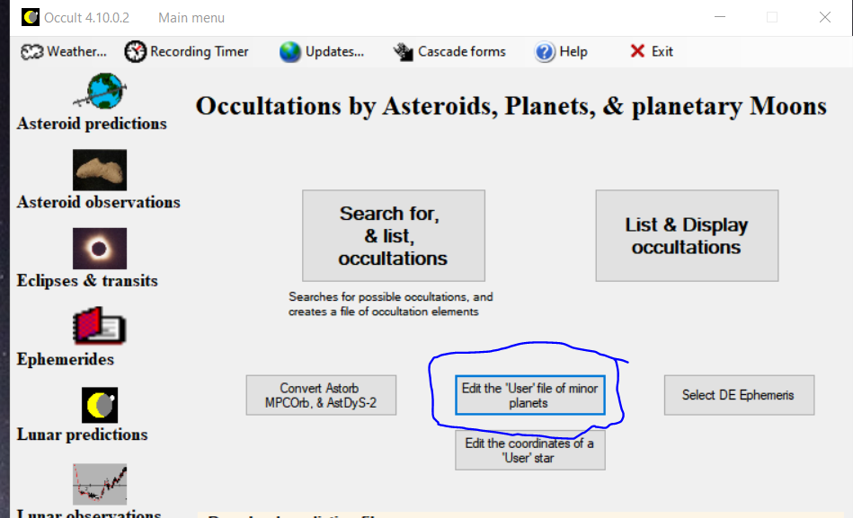
Step 1
Open the ‘User’ file of elements

Slide 12
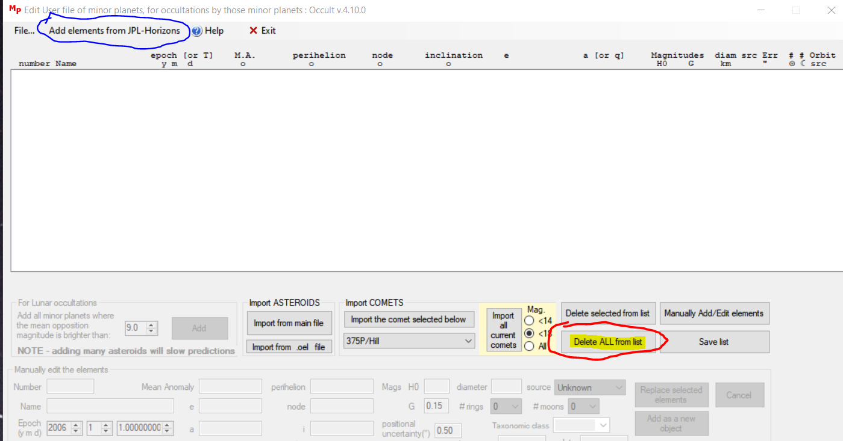
Step 2
Clear all elements from the list; then
Click Add elements from JPL-Horizons

Slide 13
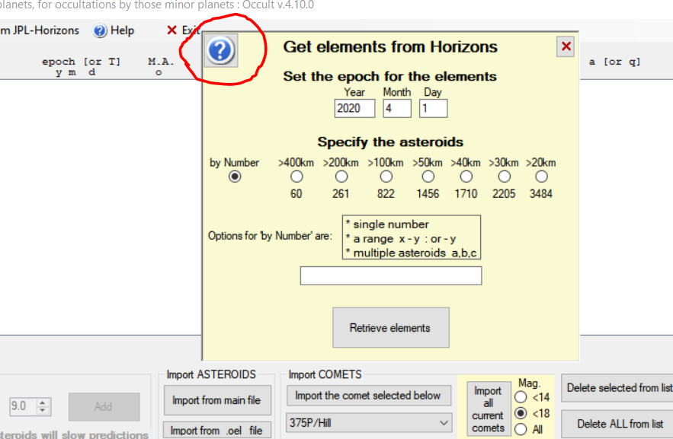
Step 3
Click the Help on the form, and read it!

Slide 14
Some background info
The elements are downloaded one-by-one
The asteroids to be downloaded are identified by:
  number, or a series of numbers;
  a range of numbers; or
  Being larger than a selected diameter
    The selection is based on your current file of asteroid elements, as converted from MPCORB, Astorb or AstDyS-2.

Slide 15
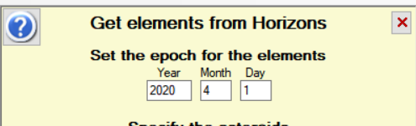
Step 4
Set the selection criteria
Set the epoch for the elements. These should be for about the midpoint of your search period. [It’s best you work on a period not much greater than a month]
Then select the asteroids…..

Slide 16
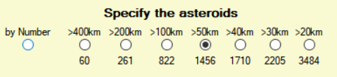
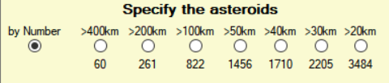
Selection by diameter
Form lists the number of asteroids for each selection. In this example, asteroids larger than 50km are selected - and there are 1456 such asteroids
To retrieve asteroids by number rather than diameter, check ‘by Number’

Slide 17
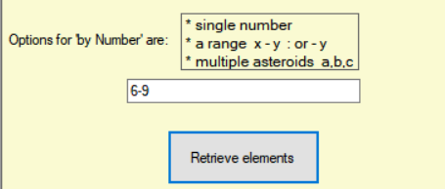
Selection by number(s)
Valid inputs are:
  A single number
  Multiple asteroids, such as a, b, c
  A range, such as x – y, or -y
However (c) can’t be used with (a) or (b)

Slide 18
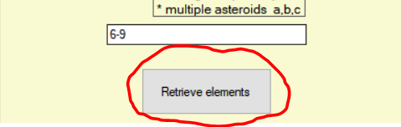
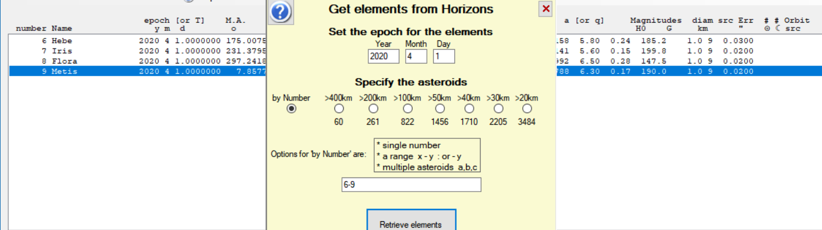
Step 5 Download the elements
a box will appear showing each asteroid as it is
downloaded. The elements will appear in the User Elements list as every 10 are downloaded;
When the download is finished, the elements are automatically saved. Click the X in the Horizons box to close it, then exit the User File editor in the usual way

Slide 19
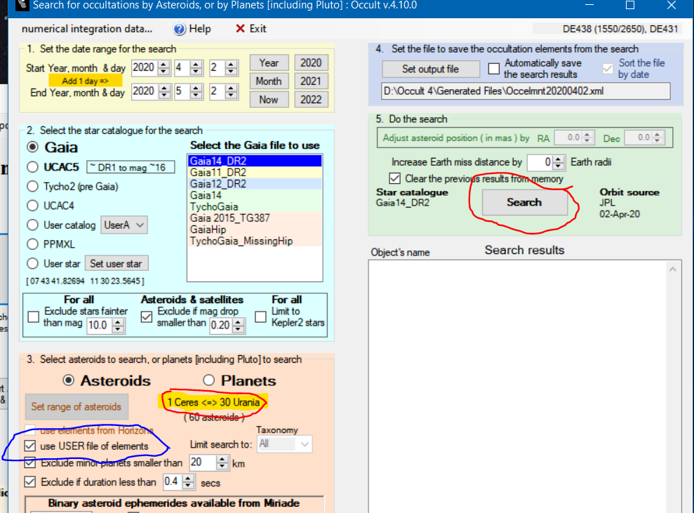
Step 6 Do the Search
Check use USER file of elements. The first and last asteroid in the file will be listed
Click Search in the usual way

Slide 20

Questions?

