Slide 1
NASA New Horizons Parallax Educational Outreach Program
Bill Hanna
Columbia Falls, Montana
TTSO14 Online
Monday 13 April 2020
Notes:
xxx

Slide 2
Topics
NASA Educational Outreach Program
Target Stars for Parallax Determination
Recent Star Images
Related Web Sites For More Information
Notes:
xxx

Slide 3
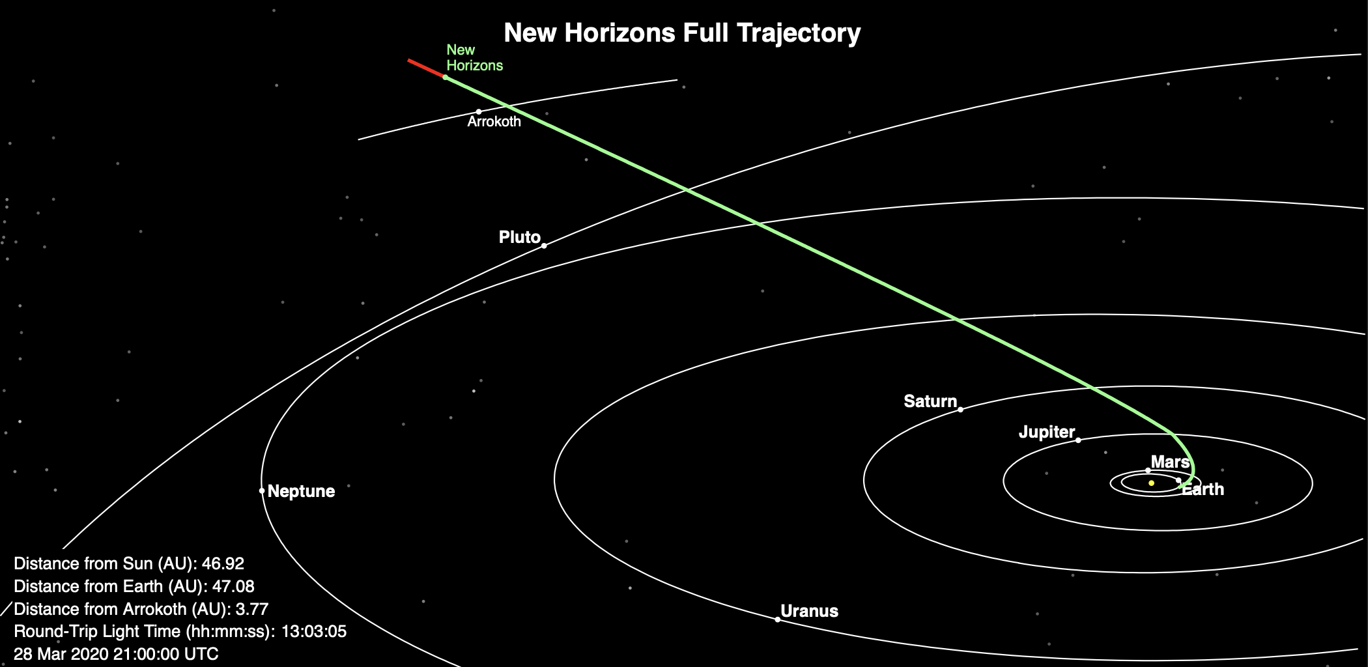
New Horizons is Healthy
NASA
Notes:
xxx

Slide 4
Targets Are Two Nearby Stars
Proxima Centauri
UCAC4 137-116050
14h 29m 28s / -62° 40’ 26” (of date; approximate)
Mag 11.1
4.2 ly
Wolf 359
UCAC4 486-052877
10h 56m 26s / +06° 59’ 28” (of date; approximate)
Mag 13.0
7.9 ly
Notes:
xxx

Slide 5
Proxima Centauri
New Horizons image at 20200422/1300 UT
Yass particulars
Never Sets
0731 UT Sunset
0856 UT End Astronomical Twilight
1300 UT Ideal Image Time (59° @ 160°)
1425 UT Transits
Notes:
xxx

Slide 6
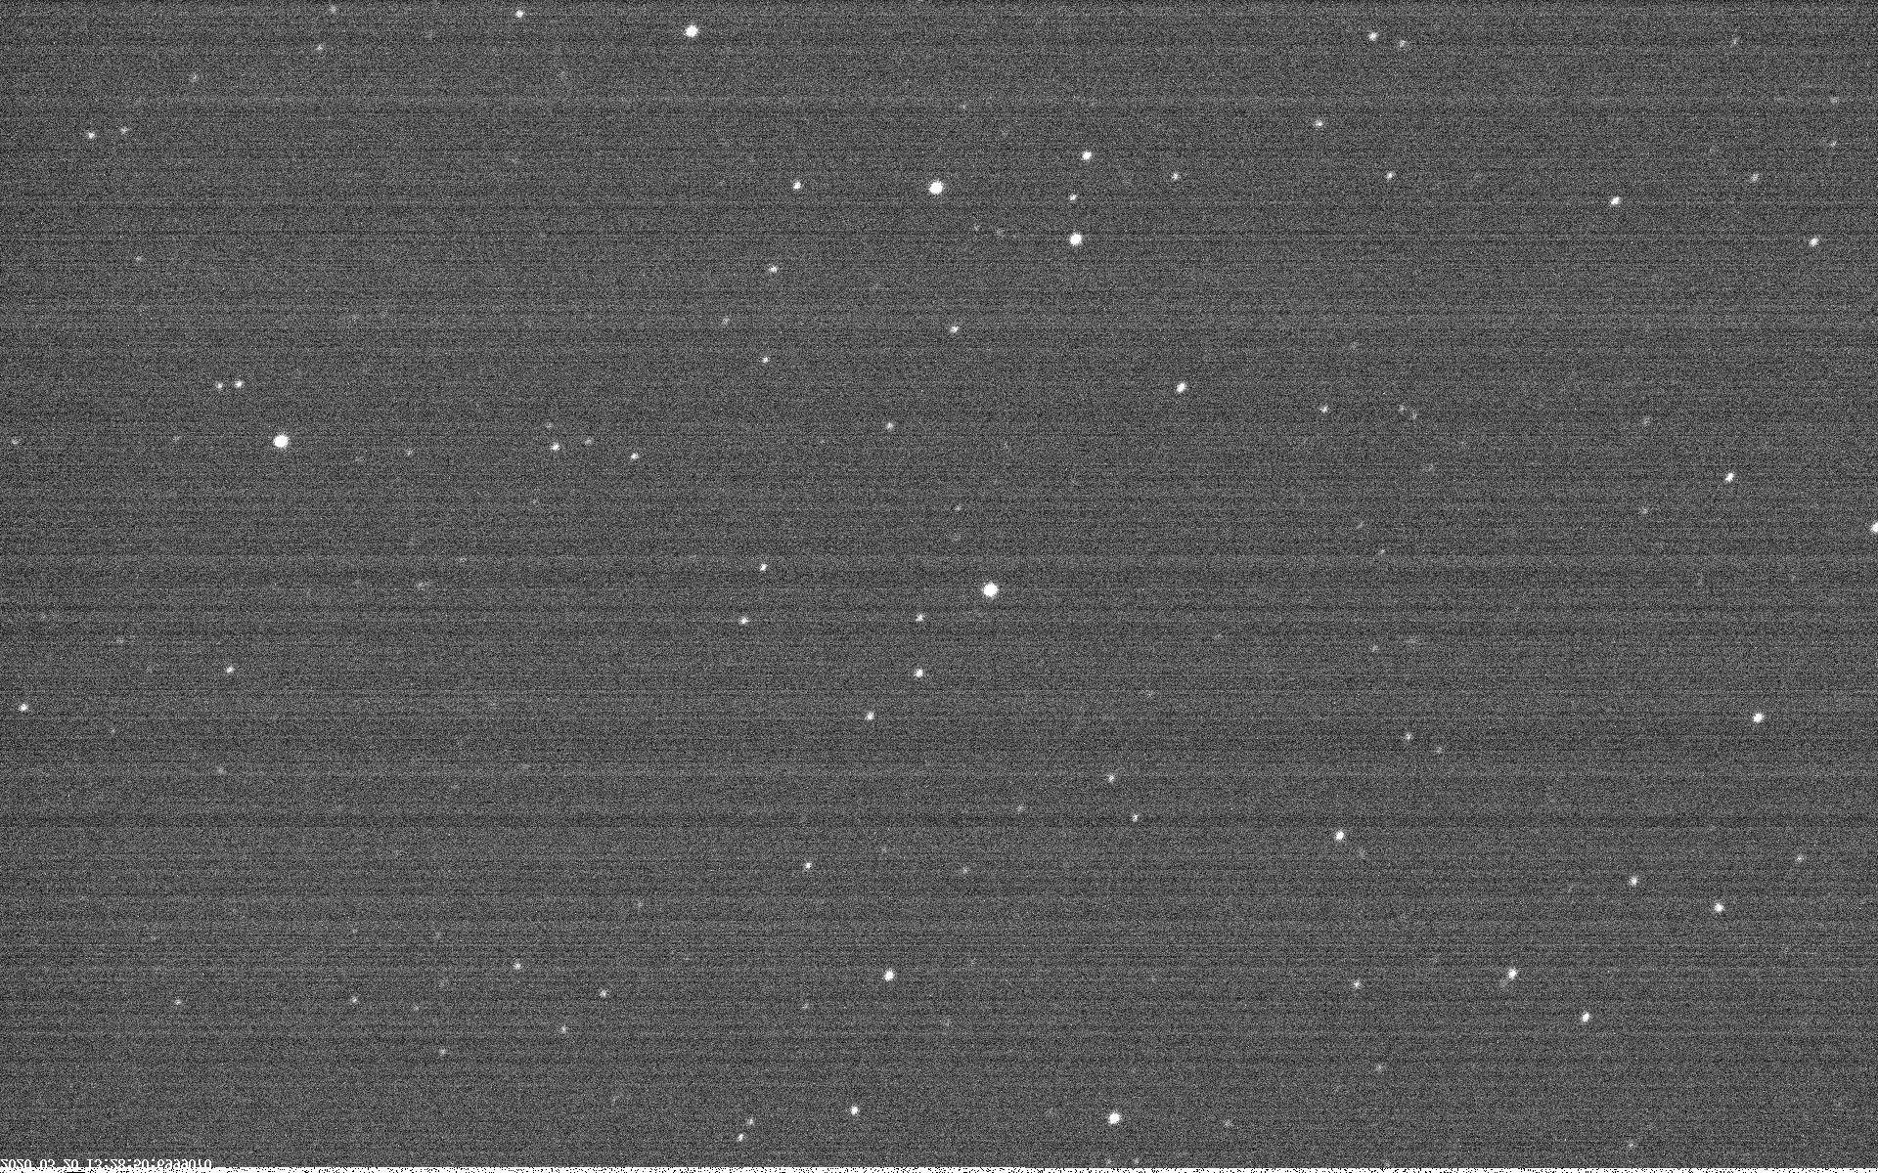
Proxima Centauri (just saturated)
Notes:
xxx

Slide 7
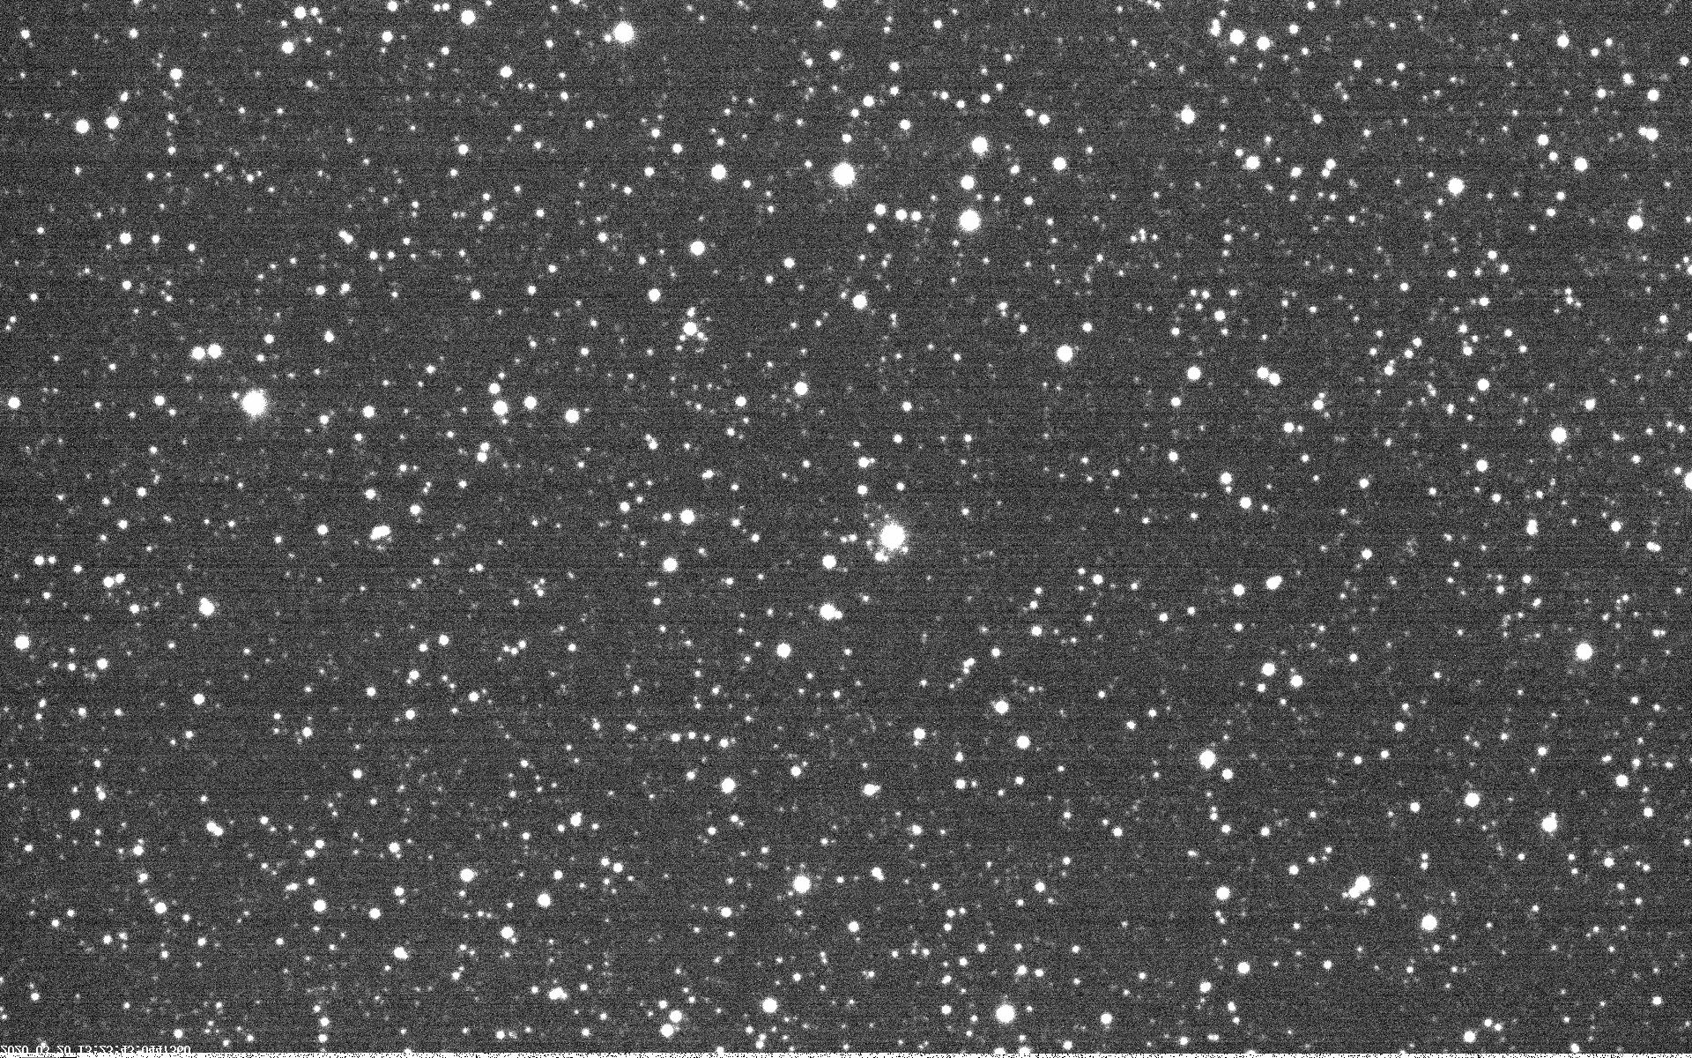
Proxima Centauri (rich field)
Notes:
xxx

Slide 8
Wolf 359
New Horizons image at 20200423/1000 UT
Yass particulars
0511 UT Rises
0731 UT Sunset
0856 UT End Astronomical Twilight
1000 UT Ideal Image Time (46° @ 019°)
1057 UT Transits
1637 UT Sets
Notes:
xxx

Slide 9
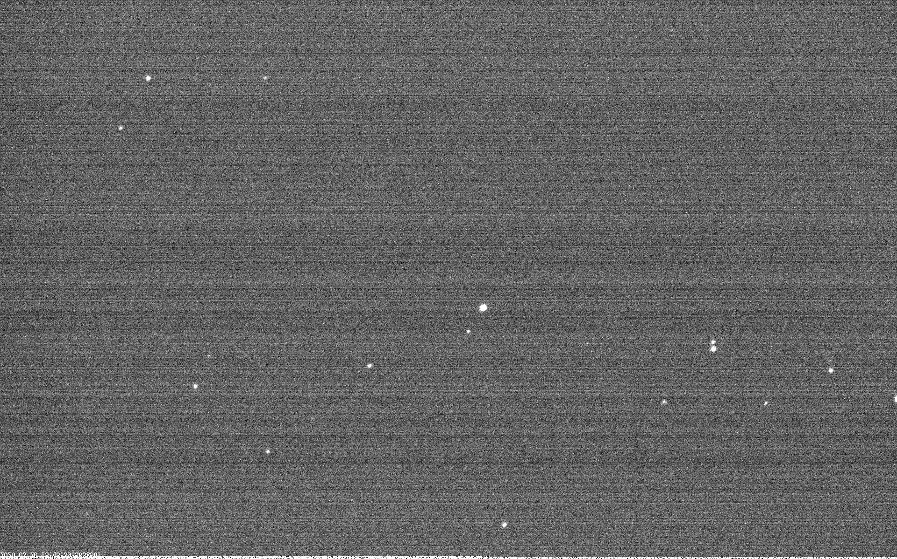
Wolf 359 (just saturated)
Notes:
xxx

Slide 10
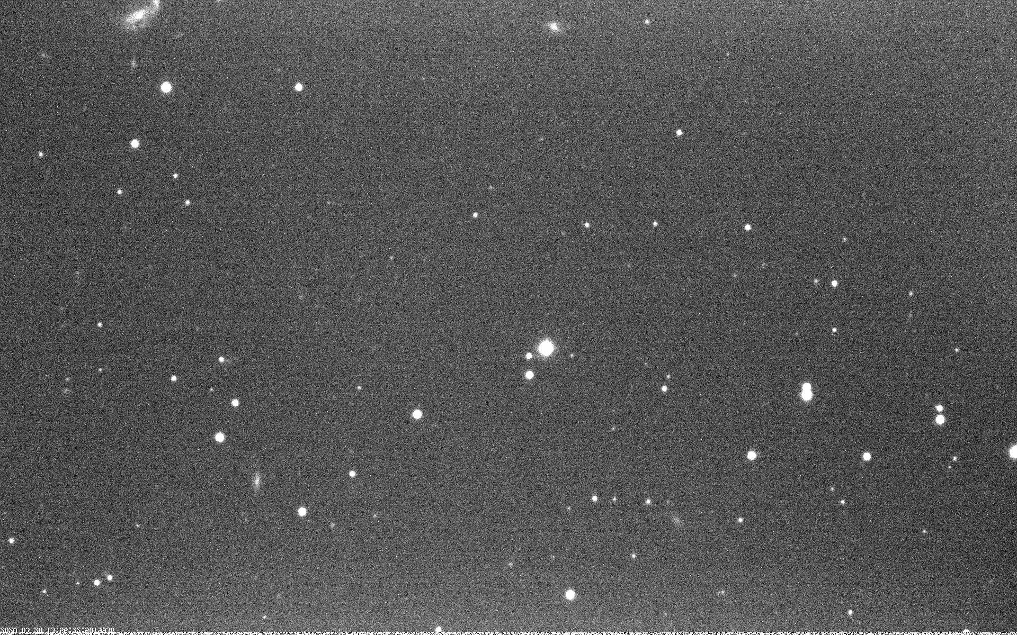
Wolf 359 (rich field)
Notes:
xxx

Slide 11
Related Web Sites
http://pluto.jhuapl.edu/News-Center/News-Article.php?page=20200129
http://pluto.jhuapl.edu/Learn/Get-Involved.php#Parallax-Program
Notes:
xxx

Slide 12
Reporting
Dr. Tod R. Lauer (lauer@noao.edu)
National Optical Astronomy Observatory
Send Images via DropBox (or similar)
Notes:
xxx

Slide 13
Questions?
Notes:
Questions?

