Slide 1
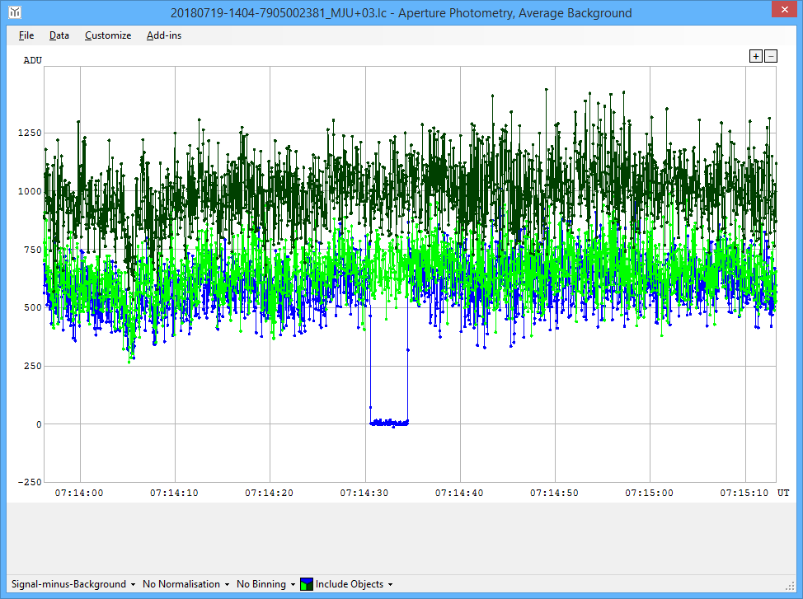
Karearea Observatory Tracking occultations from 45° S
Martin Unwin (RASNZ)
TTSO13, Devon Hotel, New Plymouth, 20-21 May 2019

Slide 2
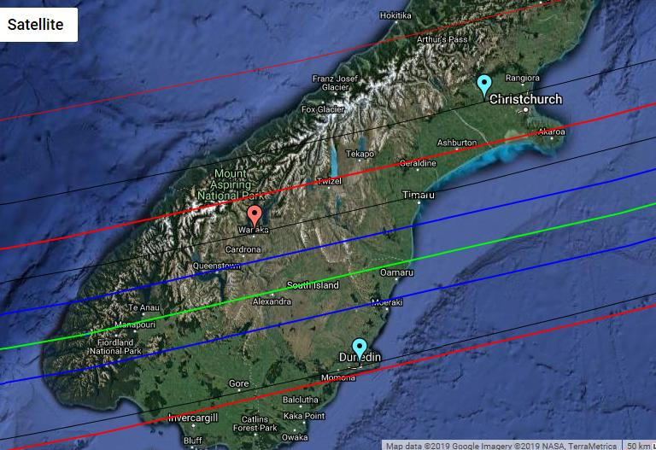
Wanaka: 44° 40′ S, 169° 08′ E
Darfield
Tekapo
Wanaka
Dunedin

Slide 3
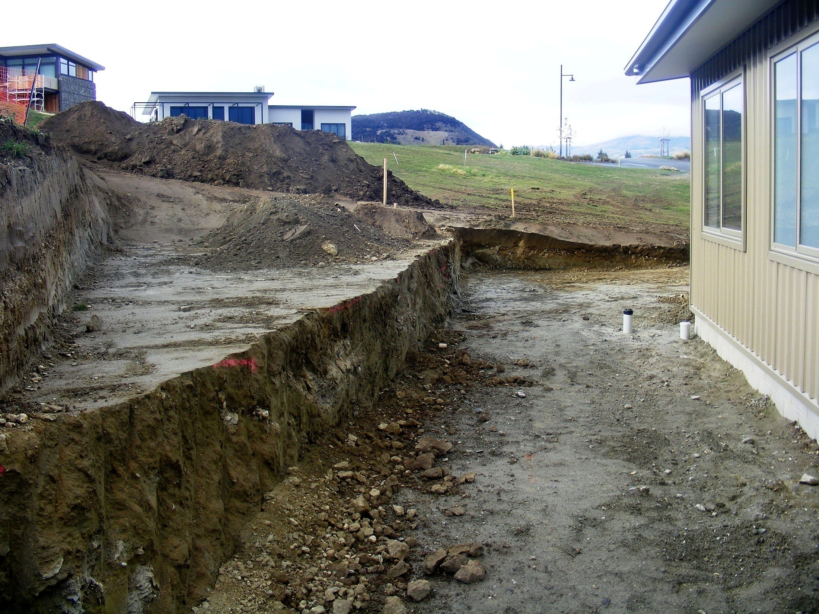
Observatory Site (326 m a.s.l.)
Footprint area ≤ 5 m²
2.236 m square

Slide 4
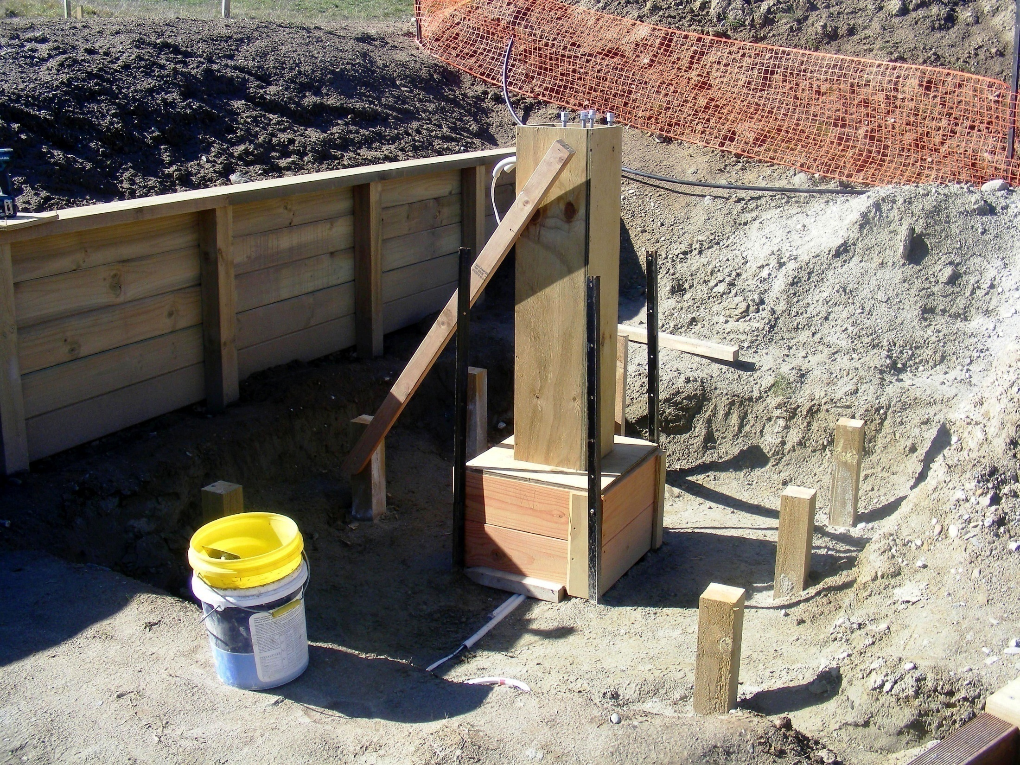

Slide 5
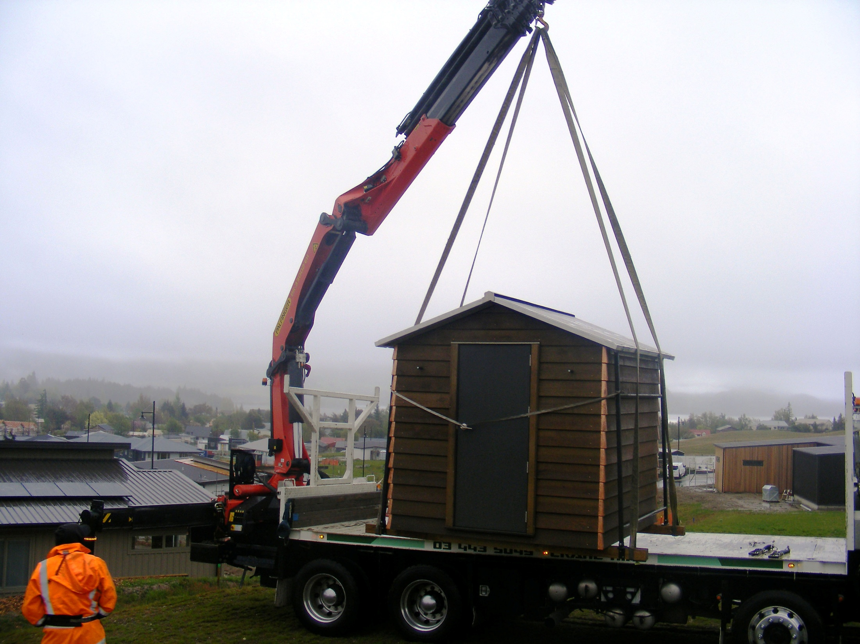

Slide 6
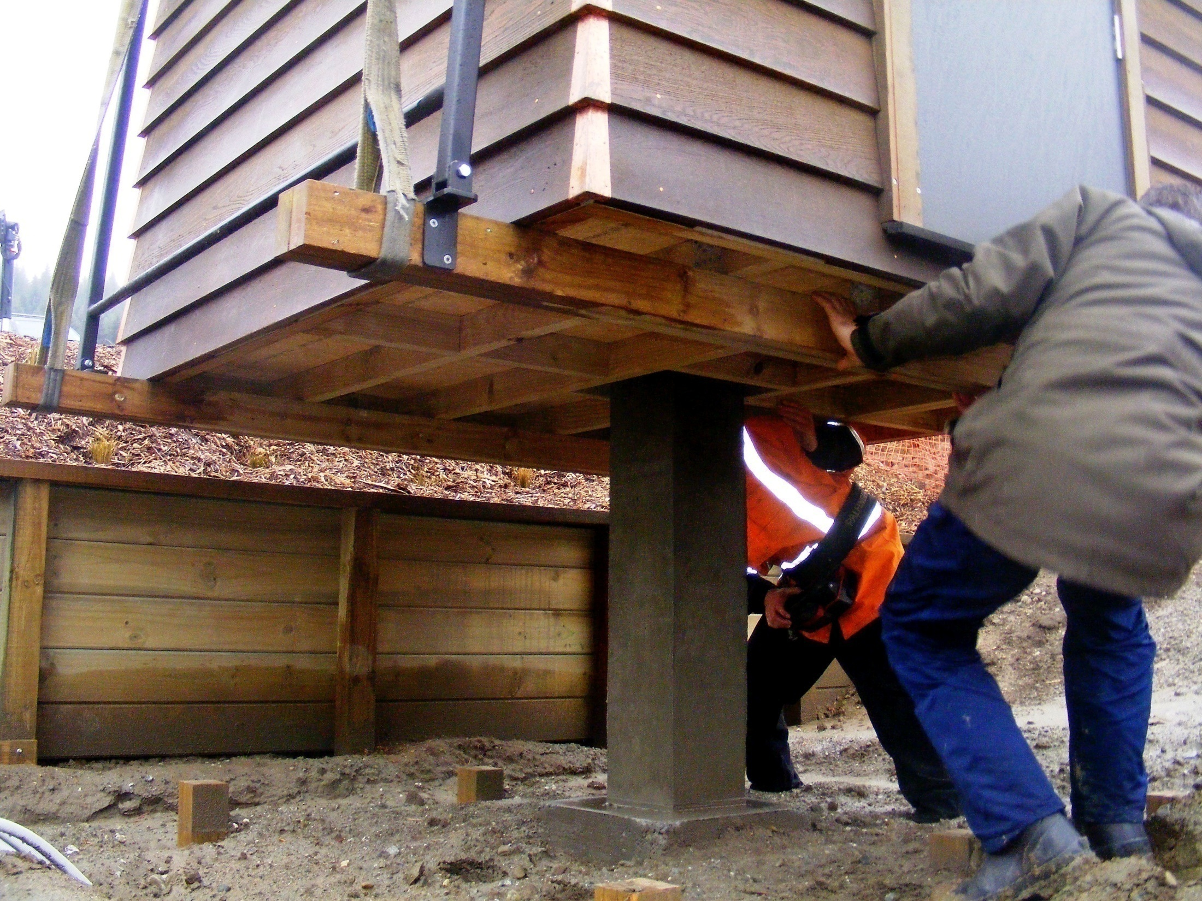

Slide 7
Hardware
Meade 30 cm LX200 (f/10)
Skywatcher AZ-EQ6 mount
SYNSCAN hand controller
Watec-910BD-TACOS camera & controller
courtesy Dave Gault / Dave Herald
0.63 focal reducer
IOTA VTI

Slide 8
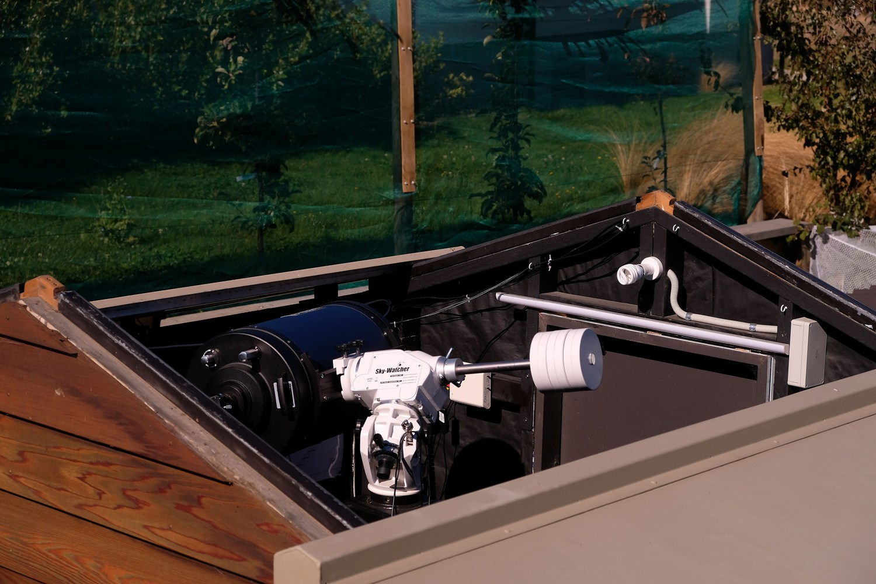

Slide 9
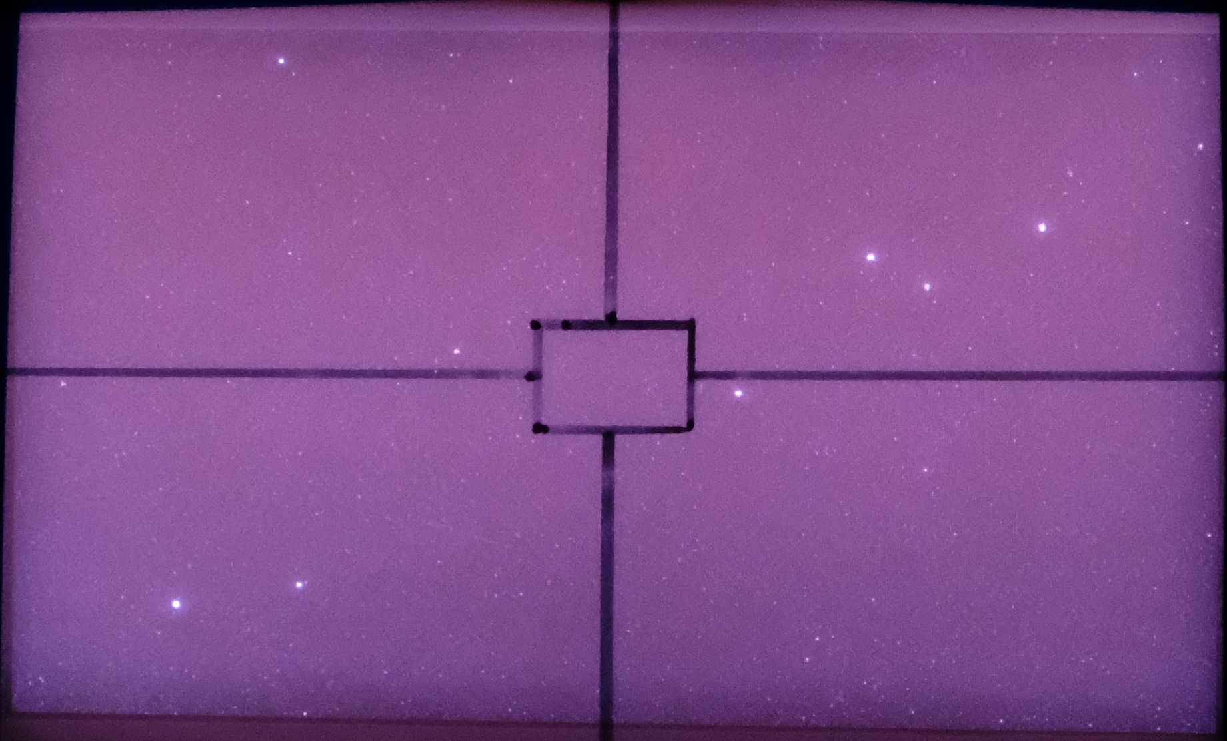
Finder FOV: 1° 34′ x 1° 07′ Watec 910BD FOV: 10.9′ x 8.0′
93
93
88
98
97

Slide 10
Software
Guide 9.1 (with UCAC4)
ASCOM drivers (not currently in use)
VirtualDub
low integration rates (≤ 8x)
OccuRec
higher integration rates (≥ 8x)
Tangra
Occult Watcher

Slide 11
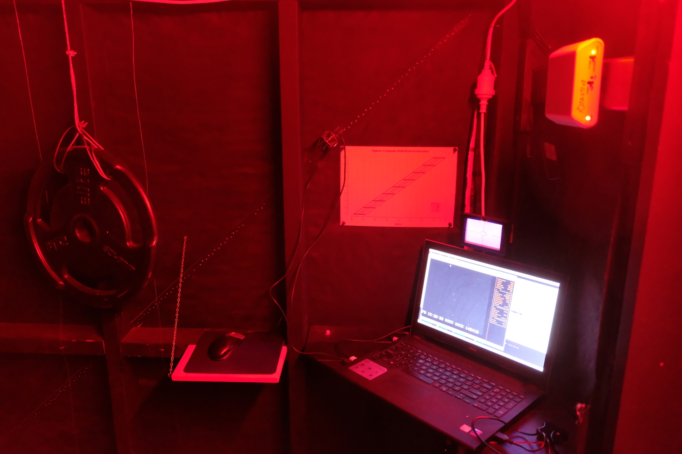

Slide 12
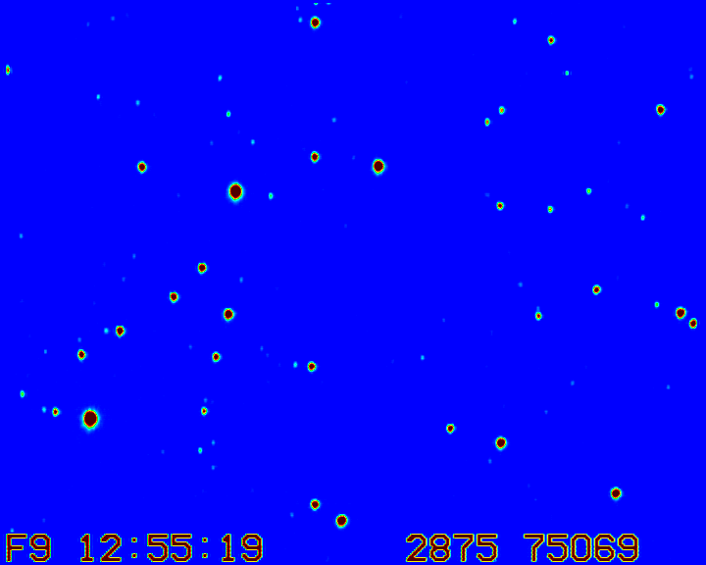
Limiting mag at 8x ≈ 14.2
139
139
149
146
141

Slide 13
2018 Scorecard
32 events yielding a video record
4 events clouded out after video started
1 event lost due to OccuRec problem
22 misses
5 positives
3 main belt asteroids (23 attempts)
2 Trojans/Centaurs (6 attempts)
0 TNOs (3 attempts)

