Slide 1
Some Upcoming Occultations
Things to look forward to for the rest of 2020 and into 2021
vTTSO14

Slide 2
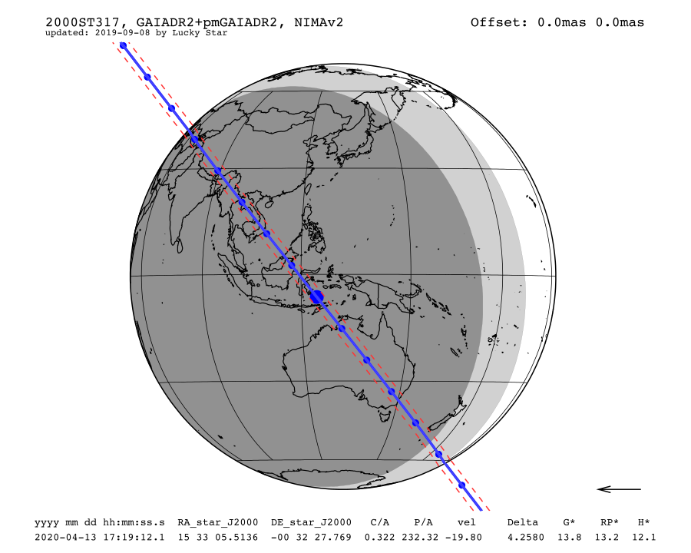
Date | Mon. 13 Apr. 2020 17:19:12
Star position (ICRF) | 15 33 05.5136 -00 32 27.769
C/A | 0.322 arcsec
P/A | 232.32 °
velocity | -19.80 km/s
Geocentric distance Δ | 4.2580 au
G mag* | 13.8
RP mag* | 13.2
H mag* | 12.1
Magnitude drop | 4.4
Uncertainty in time | 4.9 sec
Uncertainty in C/A | 55.7 mas
Uncertainty in projected distance | 171.9 km
Probability of occultation on centrality | 9.0%
Maximum duration | 2.0 sec
Moon distance to the object | 51.0°
Fraction of illuminated Moon | 62.8 %
Solar elongation | 147.5°

Slide 3
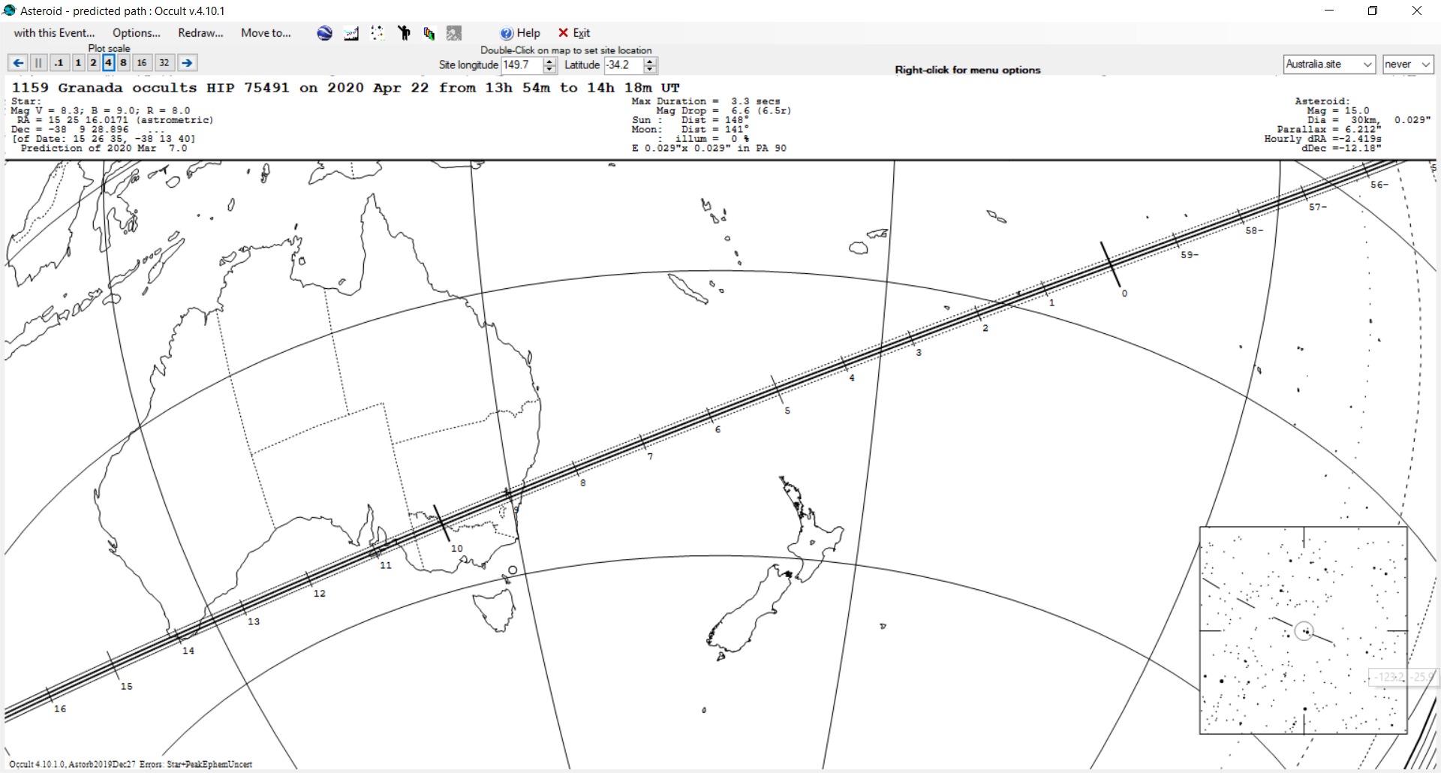

Slide 4
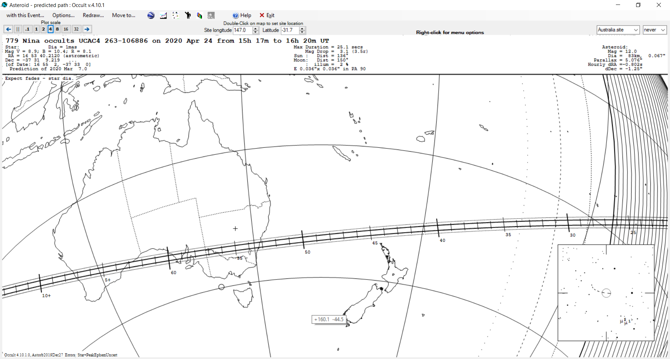

Slide 5
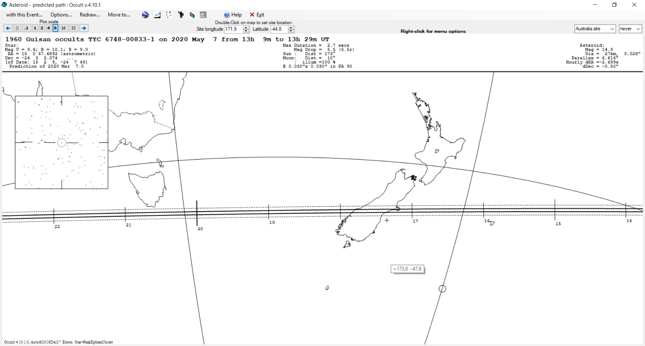

Slide 6
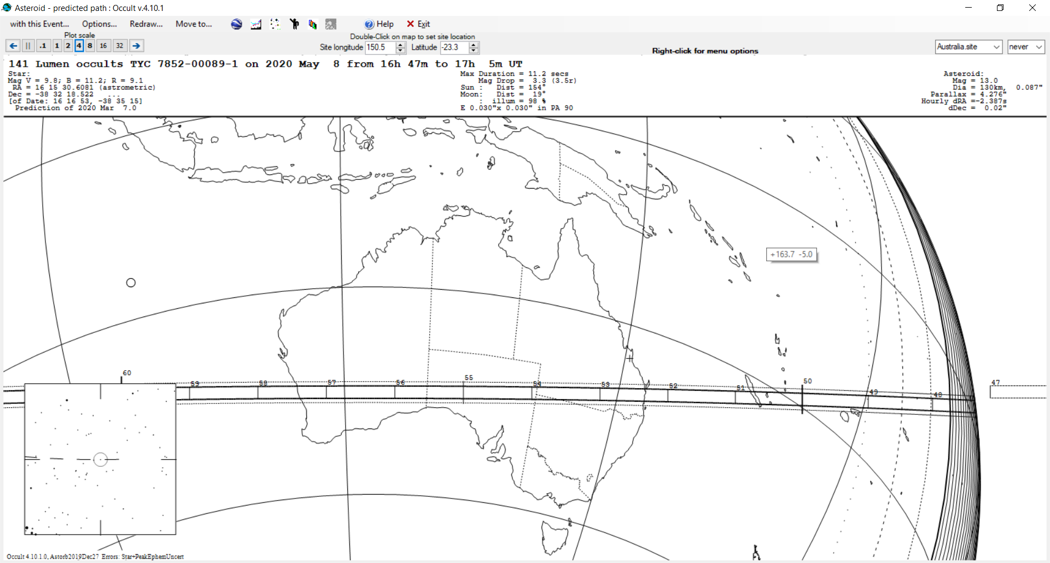

Slide 7
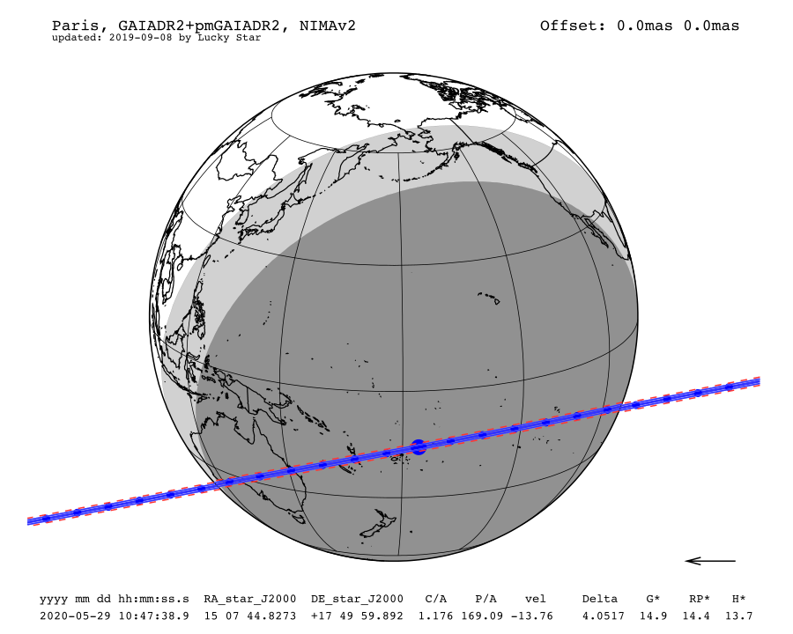
Date | Fri. 29 May. 2020 10:47:38
Star position (ICRF) | 15 07 44.8273 +17 49 59.892
C/A | 1.176 arcsec
P/A | 169.09 °
velocity | -13.76 km/s
Geocentric distance Δ | 4.0517 au
G mag* | 14.9
RP mag* | 14.4
H mag* | 13.7
Magnitude drop | 0.8
Uncertainty in time | 7.4 sec
Uncertainty in C/A | 15.4 mas
Uncertainty in projected distance | 45.4 km
Probability of occultation on centrality | 81.0%
Maximum duration | 8.6 sec
Moon distance to the object | 70.3°
Fraction of illuminated Moon | 42.3 %
Solar elongation | 136.3°

Slide 8
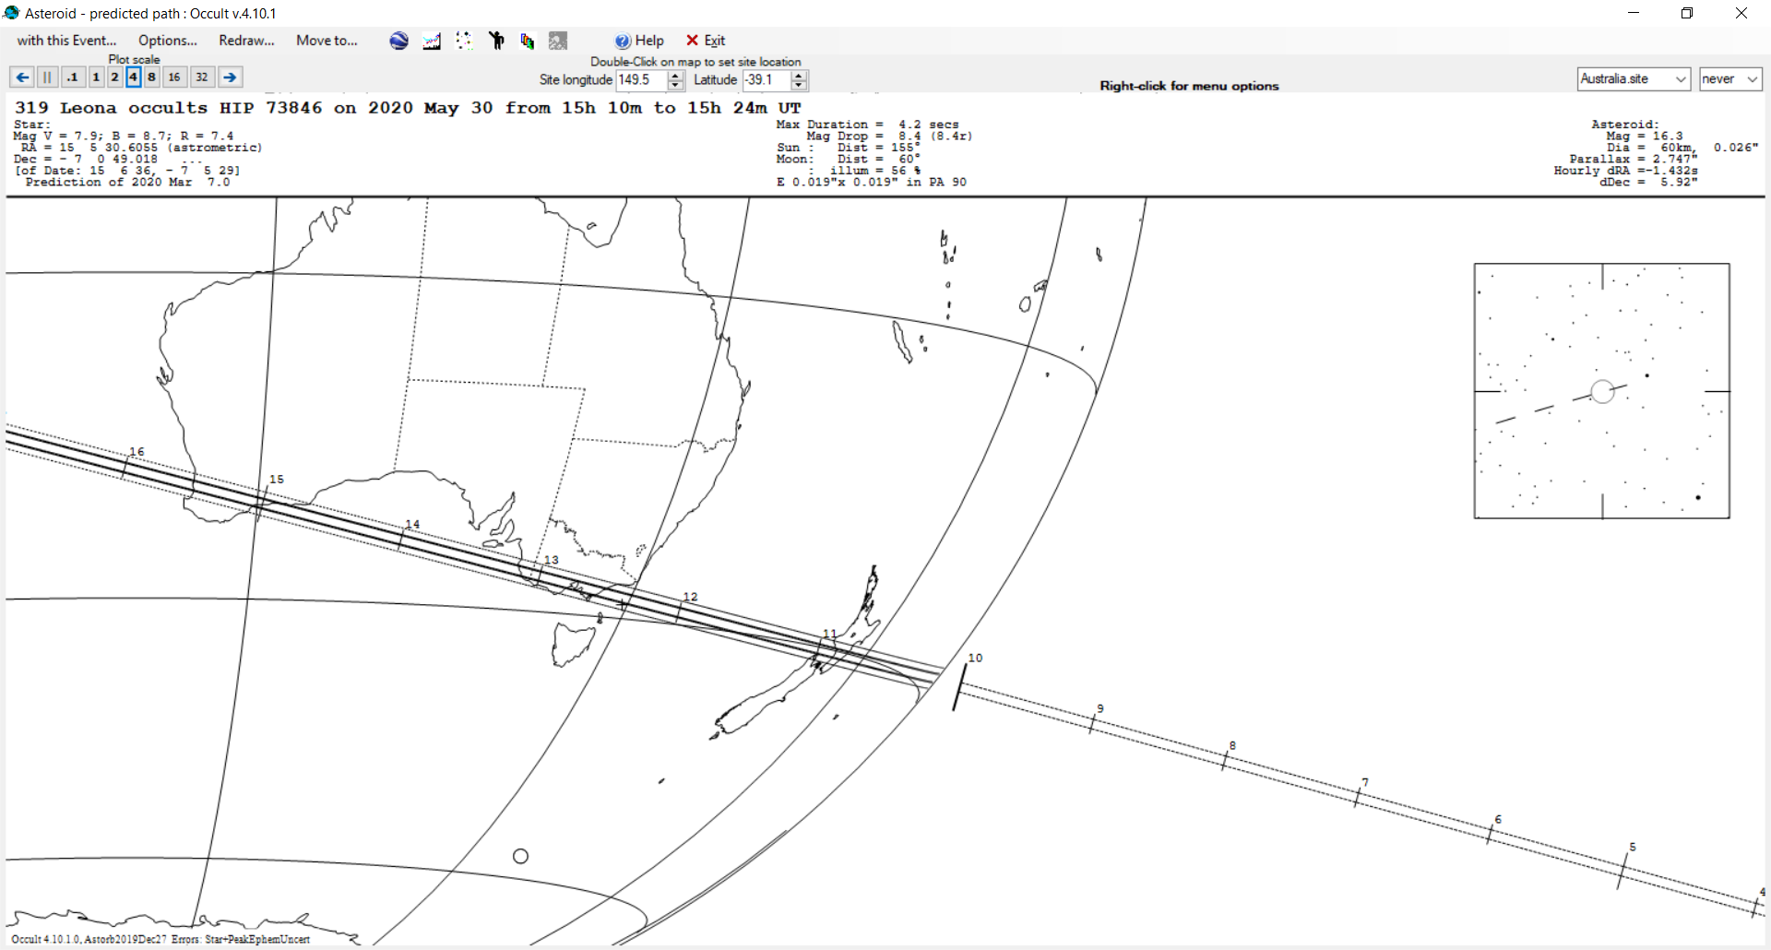

Slide 9
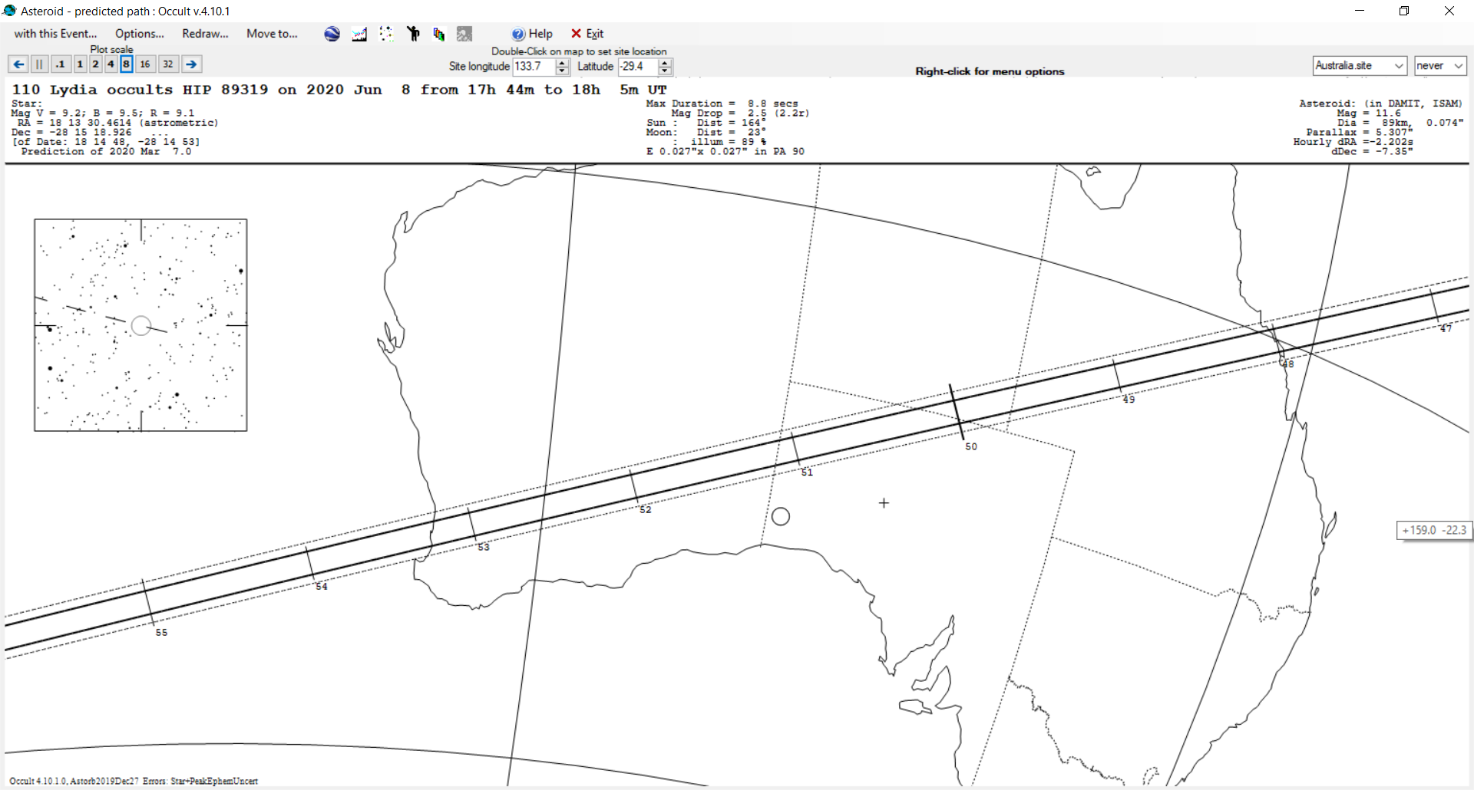

Slide 10
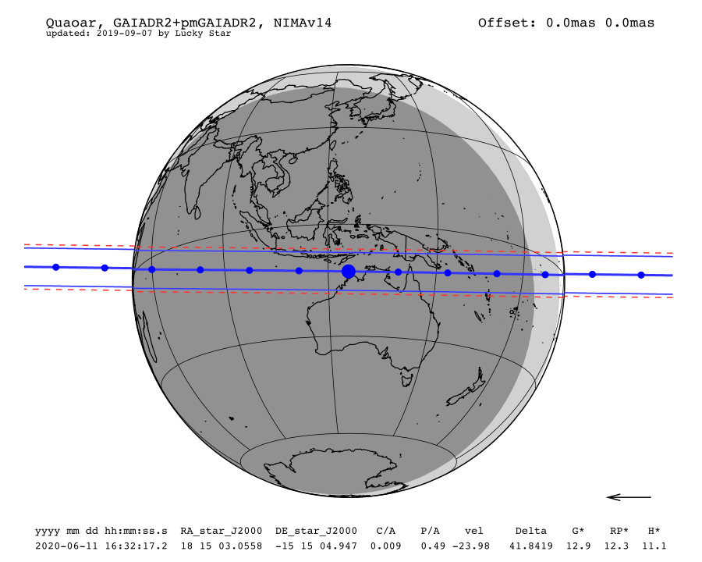
Date | Thu. 11 Jun. 2020 16:32:17
Star position (ICRF) | 18 15 03.0558 -15 15 04.947
C/A | 0.009 arcsec
P/A | 0.49 °
velocity | -23.98 km/s
Geocentric distance Δ | 41.8419 au
G mag* | 12.9
RP mag* | 12.3
H mag* | 11.1
Magnitude drop | 6.1
Uncertainty in time | 5.6 sec
Uncertainty in C/A | 3.3 mas
Uncertainty in projected distance | 101.1 km
Probability of occultation on centrality | 100.0%
Maximum duration | 46.3 sec
Moon distance to the object | 60.9°
Fraction of illuminated Moon | 65.2 %
Solar elongation | 164.6°

Slide 11
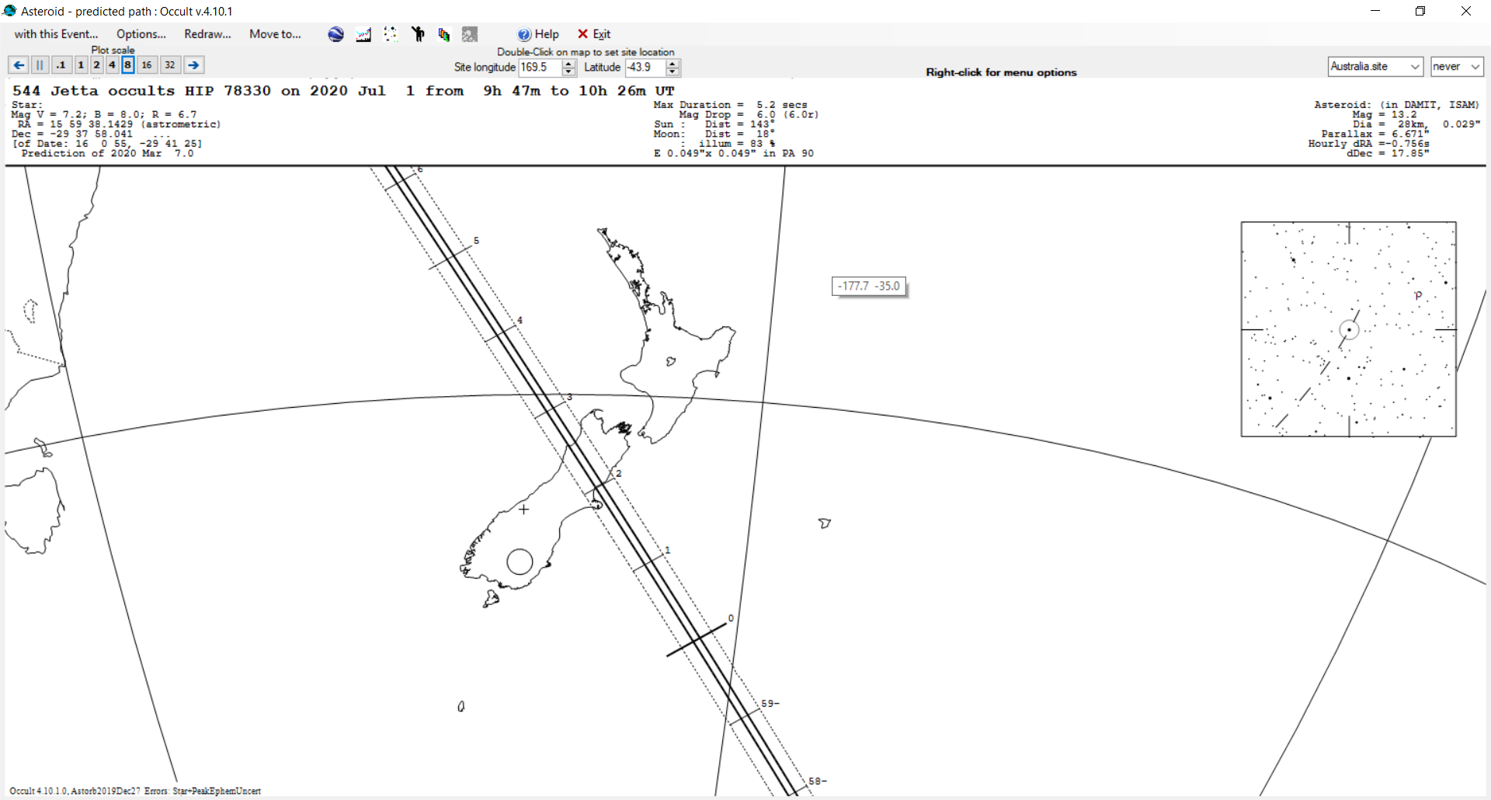

Slide 12
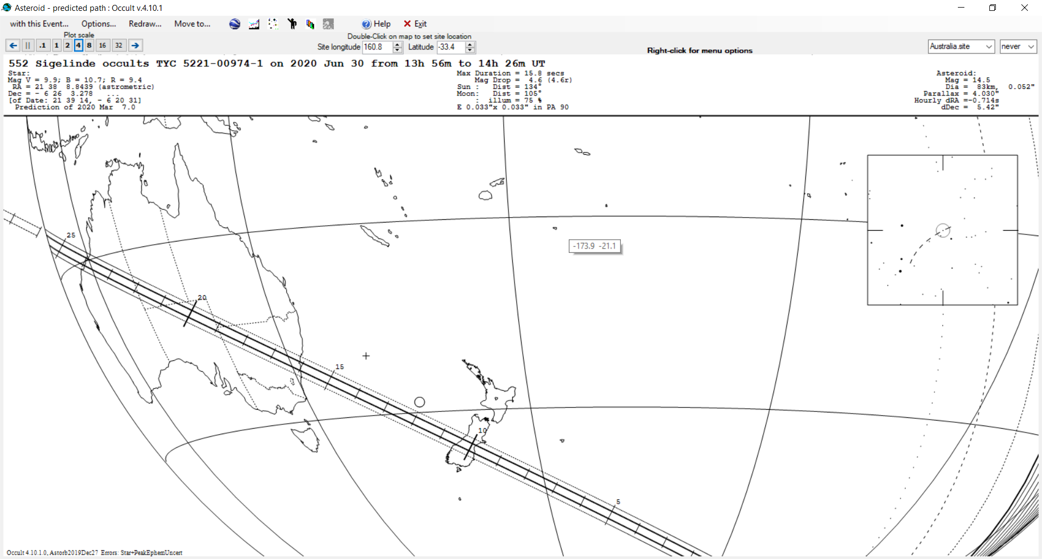

Slide 13
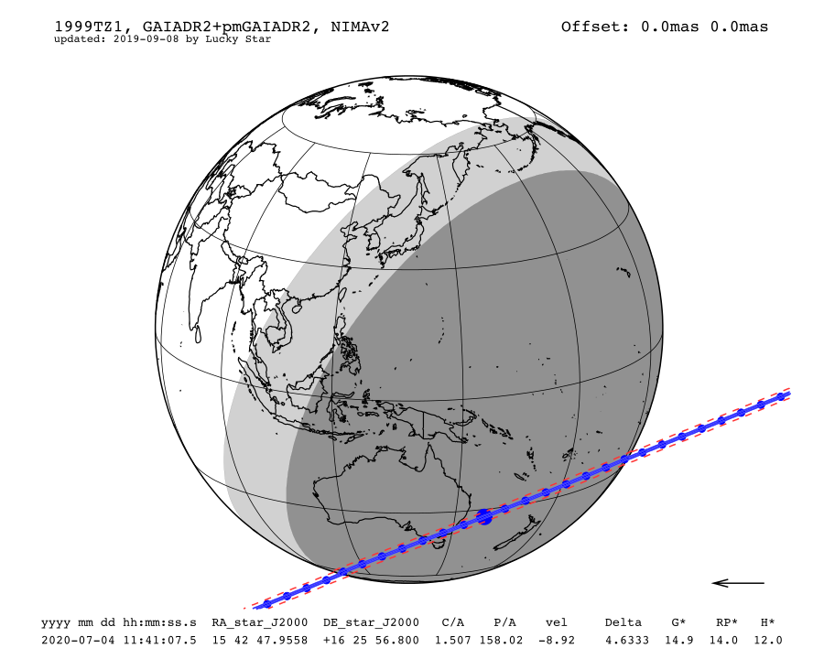
Date | Sat. 4 Jul. 2020 11:41:07
Star position (ICRF) | 15 42 47.9558 +16 25 56.800
C/A | 1.507 arcsec
P/A | 158.02 °
velocity | -8.92 km/s
Geocentric distance Δ | 4.6333 au
G mag* | 14.9
RP mag* | 14.0
H mag* | 12.0
Magnitude drop | 1.9
Uncertainty in time | 17.8 sec
Uncertainty in C/A | 25.4 mas
Uncertainty in projected distance | 85.2 km
Probability of occultation on centrality | 28.4%
Maximum duration | 6.9 sec
Moon distance to the object | 55.0°
Fraction of illuminated Moon | 99.4 %
Solar elongation | 118.9°

Slide 14
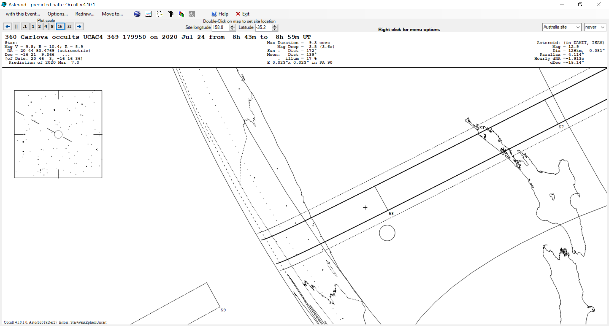

Slide 15
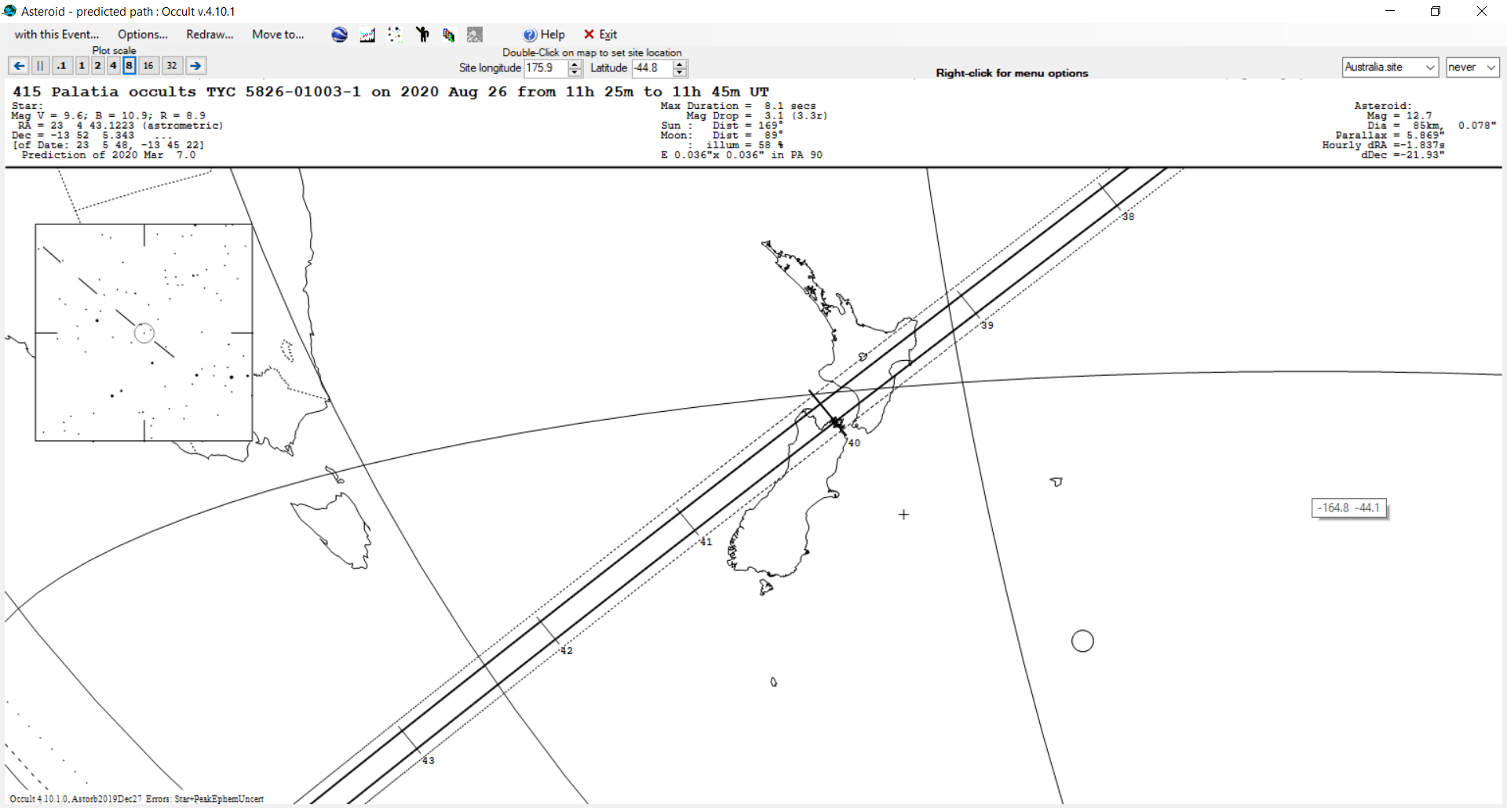

Slide 16
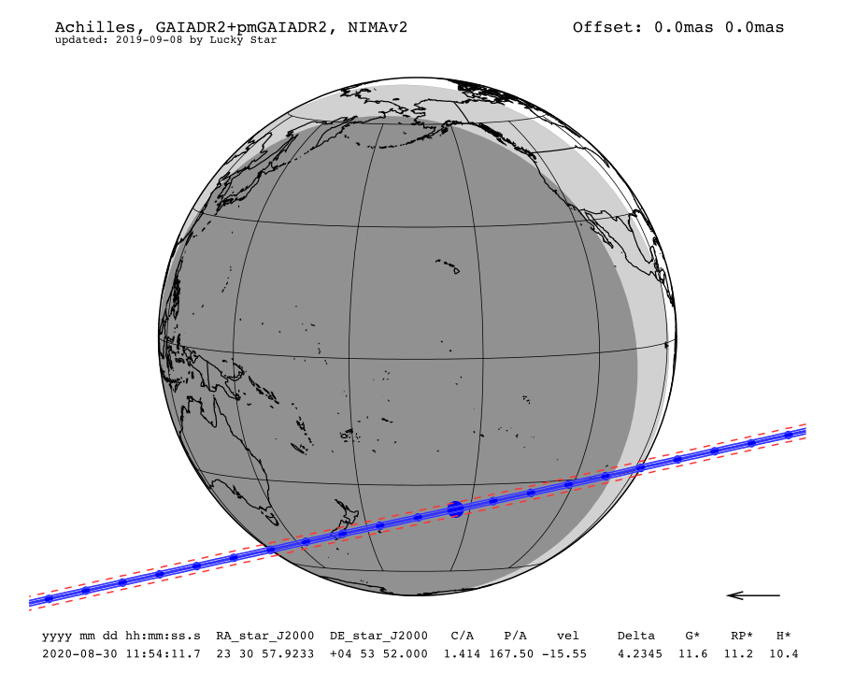
Date | Sun. 30 Aug. 2020 11:54:11
Star position (ICRF) | 23 30 57.9233 +04 53 52.000
C/A | 1.414 arcsec
P/A | 167.50 °
velocity | -15.55 km/s
Geocentric distance Δ | 4.2345 au
G mag* | 11.6
RP mag* | 11.2
H mag* | 10.4
Magnitude drop | 3.9
Uncertainty in time | 9.0 sec
Uncertainty in C/A | 32.4 mas
Uncertainty in projected distance | 99.6 km
Probability of occultation on centrality | 48.6%
Maximum duration | 8.4 sec
Moon distance to the object | 50.6°
Fraction of illuminated Moon | 92.6 %
Solar elongation | 160.8°

Slide 17
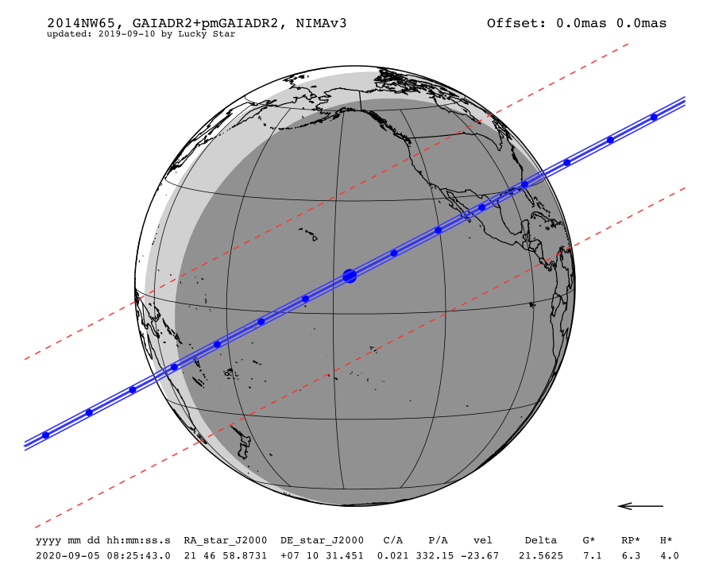
Date | Sat. 5 Sep. 2020 08:25:43
Star position (ICRF) | 21 46 58.8731 +07 10 31.451
C/A | 0.021 arcsec
P/A | 332.15 °
velocity | -23.67 km/s
Geocentric distance Δ | 21.5625 au
G mag* | 7.2
RP mag* | 6.3
H mag* | 4.0
Magnitude drop | 13.2
Uncertainty in time | 152.4 sec
Uncertainty in C/A | 135.8 mas
Uncertainty in projected distance | 2123.4 km
Probability of occultation on centrality | 4.0%
Maximum duration | 9.0 sec
Moon distance to the object | 51.3°
Fraction of illuminated Moon | 91.0 %
Solar elongation | 157.5°

Slide 18
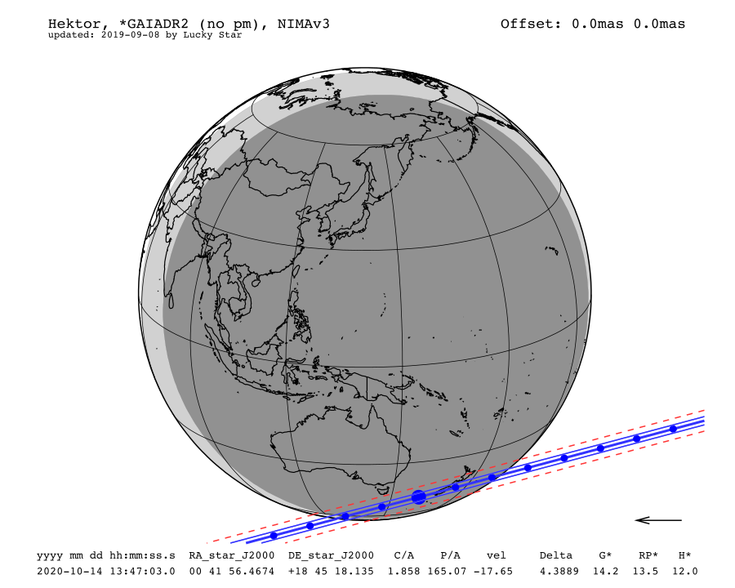
Date | Wed. 14 Oct. 2020 13:47:03
Star position (ICRF) | 00 41 56.4674 +18 45 18.135
C/A | 1.858 arcsec
P/A | 165.07 °
velocity | -17.65 km/s
Geocentric distance Δ | 4.3889 au
G mag* | 14.2
RP mag* | 13.5
H mag* | 12.0
Magnitude drop | 0.8
Uncertainty in time | 10.0 sec
Uncertainty in C/A | 54.0 mas
Uncertainty in projected distance | 172.0 km
Probability of occultation on centrality | 48.7%
Maximum duration | 12.7 sec
Moon distance to the object | 147.3°
Fraction of illuminated Moon | 7.7 %
Solar elongation | 166.1°

Slide 19
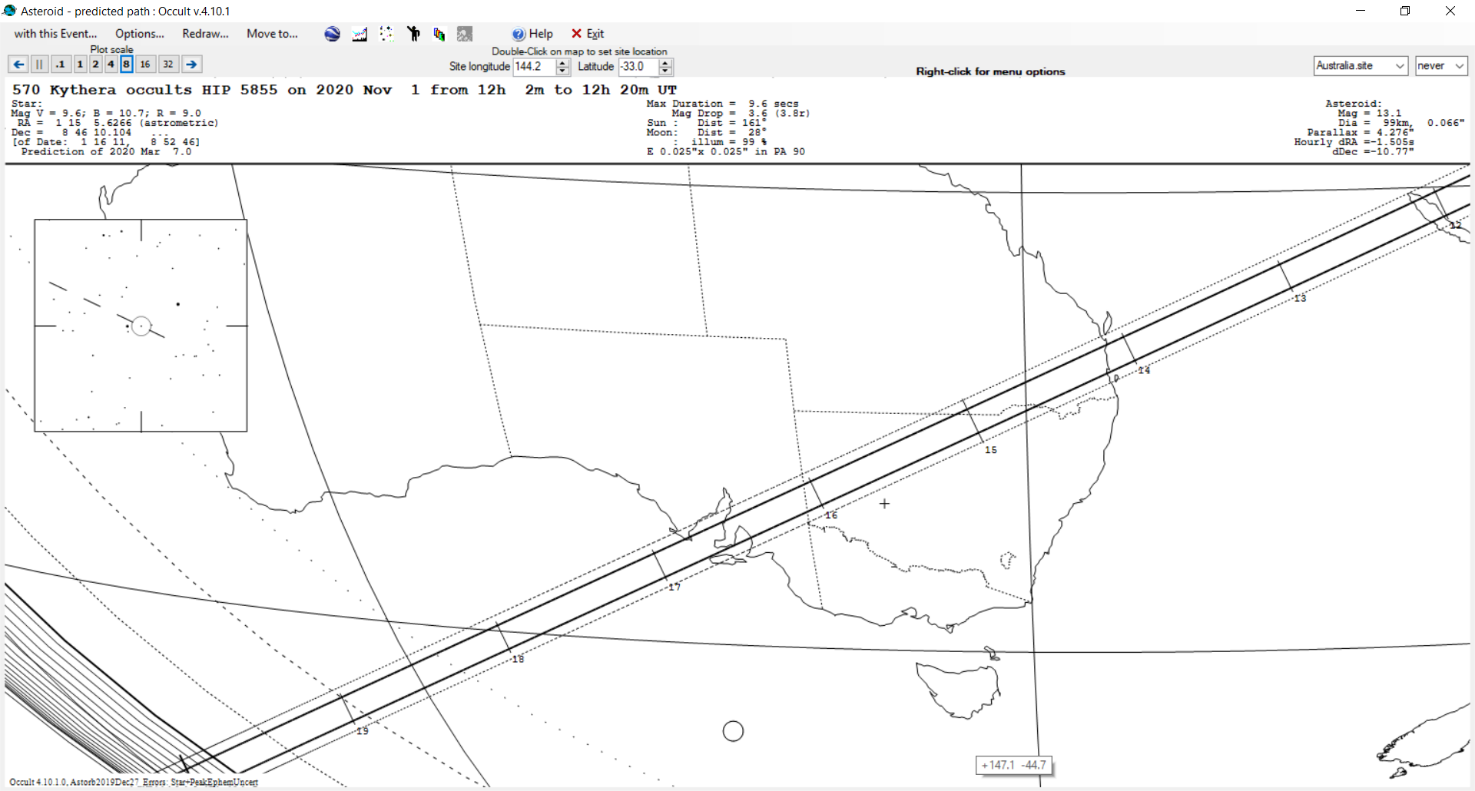

Slide 20
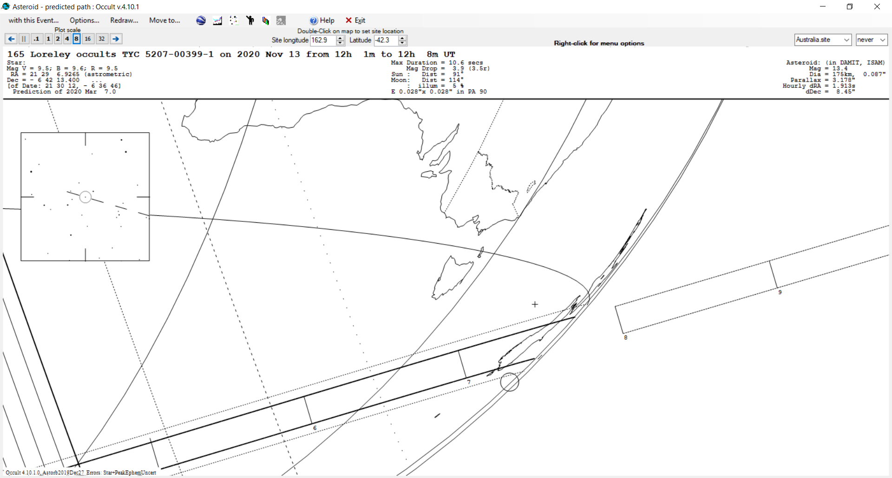

Slide 21
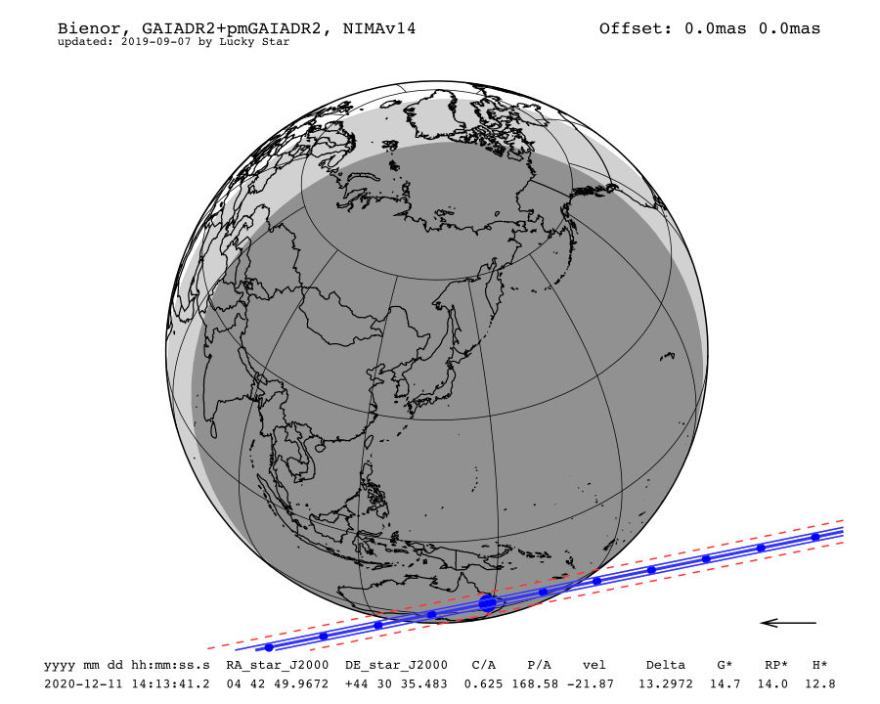
Date | Fri. 11 Dec. 2020 14:13:41
Star position (ICRF) | 04 42 49.9672 +44 30 35.483
C/A | 0.625 arcsec
P/A | 168.58 °
velocity | -21.87 km/s
Geocentric distance Δ | 13.2972 au
G mag* | 14.7
RP mag* | 14.0
H mag* | 12.8
Magnitude drop | 4.5
Uncertainty in time | 21.5 sec
Uncertainty in C/A | 16.6 mas
Uncertainty in projected distance | 160.4 km
Probability of occultation on centrality | 44.2%
Maximum duration | 8.6 sec
Moon distance to the object | 134.8°
Fraction of illuminated Moon | 13.3 %
Solar elongation | 157.4°

Slide 22
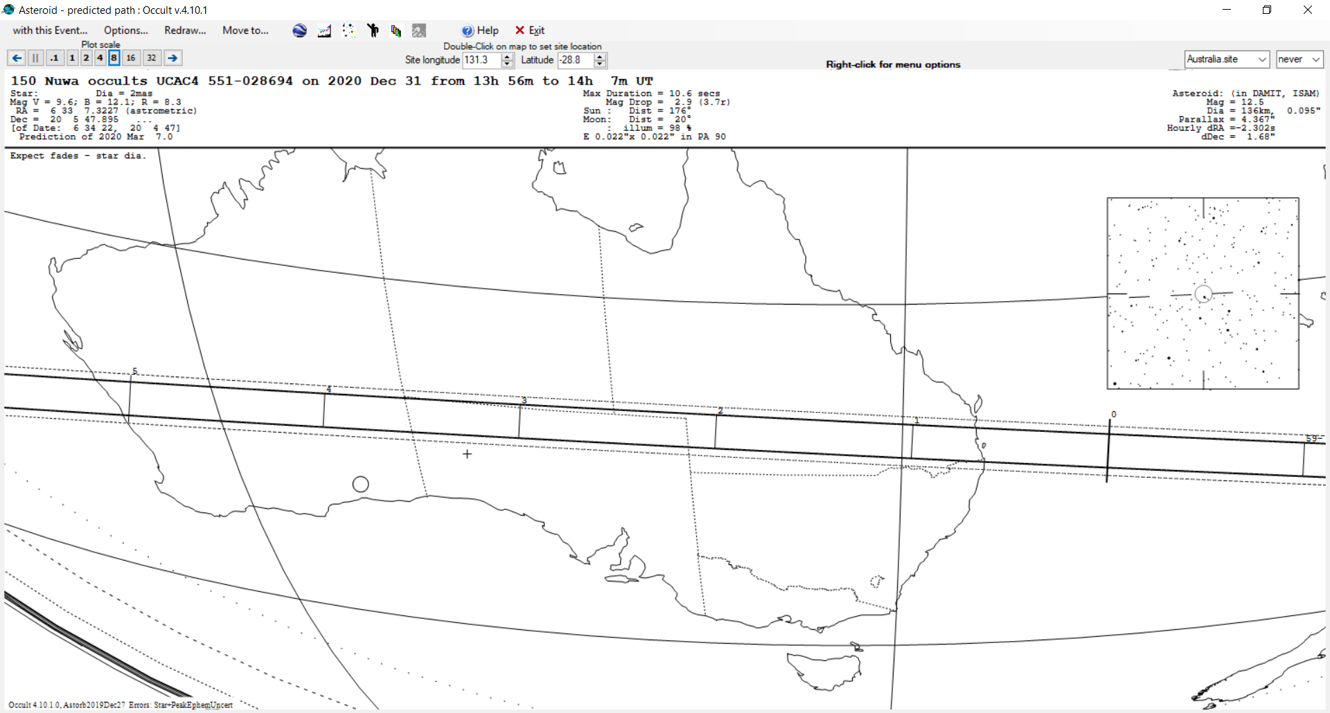

Slide 23
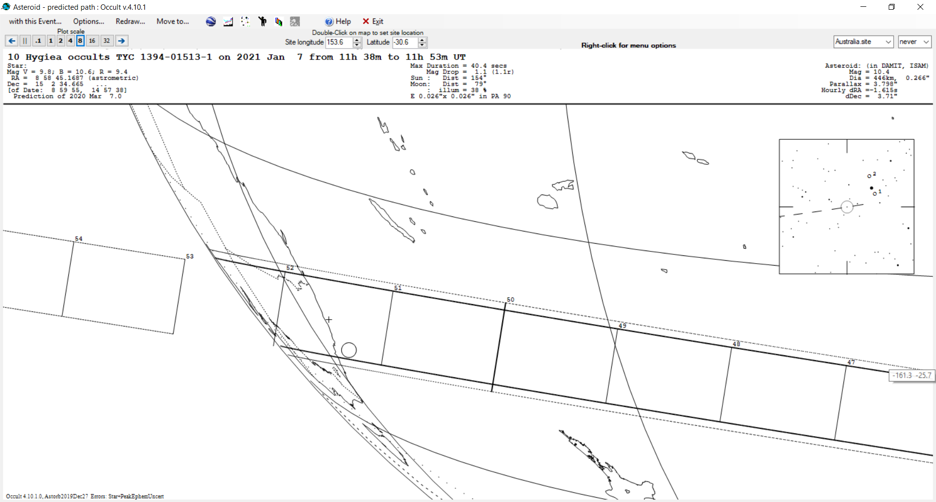

Slide 24
